Slide 1

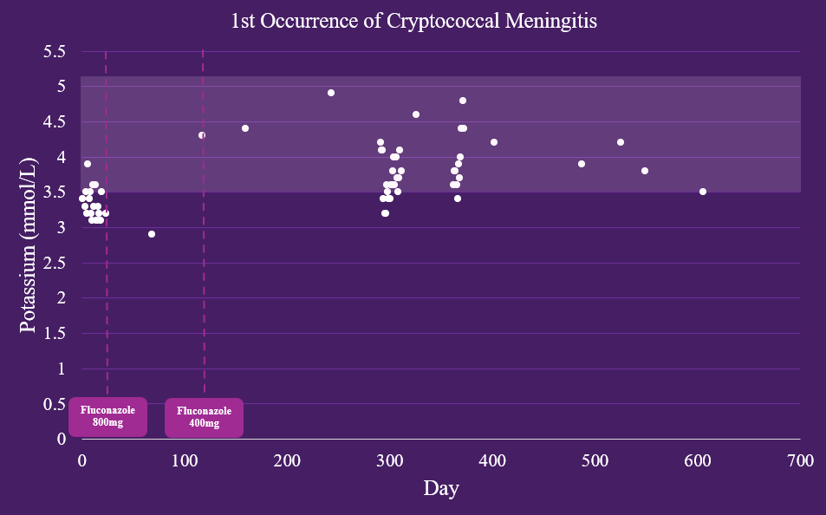
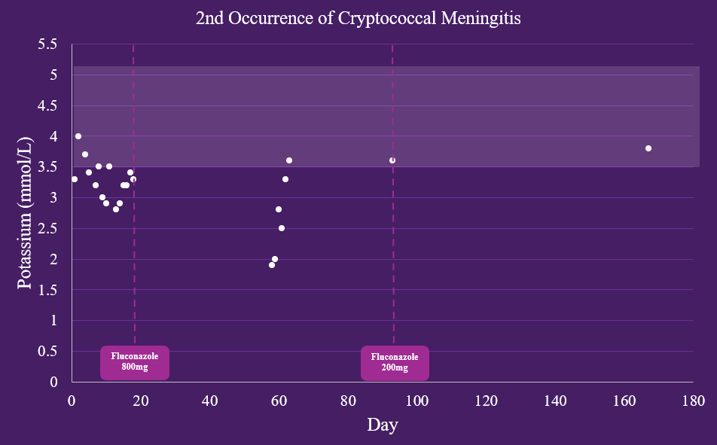
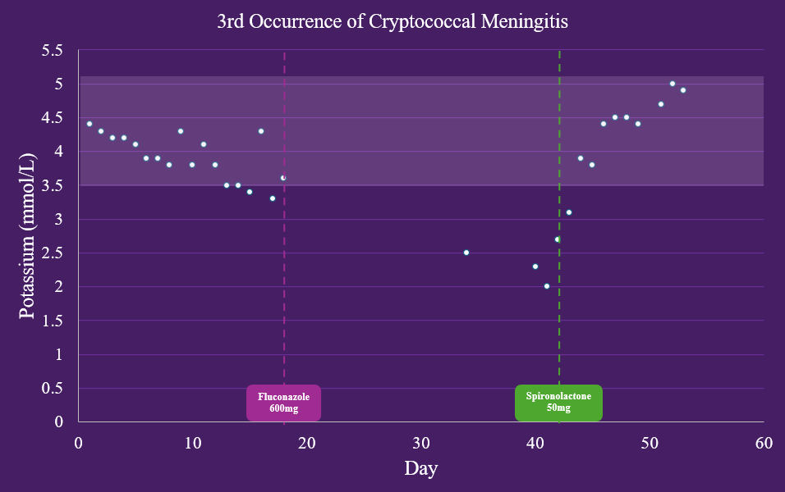
A Cryptogenic Cause of Hypokalemia
in a Patient with Cryptococcal Meningitis
Jonathan Aphaiyarath B.S., Alivia Johnson B.S., Claire Karcher B.S.,
Cameron Bourgeois M.D., Lauren Miles M.D.
Introduction
Recommended treatment of cryptococcal meningitis includes amphotericin B-based regimens and flucytosine followed by fluconazole for consolidation and long-term suppression.
Azole antifungal therapy has adverse effects including disruption of adrenal and gonadal steroid synthesis which can lead to acquired apparent mineralocorticoid excess syndrome (AME).
AME is characterized by hypertension, hypokalemia, and metabolic alkalosis with suppressed levels of renin and aldosterone.
Case Presentation
Figure 1. 1st Occurrence of Cryptococcal Meningitis
Potassium Trend
A 39-year-old man with a past medical history of HIV/AIDS (on Biktarvy, CD4 282, VL 90), recurrent cryptococcal meningitis, right basal ganglia CVA in 2022 with residual LLE weakness, hypertension, and polysubstance abuse (cocaine, amphetamines, THC, tobacco) presented to the emergency department with back pain after a mechanical fall due to lower extremity weakness.
Initial labs revealed severe hypokalemia and acute kidney injury
Potassium level of 2.3 despite home supplementation.
Creatinine of 1.7 mg/dL (baseline 1.1-1.2 mg/dL).
He had a blood pressure of 137/84.
Investigation & Management
FIRST OCCURRENCE OF CRYPTOCOCCAL MENINGITIS
Diagnosed with HIV/AIDS and cryptococcal meningitis in September 2021 and treated with a amphotericin B and flucytosine followed by oral fluconazole.
RECURRENT CRYPOTOCOCCAL MENINGITIS
Throughout the following four years, the patient has had multiple recurrences of cryptococcal meningitis with identical treatments, which included fluconazole (400 to 800mg) in addition to varying amounts of potassium chloride supplementation (Figures 1-3).
ADMISSION
The patient was taking 600mg fluconazole daily with daily potassium chloride supplementation (Figure 3).
Potassium levels were as low as 2.0 despite supplementation of 200 mEq/day.
NEPHROLOGY CONSULT & WORKUP
very low renin and aldosterone levels
elevated serum bicarbonate
persistent hypertension
denied licorice ingestion
Figure 2. 2nd Occurrence of Cryptococcal Meningitis
Potassium Trend
Figure 3. 3rd Occurrence of Cryptococcal Meningitis
Potassium Trend
A diagnosis of AME was suspected, and the patient was started on spironolactone.
His hypokalemia resolved with this therapy, and he was able to discontinue potassium supplementation prior to discharge.
Discussion
Conclusion
This case report presents a patient with a history of recurrent cryptococcal meningitis with subsequent apparent mineralocorticoid excess (AME) secondary to fluconazole treatment with hypokalemia resolution after initiation of spironolactone and potassium supplementation. These findings emphasize the importance of monitoring blood pressure and electrolytes in patients receiving azole antifungals.
Standard of care treatment with fluconazole may also induce AME.
In patients taking long-term azole antifungals, the combination of spironolactone and potassium supplementation may be beneficial in mitigating these effects.
References
Balcerek, Matthew I., et al. “Reducing the off-target endocrinologic adverse effects of azole antifungals—can it be done?” International Journal of Antimicrobial Agents, vol. 59, no. 5, May 2022, p. 106587, https://doi.org/10.1016/j.ijantimicag.2022.106587.
Chang, Christina C, et al. “Global guideline for the diagnosis and management of Cryptococcosis: An initiative of the ECMM and Isham in cooperation with the ASM.” The Lancet Infectious Diseases, vol. 24, no. 8, Aug. 2024, https://doi.org/10.1016/s1473-3099(23)00731-4.
Ji, Huan-huan, et al. “Antifungal therapy with azoles induced the syndrome of acquired apparent Mineralocorticoid Excess: A Literature and database analysis.” Antimicrobial Agents and Chemotherapy, vol. 66, no. 1, 18 Jan. 2022, https://doi.org/10.1128/aac.01668-21.

