Slide 1


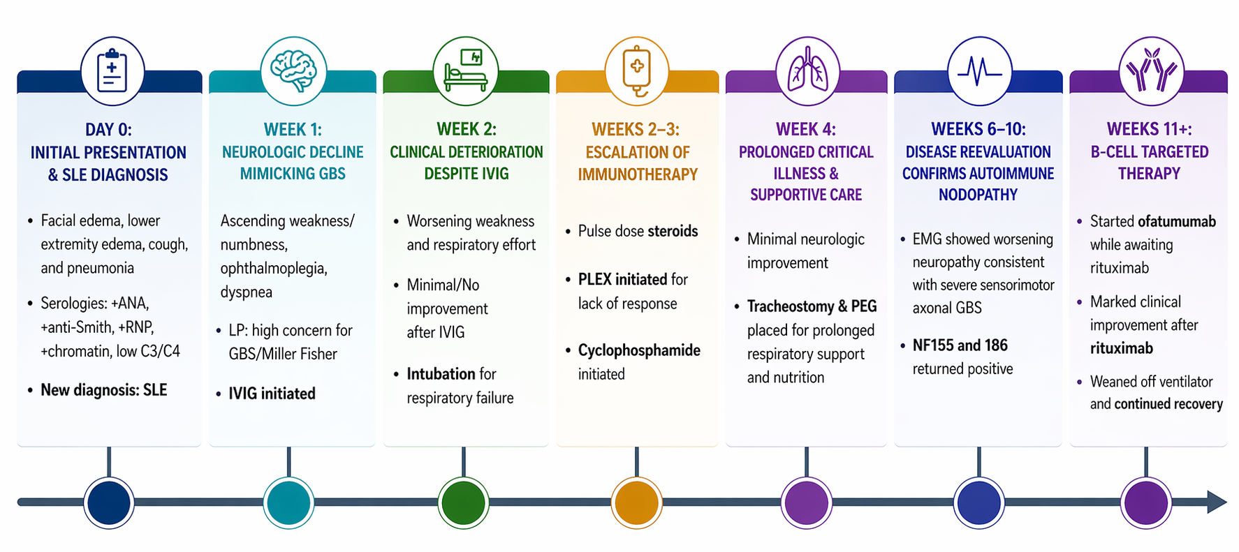
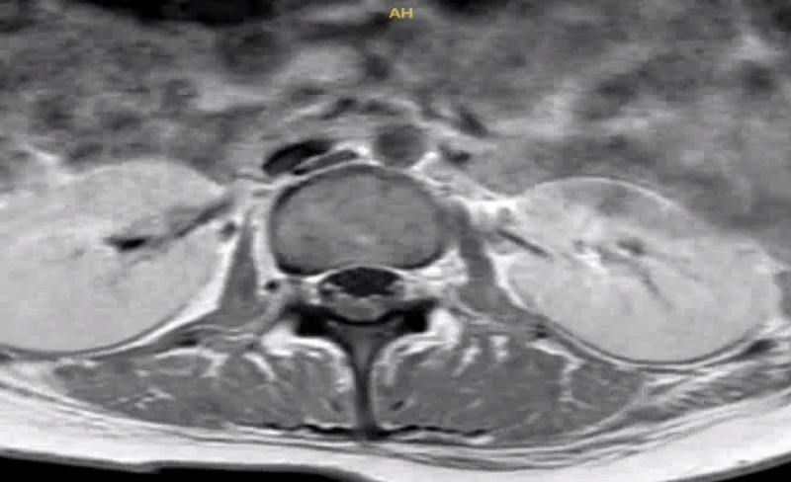
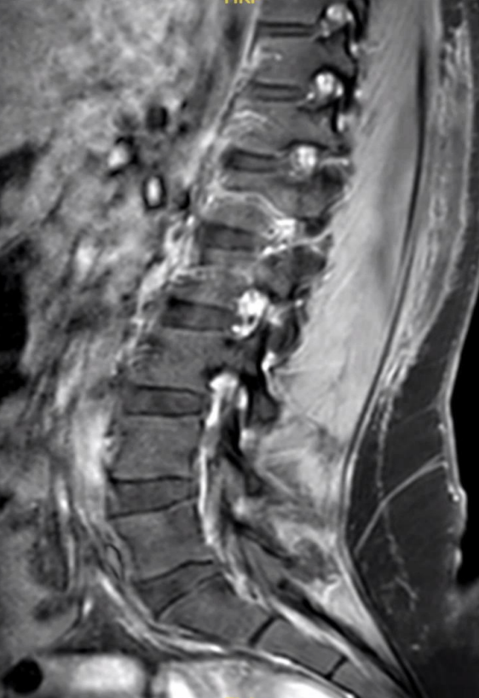
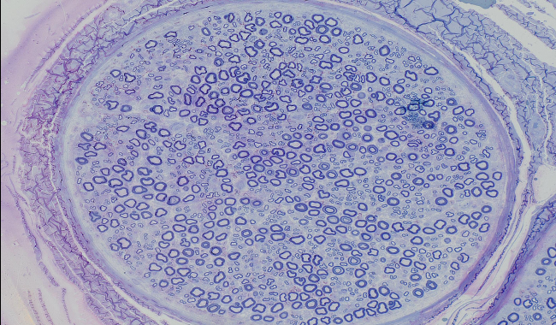
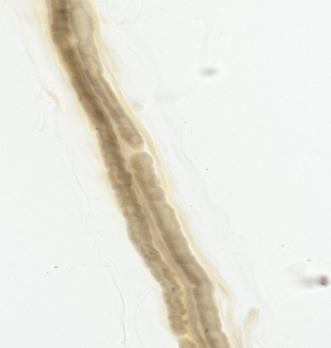
A Guillain-Barré Mimic with Rapid Deterioration: Pan-Neurofascin Autoimmune Nodopathy in a patient with Systemic Lupus Erythematosus
Laiba Iqbal, Katherine Sclafani, Ereny Mikhael, M.D., Jesus Lovera M.D., Rima El-Abassi, M.D. Louisiana State University Health Sciences Center Department of Neurology, New Orleans, LA
Background
Clinical and Pathological Images
Discussion
Autoimmune nodopathies are immune-mediated neuropathies with clinical and electrophysiologic signs that often mimic Guillain-Barré Syndrome (GBS), complicating diagnosis.
They are caused by IgG4 antibodies against nodal and paranodal proteins: NF186, NF155
In 2021, the EAN/PNS classified autoimmune nodo-paranodopathy as a distinct form of polyneuropathy, separate from CIDP.
Clinically, it is characterized by a more aggressive course, frequent cranial nerve involvement, and poor or absent response to IVIG.
Previously the cooccurrence with SLE has not been described.
Autoimmune nodopathies can present with acute demyelinating neuropathy mimicking GBS but often demonstrate continued progression or poor response to IVIG.
Recognition of this entity is important, as it carries distinct treatment implications and may require escalation to targeted immunosuppressive therapy.
The temporal association between recent infection and new-onset SLE in our patient raises the possibility of compounded immune activation contributing to her severe and rapidly progressive neurologic presentation.
Ofatumumab was initiated at long term care facility while awaiting transfer to hospital for rituximab administration, demonstrating that ofatumumab is an option for continuing treatment when rituximab is not available.
This case highlights the importance of reassessing the diagnosis in patients with presumed GBS who fail to improve or who demonstrate an atypical clinical course.
Figure 1: Clinical timeline of acute autoimmune nodopathy initially mimicking GBS.
Case Presentation
An 18-year-old woman with newly diagnosed SLE and recent pneumonia developed rapidly progressive ascending flaccid paresis.
Initial findings including electrodiagnostic studies and CSF analysis suggested GBS.
She received IVIG, but her condition deteriorated over three days to quadriplegia with bulbar dysfunction and respiratory failure requiring intubation.
Electrodiagnostic studies demonstrated a demyelinating polyneuropathy. Nerve and muscle biopsies showed mild axonal loss.
Given her rapid decline and lack of response to IVIG, additional immunotherapy was initiated, including PLEX, high-dose steroids, CellCept, Plaquenil, and Cytotoxan.
Serology revealed pan-neurofascin (NF155/NF186) IgG4 antibodies, confirming autoimmune nodopathy.
B-cell directed therapy with ofatumumab and then rituximab showed drastic clinical improvement. Patient was weaned off ventilator and began to regain function.
.
A.
Figure 2. T1 axial (A) and sagittal (B) showing contrast enhancement of cauda equina roots.
References
B.
Devaux JJ, Miura Y, Fukami Y, et al. Neurofascin-155 IgG4 in chronic inflammatory demyelinating polyneuropathy. Neurology. 2016;86(9):800-807. doi:10.1212/WNL.0000000000002418
Pang ZD, Sun H, Wei XJ, Nie CP, Yu XF. Advances in the treatment of autoimmune nodopathy: based on treatment strategies of CIDP. Front Immunol. 2026;17:1735745. doi:10.3389/fimmu.2026.1735745
Pröbstel AK, Thanei M, Erni B, et al; Swiss Systemic Lupus Erythematosus Cohort Study Group. Association of antibodies against myelin and neuronal antigens with neuroinflammation in systemic lupus erythematosus. Rheumatology (Oxford). 2019;58(5):908-913. doi:10.1093/rheumatology/key282
Querol L, Dalakas MC. The discovery of autoimmune nodopathies and the impact of IgG4 antibodies in autoimmune neurology. Neurol Neuroimmunol Neuroinflamm. 2025;12(1):e200365. doi:10.1212/NXI.0000000000200365
Figure 3: Toluidine blue stained semithin nerve sections showing rare axonal damage.
Figure 4: Neurofilament staining of the nerve demonstrating very mild loss of small and large axons.

