Slide 1


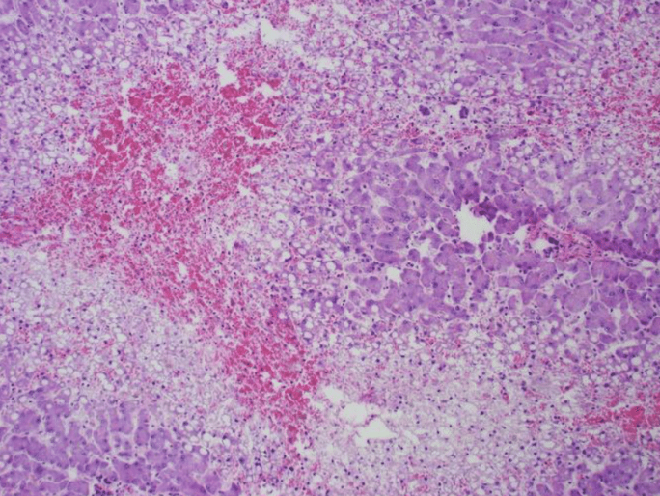
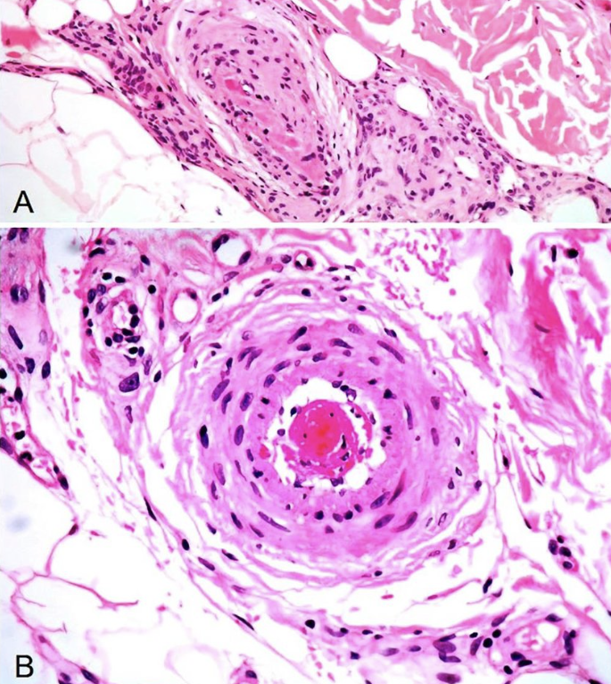
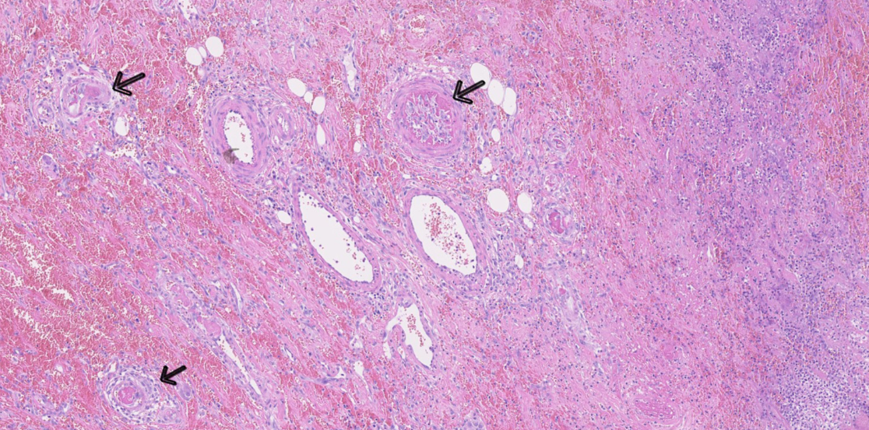
Catastrophic Antiphospholipid Syndrome in the setting of Autoimmune Overlap Syndrome
Kaitlyn Calabresi, Camille Gelis, Grace Sheets, Brendan Tate, M.D., Prianca Shrestha, M.D., Merrick Firoz, M.D., Spencer Lemoine, M.D., Monica Moreno, M.D., Sarah Griffin, M.D., Seth Vignes, M.D., Jorge Martinez, M.D. J.D. Department of Internal Medicine, LSUHSC School of Medicine
Introduction
Intervention
Discussion
Catastrophic Antiphospholipid Syndrome (CAPS) is a severe subtype of antiphospholipid syndrome (APS) representing just 4.39% of incident APS cases. It is defined by the acute development (≤ 1 week) of thromboses in three or more organs, with positive antiphospholipid antibodies, and confirmation of micro thrombosis in affected organs by histopathology. CAPS is highly fatal due to the risk of multi-organ failure, with a mortality of 44% even with intervention.
Rheumatology and Hematology were consulted for evaluation of Thrombotic thrombocytopenic purpura (TTP) versus antiphospholipid disease given her history of Overlap Syndrome. Immunologic labs were consistent with triple positive Catastrophic Antiphospholipid Syndrome (CAPS) (+ANA screen, +Anti-cardiolipin, +b2 GLP, +Lupus anticoagulant, normal ADAMTS-13 activity). The patient completed treatment with 4 days of plasma exchange followed by IVIG therapy, and a steroid course. After the patient stabilized, she began warfarin with heparin bridge for long term anticoagulation. Her discharge was delayed due to difficulty achieving a consistently therapeutic INR. Lovenox was discussed as an alternative, and the patient was discharged on lovenox.
CAPS is a rare, high-risk variant of APS characterized by its rapid onset and multi-system effects. It is often associated with autoimmune conditions, specifically SLE. CAPS does not have a specific trigger, and has been documented to occur after infections, trauma, surgery, and tumor development. The presence of antiphospholipid antibodies in combination with a trigger event is thought to initiate the cytokine cascade and widespread micro-thrombosis.
Acute management of CAPS includes corticosteroids, plasma exchange, and IVIG to suppress the cytokine cascade. The anticoagulant of choice in CAPS is unfractionated heparin, which is transitioned to long-term anticoagulation to reduce the risk of future thrombotic events.
For APS, warfarin is the preferred long term anti-coagulant with a target INR of 2.0 to 3.0. However, lupus anticoagulant can cause falsely elevated INR due to interactions with phospholipids in the test. If interaction is suspected, it is recommended to compare the venous PT-INR with the point of care PT-INR test, and the target INR can be increased to 3.0 to 4.0. If therapeutic INR is not achievable, low molecular weight heparin and DOACs are viable for long-term anticoagulation in CAPS. However, DOACs are not recommended for patients with triple positive APS or arterial thromboses due to increased risk of repeat thrombosis.
Case Background
A 35-year-old female with past medical history of autoimmune Overlap Syndrome (Systemic Lupus Erythematosus, Sjogren’s, CREST), primary biliary cholangitis, and pulmonary hypertension with right-sided heart failure presented to the hospital with an 8-day history of shortness of breath and 2-week history of progressive cough and fatigue. On initial evaluation in the ED, she was lethargic, jaundiced, and in respiratory distress, with O2 saturation of 85% and tachycardia to 113.
Labs were significant for lactic acid 13.5, WBC 15.8, platelets 29, glucose 64, ALT 46, AST 139, Alk phos 436, GGT 133 with evidence of a combined metabolic and respiratory acidosis (VBG: pH 6.97, CO2 37; CMP: Na 131, K 4.4, Cl 101, HCO3 8). CT Angio of the Chest and Abdomen revealed diffuse tree-in-bud pulmonary opacities, perfusion abnormalities of her liver, and a splenic infarct. There was initially concern for DIC in the setting of septic shock (D-dimer 36,000, PT 31.5, INR 2.7, fibrinogen 297). She received empiric Vancomycin and Zosyn in the ED. However, her blood cultures remained negative. She was admitted to the ICU in the setting of her respiratory distress and AMS.
Thrombosis in CAPS
1
2
3
References
1. Murtaza G, Iskandar J, Humphrey T, Adhikari S, Kuruvilla A. Lupus-Negative Libman-Sacks Endocarditis Complicated by Catastrophic Antiphospholipid Syndrome. Cardiology Research. 2017;8:57–62. doi:10.14740/cr534e
2. Merino MJ, Diago A, Fernandez-Flores A, et al. Clinical and Histopathologic Characteristics of the Main Causes of Vascular Occusion — Part II: Coagulation Disorders, Emboli, and Other. Actas Dermo-Sifiliográficas (English Edition). 2020;112. doi:10.1016/j.adengl.2020.12.024
3. Tobias KC, Anna CN, Gunvor IM, Voss A. Small intestine necrosis in catastrophic antiphospholipid syndrome: A rare and severe case. Lupus. 2022;31(6):754–758. doi:10.1177/09612033221093496
4. Parepalli A, Sarode R, Kumar S, Nelakuditi M, Kumar MJ. Antiphospholipid Syndrome and Catastrophic Antiphospholipid Syndrome: A Comprehensive Review of Pathogenesis, Clinical Features, and Management Strategies. Cureus. 2024;16(8):e66555. doi:10.7759/cureus.66555
5. Mittal P, Sayar Z, Cohen H. Warfarin and heparin monitoring in antiphospholipid syndrome. Hematology Am Soc Hematol Educ Program. 2024;2024(1):192–199. doi:10.1182/hematology.2024000547
6. Ruiz-Irastorza G, Tektonidou MG, Khamashta M. Anticoagulant and non-anticoagulant therapy in thrombotic antiphospholipid syndrome: old drugs and new treatment targets. Rheumatology (Oxford). 2024;63(SI):SI96–SI106. doi:10.1093/rheumatology/kead538
7. Okunlola AO, Ajao TO, Sabi M, et al. Catastrophic Antiphospholipid Syndrome: A Review of Current Evidence and Future Management Practices. Cureus. 2024;16(9):e69730. doi:10.7759/cureus.69730
8. Bucciarelli S, Espinosa G, Cervera R, et al. Mortality in the catastrophic antiphospholipid syndrome: causes of death and prognostic factors in a series of 250 patients. Arthritis Rheum. 2006;54(8):2568–2576. doi:10.1002/art.22018
9. Aguiar CL, Erkan D. Catastrophic antiphospholipid syndrome: how to diagnose a rare but highly fatal disease. Ther Adv Musculoskelet Dis. 2013;5(6):305–314. doi:10.1177/1759720X13502919
10. Khellaf M, Meisner P, Sarno M, Zaremba P, Jedrzejczyk A, Scowcroft A. Incidence and prevalence of antiphospholipid syndrome (APS) in the USA (2016-2019): a retrospective database study. BMJ Open. 2024;14(12):e084563–084563. doi:10.1136/bmjopen-2024-084563
Necrosis and congestion of the liver in a patient with CAPS following endocarditis
Venous (A) and Arterial (B) thrombosis in a patient with CAPS causing necrosis of the skin
Small vessel thrombotic occlusions of the intestine in a patient with CAPS

