Slide 1


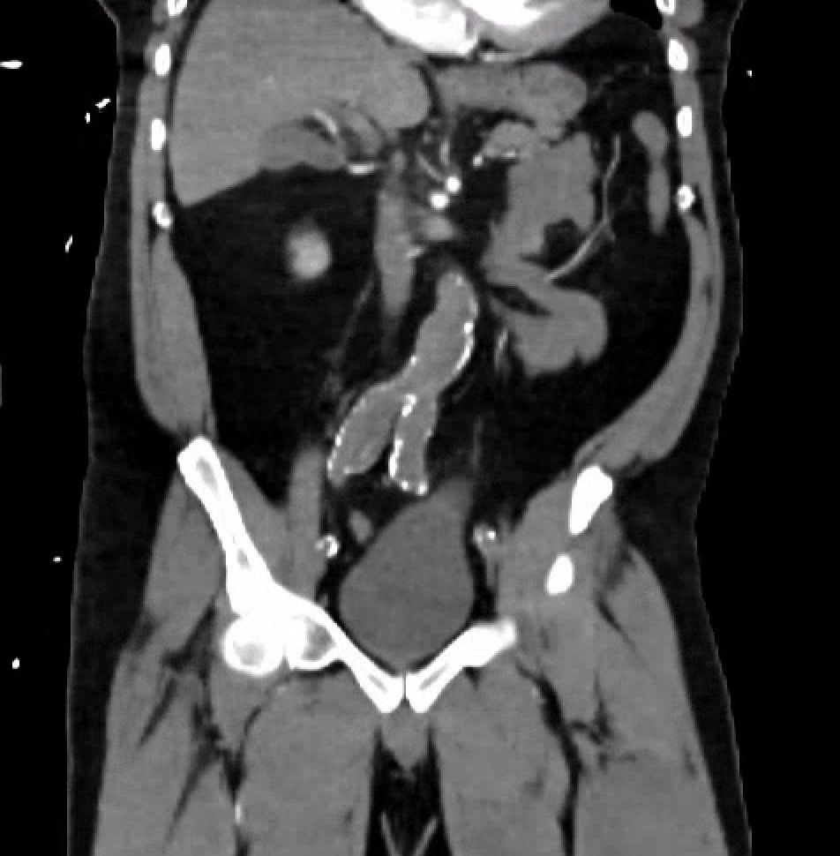
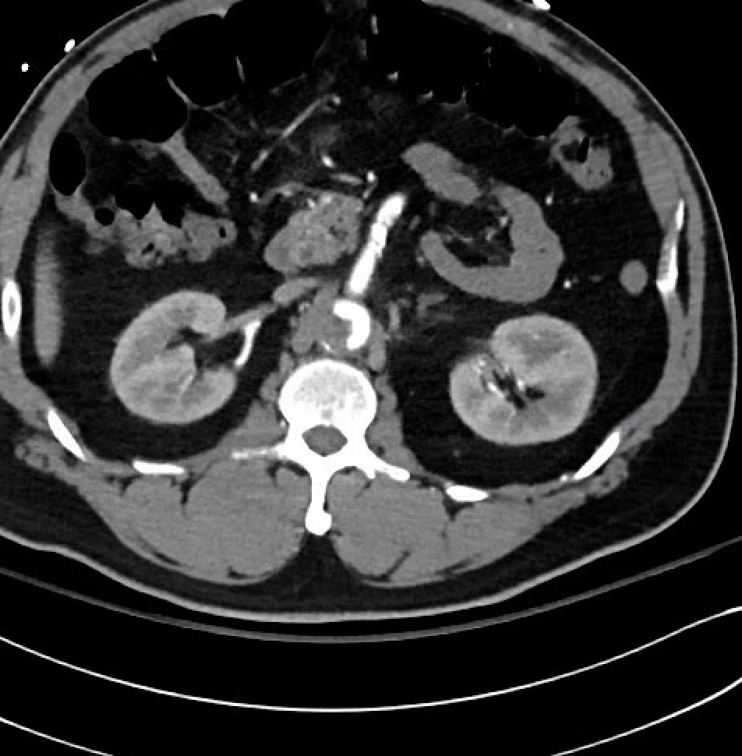
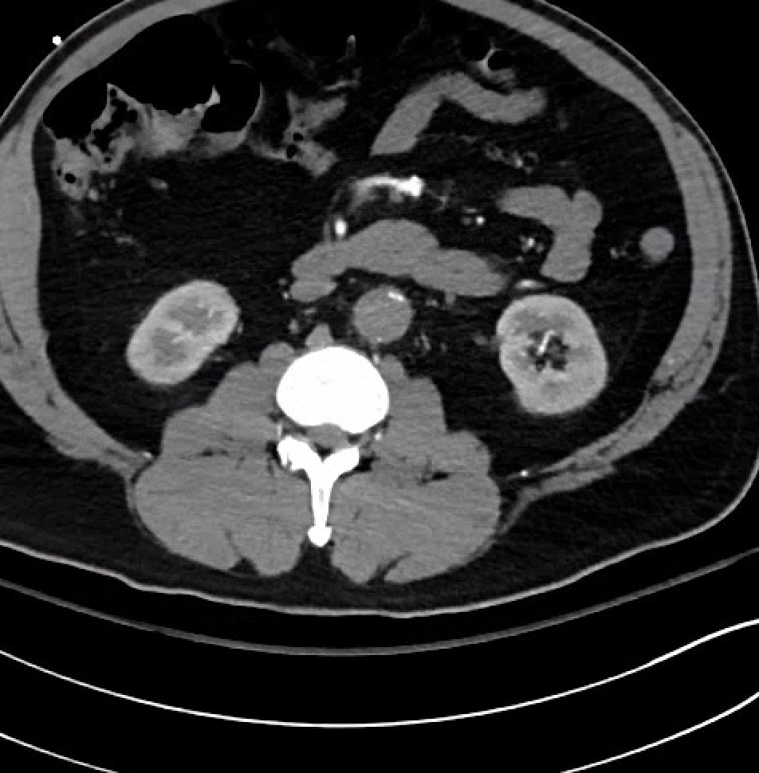
An Overlooked Case of Leg Pain
Maria Rodriguez, DO, Brandon Ozier, MD, Michael Modica, MD
Department of Medicine, LSU Health New Orleans
Introduction
Leriche syndrome, also known as aortoiliac occlusive disease (AIOD), is a rare atherosclerotic disorder that is described as a triad of symptoms including erectile dysfunction, claudication of the lower limbs, and absent or weak peripheral pulses (1). Given the chronic nature of this process, a wide spectrum of presentations can be encountered (2, 3). Given the rarity of the condition, lack of practitioner awareness, and vague presentations, making the diagnosis challenging, the incidence and prevalence of this disease process are unknown, with significant variation (6).
Case Presentation
Discussion
A 60-year-old male with PMH HTN, DM, and AFib presented to the ED for worsening acute on chronic left leg pain. Denied any chest pain, shortness of breath, or trauma. Seen at an outside ED day prior for the same complaint and sent home after pain control, no skin or motor changes were documented on that evaluation. Initially, planned to be discharged with pain control, but found to be in atrial flutter. Upon further questioning, the patient had not been taking his dabigatran for the past few weeks for unclear reasons and had endorsed erectile dysfunction.
On exam, tachy to 120s and irregular. Bilateral lower extremities were cool to the touch without palpable pulses with notable left leg paralysis.
Labs: rhabdomyolysis (CK 13.7K) and HS-troponin (19K)
CXR: tortuous aorta prompting CT angiography to rule out dissection.
CTA chest: complete occlusion of the infrarenal abdominal aorta extending throughout the bilateral iliacs and lower extremities without distal reconstitution and multi-level fusiform aneurysmal dilatations.
HD#0: Transferred to hospital with vascular surgery capabilities, underwent emergent right axillary to bilateral CFA bypass, thrombectomy, endarterectomy, and bilateral calf 4-compartment fasciotomies within an hour of arrival.
His rhabdomyolysis worsened from reperfusion syndrome with concern that aggressive resuscitation could lead to volume overload.
HD#3 underwent washout and left below-the-knee amputation.
HD#4 developed abdominal distention with abdominal compartment syndrome and was taken to the OR for exploratory laparotomy, noting diffuse necrotic colon, and underwent total colectomy.
The patient developed worsening acidemia and renal function and volume overload requiring continuous renal replacement (CRRT). Simultaneously, developed multifactorial shock, refractory acidemia, and CRRT was poorly tolerated despite multiple pressors.
HD#6 given worsening status, underwent bedside ex-lap with worsening bowel ischemia and gangrenous gallbladder. Had additional bowel resection and cholecystectomy.
Unable to tolerate more aggressive measures. Patient transitioned to comfort care, passing HD#6.
Only a few reported cases have noted a sudden onset, worsening critical limb ischemia in the span of days in the setting of AIOD. Although the day prior, our patient had denied claudication, his rapid progression from pain to paralysis emphasizes the need for a high index of suspicion in patients with co-morbidities, lower extremity complaints, and concern for acute clot propagation.
The variability in the presentations from asymptomatic to critical ischemia, rarity of the condition, and poor awareness in practitioners make the diagnosis challenging.
It is important to consider other modalities to risk-stratify patients, including echocardiogram and other hypercoagulability workups, when considering embolic etiologies. The risk factors for general atherosclerosis are the same that place individuals at risk of AIOD.
We should consult early, especially vascular surgery, for evaluation of reperfusion/salvage therapies. Although aorto-bifemoral bypass remains the gold standard, especially in complex lesions, endovascular repair might offer additional benefits to higher-risk patients (12). Early vascular surgery involvement. Consider surgical candidacy, comorbidities, and practitioner experience when deciding between treatment approaches, as mortality and morbidity rates vary (11).
For those not familiar with imaging modalities, this presentation can appear similar to aortic dissection (AoD). Anticoagulation is contraindicated in dissection but vital in Leriche and thus differentiation must be made.
Key Takeaways:
Rarity and poor physician awareness make for difficulty with early diagnosis; must have a high index of suspicion
Patients need early evaluation, as well as aggressive lifestyle and risk-factor modification
Early surgical consultation and transfer are vital to improved mortality and morbidity
Be mindful of mimics like aortic dissection, as delaying anticoagulation leads to poor outcomes
V
Imaging
Figure 1
Figure 2
References
1. Marak JR, Narayan S, Navneet Ranjan Lal, Raj G, Gara H. Leriche syndrome: Clinical and diagnostic approach of a rare infrarenal aortoiliac occlusive disease. Radiology Case Reports. 2024 Feb 1;19(2):540–6.
2. Rani S, Khaliq A, Batool SA, Khan MU. Aortoiliac Occlusion in a Rare Instance of Leriche Syndrome Type I in a 65-Year-Old Woman With Chronic Leg Discomfort Refractory to Pregabalin. Cureus. 2023 Nov 15;
3. Pascarella L, Maen Aboul Hosn. Minimally Invasive Management of Severe Aortoiliac Occlusive Disease. Journal of Laparoendoscopic & Advanced Surgical Techniques. 2018 Jan 18;28(5):562–8.
4. LERICHE R, MOREL A. THE SYNDROME OF THROMBOTIC OBLITERATION OF THE AORTIC BIFURCATION. Annals of Surgery. 1948 Feb;127(2):193–206.
5. Paisley MJ, Adkar S, Sheehan BM, Stern JR. Aortoiliac Occlusive Disease. Seminars in Vascular Surgery. 2022 Apr;
6. Ligush J, Criado E, Burnham SJ, Johnson G, Keagy BA. Management and outcome of chronic atherosclerotic infrarenal aortic occlusion. Journal of Vascular Surgery. 1996 Sep;24(3):394–405.
7. Brown KN, Gonzalez L. Leriche Syndrome(Archived) [Updated 2023 Feb 13]. In: StatPearls [Internet]. Treasure Island (FL): StatPearls Publishing; 2026 Jan-. Available from: https://www.ncbi.nlm.nih.gov/books/NBK538248/
8. ‌Huei-Lung Liang, Ming-Feng Li, Chia-Chi Hsiao, Chieh-Jen Wu, Tung-Ho Wu. Endovascular management of aorto-iliac occlusive disease (Leriche syndrome). Journal of the Formosan Medical Association. Volume 120. Issue 7. 2021. Pages 1485-1492, ISSN 0929-6646. https://doi.org/10.1016/j.jfma.2020.10.033.
9. Liedenbaum MH, Verdam FJ, Spelt D, de Groot HG, van der Waal J, van der Laan L. The outcome of the axillofemoral bypass: a retrospective analysis of 45 patients. World J Surg. 2009 Nov;33(11):2490-6. doi: 10.1007/s00268-009-0189-x. PMID: 19697078; PMCID: PMC2759976.
10. Wulamu, Wubulikasimu1,2; Li, Hai-Lei3; Chan, Yiu Che1,3; Cheng, Stephen Wing-Keung1,3. Endovascular management for acute aortic thrombosis presenting with critical lower limb ischemia. Vascular Investigation and Therapy 8(2):p 81-84, Apr–Jun 2025. | DOI: 10.4103/vit.VIT-D-25-00004
11. Semaan DB, Habib SG, Abdul-Malak OM, Siracuse JJ, Madigan MC, Salem KM, Chaer RA, Eslami MH. Aortobifemoral bypass vs covered endovascular reconstruction of aortic bifurcation. J Vasc Surg. 2024 Aug;80(2):459-465.e2. doi: 10.1016/j.jvs.2024.03.437. Epub 2024 Mar 31. PMID: 38565344.
12. Keegan A, Hicks CW. Surgical Decision-Making and Outcomes in Open Versus Endovascular Repair for Various Vascular Diseases. Anesthesiol Clin. 2022 Dec;40(4):627-644. doi: 10.1016/j.anclin.2022.08.008. PMID: 36328619; PMCID: PMC9833286.
Figure 3
Fig 1. Coronal CTA abdomen showing complete aortoiliac occlusion and associated fusiform aneurysmal dilations
Fig 2. Transverse CTA abdomen showing partial aortic occlusion and patent SMA with atherosclerotic plaque
Fig 3. Transverse CTA abdomen showing beginning of complete infrarenal aortoiliac occlusion

