Slide 1

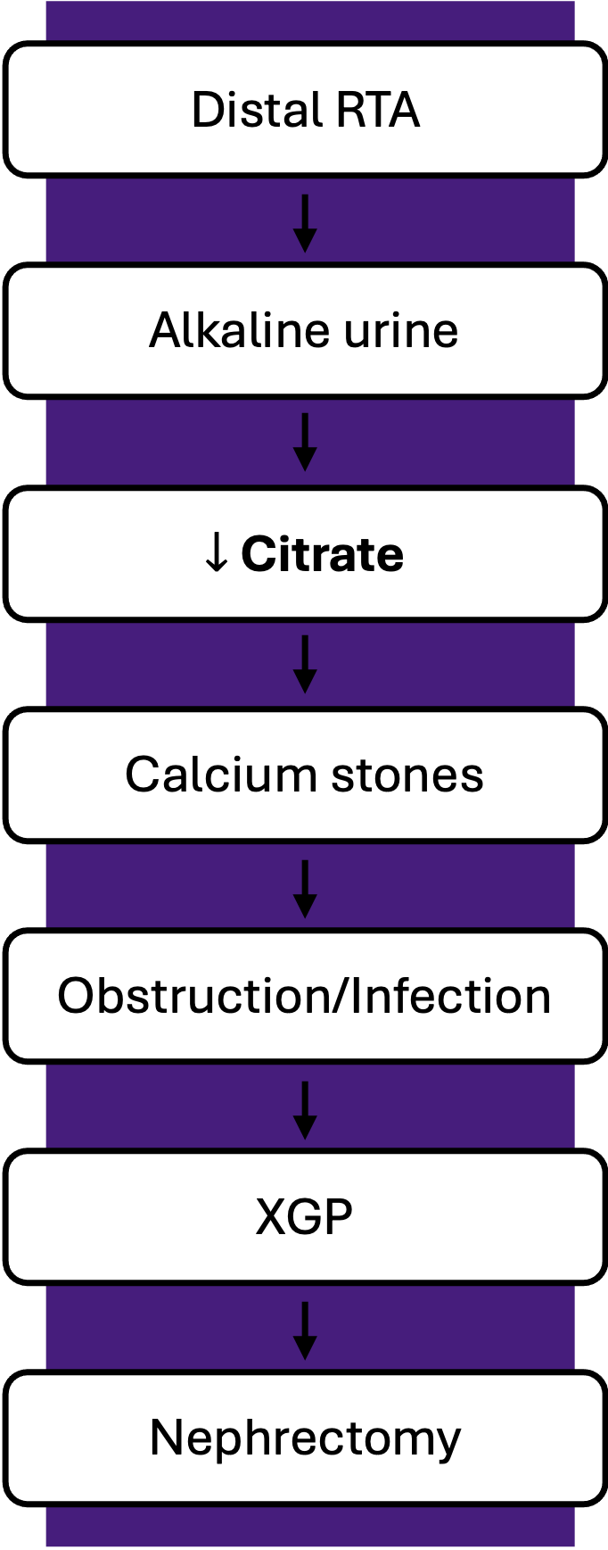
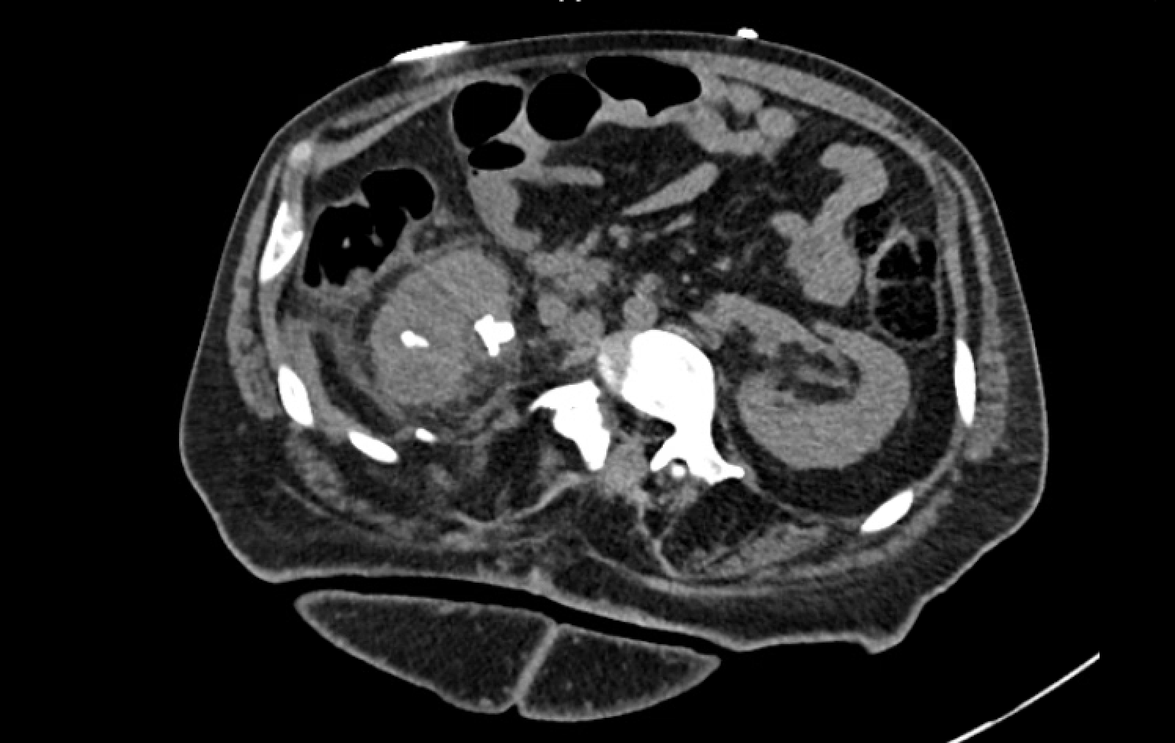
An Underrecognized Cause of Recurrent Nephrolithiasis: Distal Renal Tubular Acidosis Progressing to Xanthogranulomatous Pyelonephritis and Nephrectomy
Heeya L. Munir B.A., Sravya Sri Kuchipudi M.D., Melissa Harrington M.D.
Introduction
Figure 2. Schematic demonstrating the pathophysiologic progression of distal renal tubular acidosis leading to hypocitraturia, recurrent nephrolithiasis, obstruction, and ultimately xanthogranulomatous pyelonephritis with loss of renal function.
Distal renal tubular acidosis (RTA) is an underrecognized cause of nephrolithiasis due to impaired acid secretion, resulting in alkaline urine and hypocitraturia. These metabolic abnormalities promote recurrent calcium stone formation.
Early metabolic evaluation is critical, as delayed recognition may result in severe complications including infection, obstruction, and loss of renal function.
Case Presentation
Discussion
A 50-year-old man with spina bifida complicated by neurogenic bladder (status post ileal conduit), chronic kidney disease, and recurrent multidrug-resistant urinary tract infections presented with 2 weeks of vomiting, decreased oral intake, and cloudy urine. Evaluation revealed leukocytosis, acute kidney injury, and urinalysis with pyuria and hematuria. CT imaging demonstrated multiple obstructing right renal calculi with severe cortical loss and findings consistent with xanthogranulomatous pyelonephritis. Prior imaging confirmed a nonfunctioning right kidney.
He underwent right nephrectomy with drainage of a retroperitoneal abscess. Subsequent metabolic evaluation revealed a non-anion gap metabolic acidosis with urine pH of 7 and a positive urine anion gap. 24-hour urine studies showed hypocitraturia, confirming distal RTA as the underlying driver of recurrent nephrolithiasis. Potassium citrate therapy was initiated. Postoperatively, renal function improved but remained labile in the setting of a solitary kidney, ongoing infection, and volume shifts.
Distal RTA is an underrecognized cause of nephrolithiasis, characterized by impaired acid secretion leading to alkaline urine and hypocitraturia, both of which promote calcium stone formation. In this case, unrecognized distal RTA likely contributed to years of recurrent stone disease, culminating in chronic obstruction, infection, and progression to xanthogranulomatous pyelonephritis with loss of renal function.
While structural factors such as neurogenic bladder and urinary diversion predisposed this patient to urinary stasis and infection, distal RTA served as the key metabolic driver of ongoing stone formation. Delayed recognition represents a missed opportunity for early intervention. Earlier metabolic evaluation may have altered disease progression and prevented loss of renal function in this patient.
Conclusion
Delayed recognition of distal RTA can lead to progressive nephrolithiasis, infection, and irreversible renal damage. Early metabolic evaluation is essential to prevent complications and preserve renal function.
References
Kraut JA, Madias NE. Metabolic Acidosis of CKD: An Update. Am J Kidney Dis. 2016 Feb;67(2):307-17. doi: 10.1053/j.ajkd.2015.08.028. Epub 2015 Oct 23. PMID: 26477665.
Pearle MS, Goldfarb DS, Assimos DG, Curhan G, Denu-Ciocca CJ, Matlaga BR, Monga M, Penniston KL, Preminger GM, Turk TM, White JR; American Urological Assocation. Medical management of kidney stones: AUA guideline. J Urol. 2014 Aug;192(2):316-24. doi: 10.1016/j.juro.2014.05.006. Epub 2014 May 20. PMID: 24857648.
Figure 1. Axial CT abdomen showing an enlarged right kidney with multiple calculi, architectural distortion, and surrounding inflammatory changes consistent with xanthogranulomatous pyelonephritis; left kidney is unremarkable.

