Slide 1

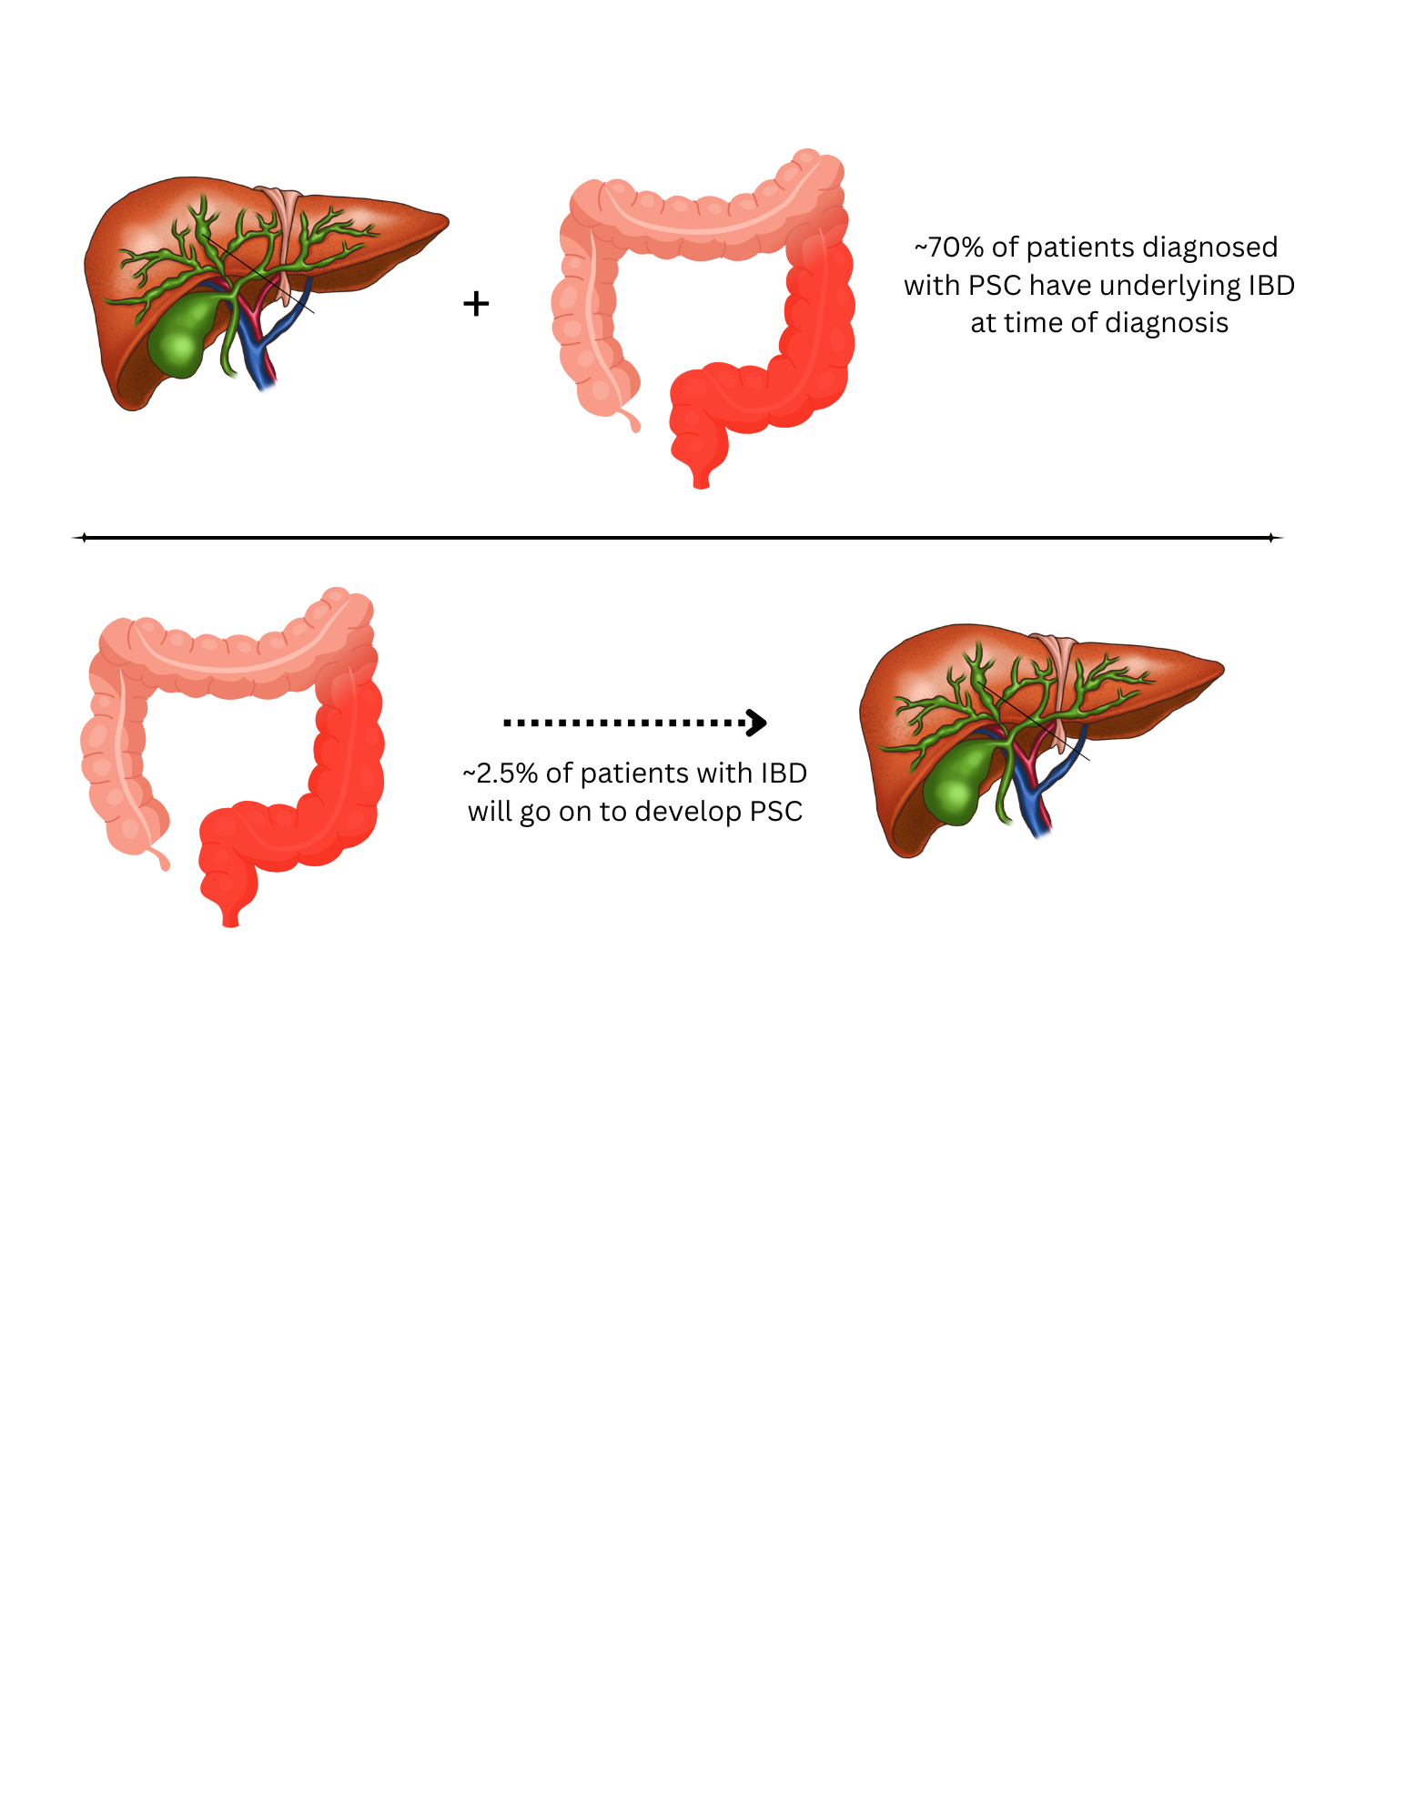
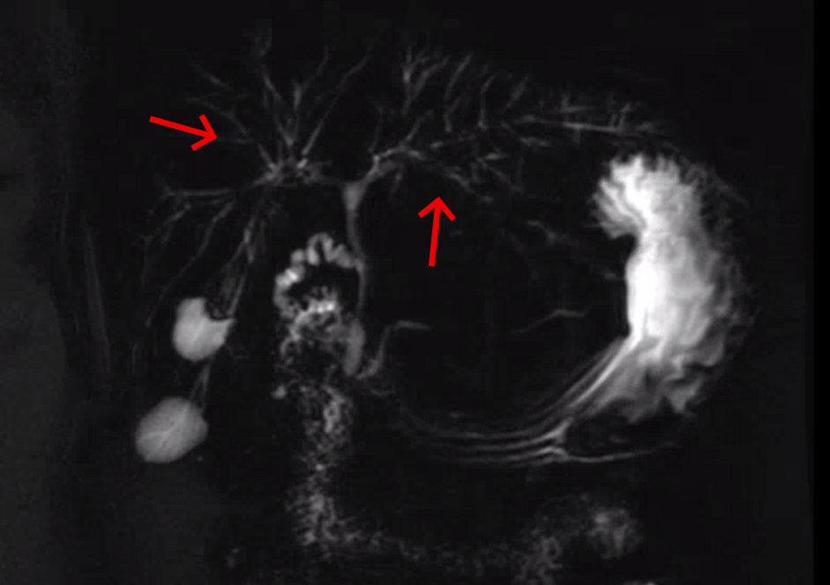
Primary Sclerosing Cholangitis Developing Years After Ulcerative Colitis: A Rare but Likely Underrecognized Phenomenon
Autumn Collins, MD; Pranaya Pakala, MD; Hanna Almoaswes, MD; Charles Woodall, DO
Department of Medicine, Louisiana State University Health Sciences Center, New Orleans, LA
Introduction
Discussion
Primary sclerosing cholangitis (PSC) is a chronic liver disease characterized by inflammation and fibrosis of intrahepatic and extrahepatic bile ducts
More than 70% of patients with PSC have concomitant inflammatory bowel disease (IBD), most commonly ulcerative colitis (UC)
In contrast, the prevalence of PSC among patients with UC is much lower, estimated at 2.5%
This association may be underrecognized, as subclinical PSC is increasingly identified in patients with long-standing UC
PSC is an uncommon but clinically significant comorbidity in patients with UC
May remain undetected for years due to subclinical disease
The literature suggests that PSC can develop long before clinical, biochemical, or radiographic abnormalities become apparent, raising the potential for delayed or missed diagnoses
Our case illustrates this phenomenon, with PSC identified nearly two decades after the patient’s UC diagnosis
This prompts the question of whether PSC is truly rare in long-standing UC or simply underrecognized
Clinical Course
Remains clinically stable on mesalamine suppositories three times weekly and ursodiol 600 mg twice daily, with ongoing follow-up in hepatology and IBD clinics
Surveillance MRI/MRCP every six months to monitor disease progression or complications
Case Presentation
A 68-year-old woman with a history of ulcerative pancolitis diagnosed in 2005
Associated with poorly differentiated sigmoid adenocarcinoma requiring proctocolectomy with ileal pouch-anal anastomosis (IPAA)
Evaluated for persistently elevated liver enzymes 18 years after her initial UC diagnosis
A magnetic resonance imaging and a magnetic resonance cholangiopancreatography (MRI/MRCP) revealed diffuse intrahepatic and extrahepatic biliary dilation extending to the peripheral ducts, consistent with PSC
An MRI/MRCP performed one year prior showed only mild intrahepatic ductal dilation without extrahepatic involvement
Conclusion
This case highlights the need for ongoing surveillance for PSC in patients with UC, even when symptoms and laboratory abnormalities are absent, as early recognition may help prevent serious complications such as cirrhosis and malignancy
References
Barberio B, Massimi D, Cazzagon N, Zingone F, Ford AC, Savarino EV. Prevalence of Primary Sclerosing Cholangitis in Patients With Inflammatory Bowel Disease: A Systematic Review and Meta-analysis. Gastroenterology. 2021 Dec;161(6):1865-1877.
Bowlus, C L, Arrivé, L, Bergquist, A, Deneau, M, Forman, L, Ilyas, S, et al. AASLD Practice Guidance on Primary Sclerosing Cholangitis and Cholangiocarcinoma. Hepatology 77(2):p 659-702, February 2023.
Lunder AK, Hov JR, Borthne A, Gleditsch J, Johannesen G, Tveit K, et al. Prevalence of Sclerosing Cholangitis Detected by Magnetic Resonance Cholangiography in Patients With Long-term Inflammatory Bowel Disease. Gastroenterology. 2016 Oct;151(4):660-669.e4.
MRCP image from our patient showing alternating segments of stenosis and normal biliary size involving the biliary tree

