Slide 1

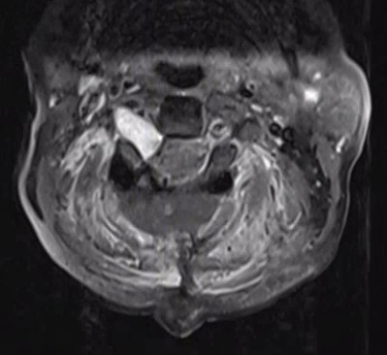
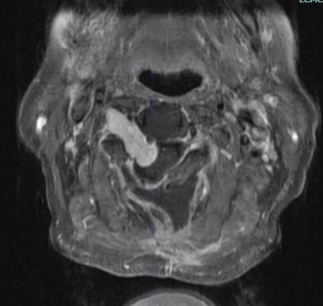
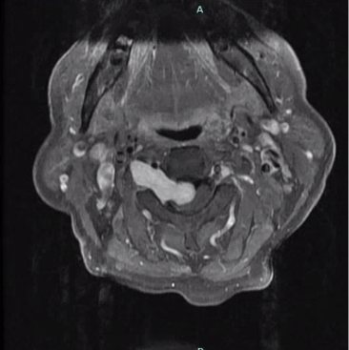
Rapid Regrowth of Residual Cervical Dumbbell Schwannoma Following Subtotal Resection
Heeya L. Munir B.A., Nicholas J. Ditta B.S., Wesley M. Shoap M.D., Cole T. Lewis M.D.
Introduction
Spinal schwannomas are benign tumors typically treated with gross total resection (GTR). Cervical dumbbell lesions often require subtotal resection (STR) due to foraminal extension and proximity to critical structures, balancing tumor removal with preservation of neurologic function and stability.
Residual schwannomas are usually slow growing, with progression over years, and rapid early regrowth is rarely described. We present a case of marked regrowth within four months following STR, highlighting implications for postoperative surveillance.
A
B
Figure 2. Axial T1 MRI with contrast demonstrating (A) postoperative decompression with residual foraminal tumor and (B) interval regrowth at 4 months with recurrent spinal cord compression.
Case Presentation
Discussion
A 65-year-old female presented with a 2 week history of progressive gait instability and right-sided weakness. Neurologic examination demonstrated spastic gait, right hemiparesis (4+/5), hyperreflexia, ankle clonus, and a positive Hoffman sign, consistent with cervical myelopathy. MRI demonstrated a C2–C3 intradural extramedullary mass with foraminal extension causing severe cord compression, consistent with a dumbbell schwannoma.
She underwent posterior posterior C2 laminectomy and partial C3 laminectomy with gross total resection of the intradural component and intentional subtotal resection of the foraminal component. Postoperatively, she had complete neurologic recovery.
At four months, she developed recurrent symptoms, and imaging demonstrated interval enlargement of the residual tumor with recurrent cord compression. Revision surgery was performed, and pathology confirmed benign schwannoma. Adjuvant radiation therapy was initiated, with stable disease at six-month follow-up.
Subtotal resection is frequently required in cervical dumbbell schwannomas due to anatomic constraints and the need to preserve neurologic function and spinal stability. Residual tumors are generally considered slow growing, with progression typically occurring over years. However, this case demonstrates that rapid early regrowth can occur even in histologically benign lesions.
This finding has important implications for postoperative management, as early progression may be underrecognized. In cases with substantial residual tumor burden, particularly in high cervical lesions, earlier postoperative surveillance imaging may be warranted to allow for timely intervention and prevent recurrent spinal cord compression.
Conclusion
This case highlights that even benign residual cervical schwannomas may behave unpredictably following subtotal resection. Recognizing the potential for early progression is important to guide postoperative surveillance and optimize timing of intervention.
Figure 1. Axial T1 MRI with contrast demonstrating a preoperative cervical schwannoma with spinal cord compression.
References
Sohn S, et al. The fate of spinal schwannomas following subtotal resection. J Neurooncol. 2013.
Ryu SM, et al. Subtotal resection of cervical schwannomas and growth rate of residual tumors. J Neurosurg Spine. 2019.

