Slide 1


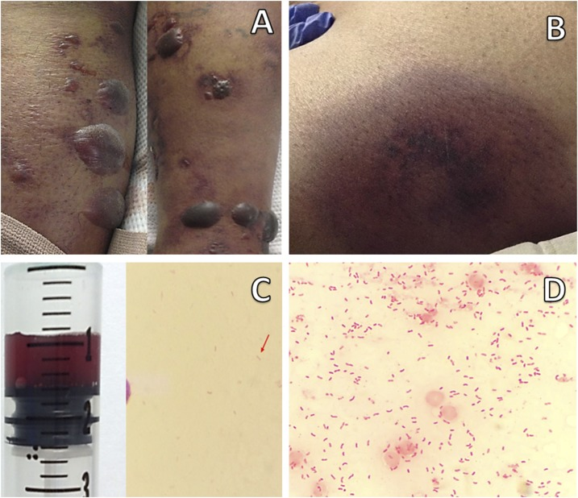
When Blood Cultures Surprise: An Unsuspecting Case of Vibrio vulnificus Bacteremia
Autumn Collins, MD¹; Prianca Shrestha, MD¹; Nikki Seraji, MD¹; Gurtaj Mahil, DO¹; Luke Sharrock, DO¹; Gabriel Sims²; Ross McCarron, MD¹
¹Department of Medicine, Louisiana State University Health Sciences Center, New Orleans, LA;
²School of Medicine, Louisiana State University Health Sciences Center, New Orleans, LA
Introduction
Vibrio vulnificus is a gram-negative bacillus known for causing severe infections
Transmission occurs via ingestion of contaminated seafood or wound exposure to brackish water
Infections typically present as primary sepsis, wound infection, or gastroenteritis
Patients with septicemia often develop rapidly progressive skin lesions, and case-fatality rates can reach 50%
Although overall incidence is low, V. vulnificus causes the most seafood-related deaths in the United States annually
In the first half of 2025, 17 infections and 4 deaths were reported in Louisiana alone
Figure 1: Gram stain of V. vulnificus showing gram negative bacilli with some exhibiting
curved appearance¹
Figure 2: Hemorrhagic bullae, a skin manifestation commonly seen in V. vulnificus infections¹
Clinical Course/Management
Discussion
Empiric vancomycin, cefepime, and metronidazole started for sepsis of unknown origin
Blood cultures grew gram-negative rods, concerning for intra-abdominal source
Non-contrast CT of the chest, abdomen, and pelvis was unrevealing
Ultrasound of the left arm graft excluded septic thrombus, and echocardiogram showed no vegetations
On day three, blood cultures speciated to V. vulnificus
On further questioning, the patient reported frequent consumption of raw shellfish, including raw oysters 48 hours before symptom onset, with nausea and vomiting that evening
Antibiotics were transitioned to doxycycline and cefepime
Repeat blood cultures were negative, and he was discharged on day six with doxycycline and ceftazidime
Bacteremia is common in V. vulnificus infections, but most patients develop skin findings such as cellulitis, bullae, or necrotizing fasciitis within 24 hours
Our patient’s isolated bacteremia despite multiple comorbidities is atypical
His nonspecific presentation made the diagnosis unexpected
This case highlights that V. vulnificus bacteremia can occur without dermatologic findings and should be considered early when the clinical context is suggestive
Case Presentation
72-year-old male
History of end-stage renal disease on hemodialysis, prosthetic aortic valve, atrial fibrillation, type 2 diabetes, hypertension
Two days of fever and fatigue
ROS: No gastrointestinal or respiratory symptoms
Initial vitals: Afebrile, mildly hypotensive
Physical Exam: Holosystolic murmur, right upper extremity arteriovenous fistula, non-functioning left upper extremity graft. Unremarkable skin exam.
Initial labs/imaging:
WBC count 26.89 (H)
Chest radiograph negative
Respiratory viral panel negative
References
Beatty NL, Marquez J, Al Mohajer M. Skin Manifestations of Primary Vibrio vulnificus Septicemia. Am J Trop Med Hyg. 2017 Jul;97(1):1-2. doi: 10.4269/ajtmh.17-0169. PMID: 28719320; PMCID: PMC5508923.
Bross MH, Soch K, Morales R, Mitchell RB. Vibrio vulnificus infection: diagnosis and treatment. American Family Physician. 2007 Aug 15;76(4):539-44.
Candelli M, Sacco Fernandez M, Triunfo C, Piccioni A, Ojetti V, Franceschi F, et al. Vibrio vulnificus – A Review with a Special Focus on Sepsis. Microorganisms. 2025 Jan 10;13(1):128.
Chuang YC, Yuan CY, Liu CY, Lan CK, Huang AH. Vibrio vulnificus infection in Taiwan: report of 28 cases and review of clinical manifestations and treatment. Clin Infect Dis. 1992 Aug;15(2):271-6.
Haftel A, Sharman T. Vibrio vulnificus Infection. StatPearls [Internet]. 2025 Jan. Available from: https://www.ncbi.nlm.nih.gov/books/NBK554404/
Louisiana Health Alert Message 25-3: Increase in Severe Vibrio vulnificus Infections in Louisiana. Louisiana Department of Health [Internet]. 2025 Jul 30. Available from: https://www.ldh.la.gov/assets/oph/Center-CP/HANs/2025/Han-25-3-Increase-Severe-Vibrio-vulnificus-Infection-Louisiana.pdf

