Slide 1


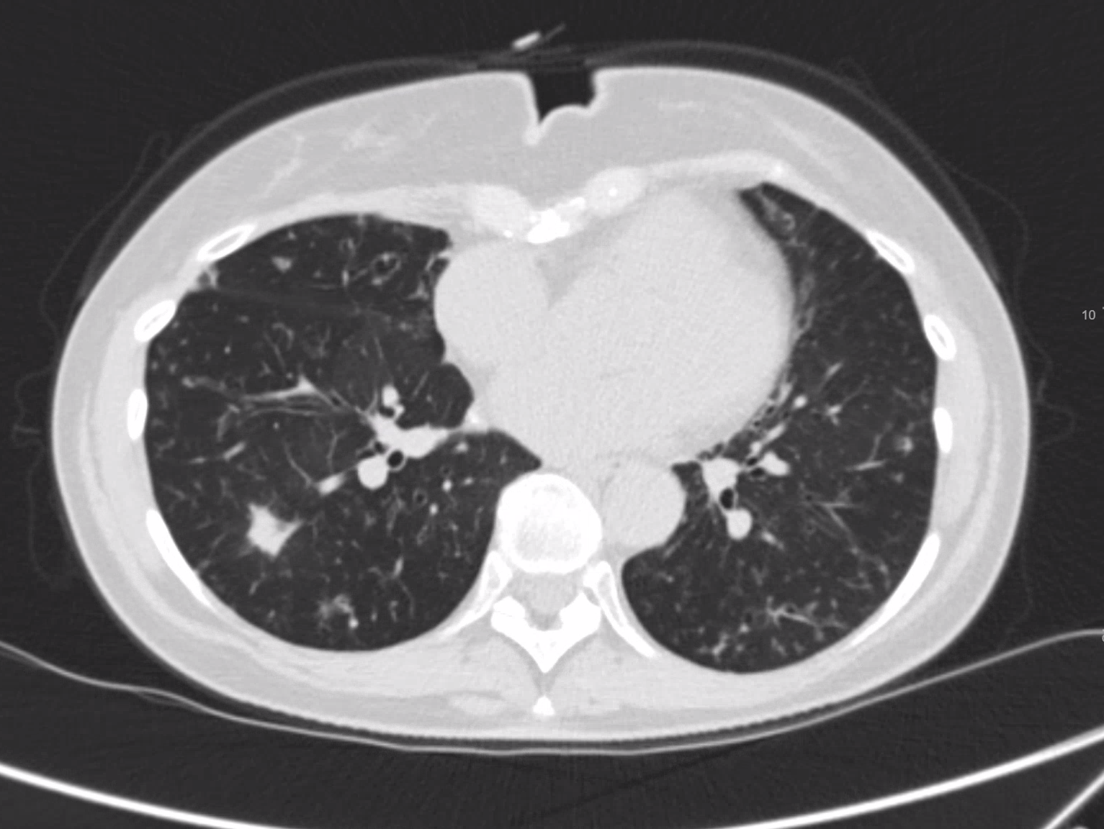
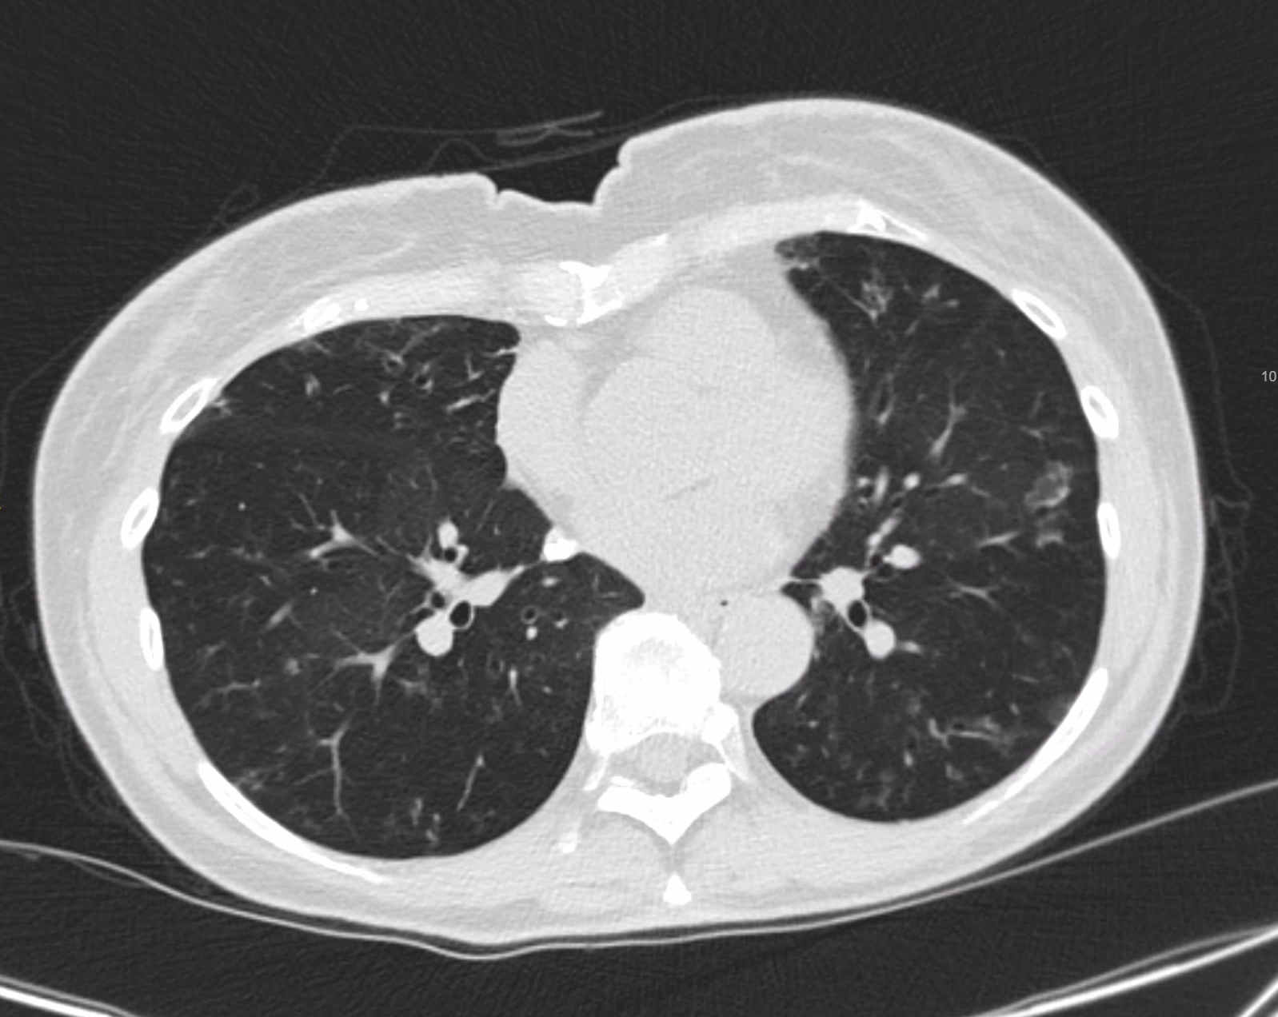
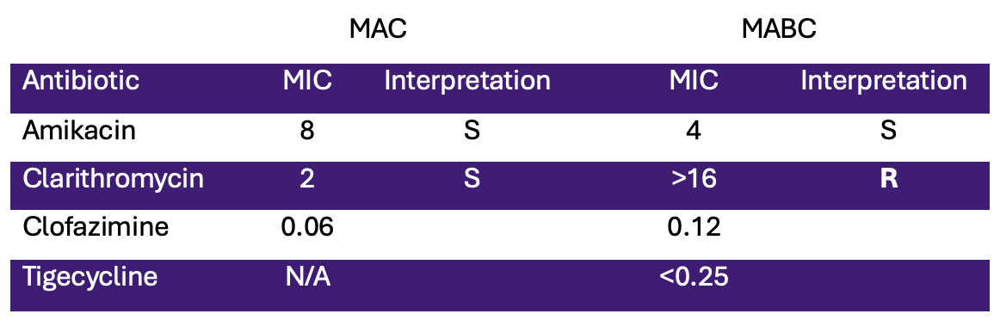
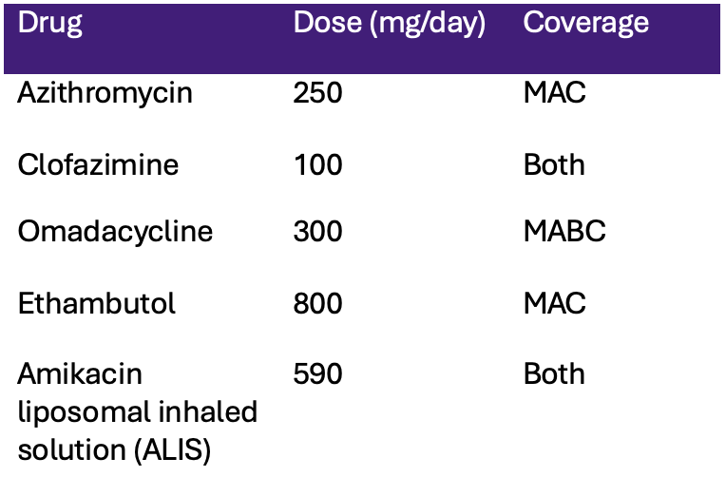
An Unconventional Approach to Unrelenting Bugs
Jacques du Passage, Shelby MacRae MD
Introduction
Case
Non-tuberculous mycobacterial (NTM) infections often affect patients with bronchiectasis (BE) [1]. Mycobacterium avium complex (MAC) and Mycobacterium abscessus complex (MABC) are two of the most common clinically relevant complexes and pose significant treatment challenges.
A 70-year-old woman with PMHx of HTN, BE, and NTM presented with 3 months of dyspnea. Her sputum cultures grew MAC and MABC. Given patient preference to avoid parenteral therapy and considering the antimicrobial susceptibility profile of both NTM species (Figure 1), a novel five-drug combination regimen was initiated (Figure 2). Patient achieved successful sustained culture clearance after 3 months of therapy, and treatment was completed after 14 months with improvement in symptoms and imaging (Figures 3-4).
Images and Figures
Figure 3: Non-contrast chest CT of patient before initiation of treatment with 1.5cm right lower lobe nodule, bronchiectasis, and diffuse tree in bud opacities.
Figure 4: Non-contrast chest CT of patient after 13 months of antimicrobial treatment, showing resolution of right lower lobe pulmonary nodule and decreased tree in bud opacities.
Figure 1: Antimicrobial susceptibility testing for both NTM species. MIC = minimum inhibitory concentration (mcg/ml); S = sensitive; R = resistant.
Summary
Shared-decision making is essential for all patients but especially when pursuing long, complex treatment. This regimen combined agents with activity against MAC (azithromycin and ethambutol), MABC (omadacycline) and both (ALIS and clofazimine). Although lacking FDA-approval for MABC treatment, omadacycline has shown promise [2]. This case, along with others demonstrates its potential use in this setting; although additional data are necessary.
Figure 2: Novel, 5-drug regimen used to resolve patient’s coinfection.
References
1. Pasipanodya JG, Ogbonna D, Ferro BE, Magombedze G, Srivastava S, Deshpande D, Gumbo T. Systematic Review and Meta-analyses of the Effect of Chemotherapy on Pulmonary Mycobacterium abscessus Outcomes and Disease Recurrence. Antimicrob Agents Chemother. 2017 Oct 24;61(11):e01206-17. doi: 10.1128/AAC.01206-17. PMID: 28807911; PMCID: PMC5655093.
2. Winthrop, K.L. & Sirbu, A. & Manley, A. & Das, A. & Chitra, Surya & Deck, D.H. & Serio, A.W. & Anastasiou, D. & Villano, S.. (2025). A Phase 2, Double-blind, Randomized, Placebo-controlled, Multi-center Study to Evaluate the Efficacy, Safety, and Tolerability of Oral Omadacycline in Adults With Nontuberculous Mycobacterial Pulmonary Disease (NTM PD) Caused by Mycobacterium Abscessus Complex (MABc). American Journal of Respiratory and Critical Care Medicine. 211. A3168-A3168. 10.1164/ajrccm.2025.211.Abstracts.A3168.

