Slide 1


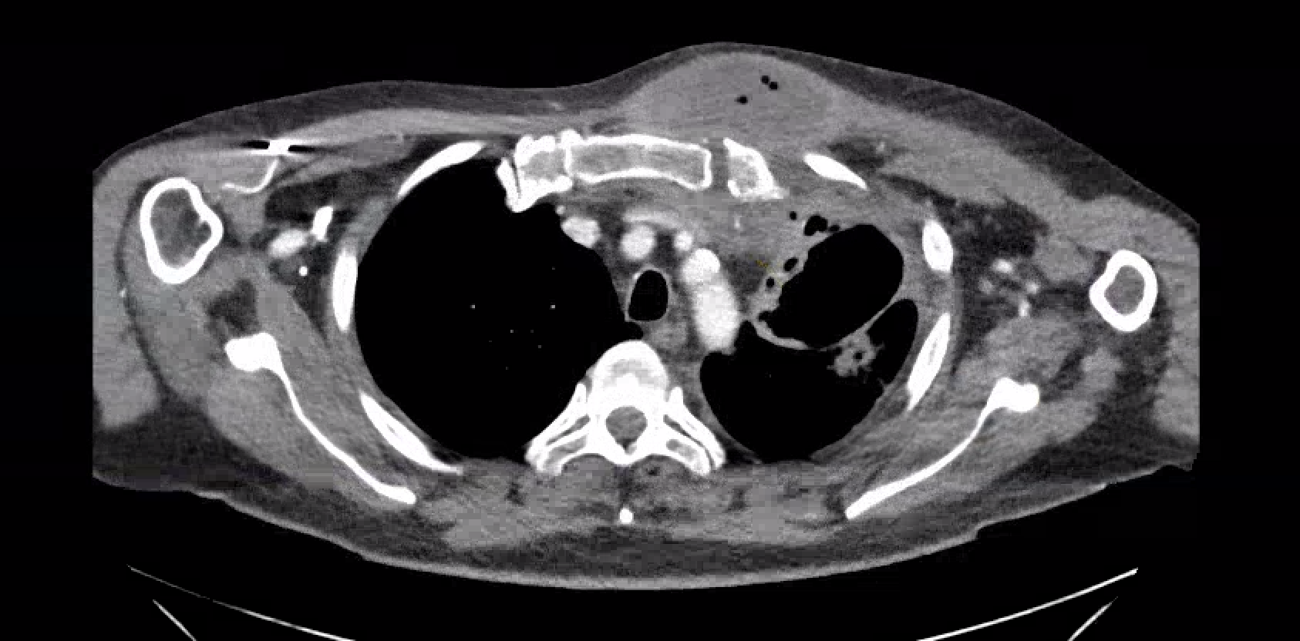
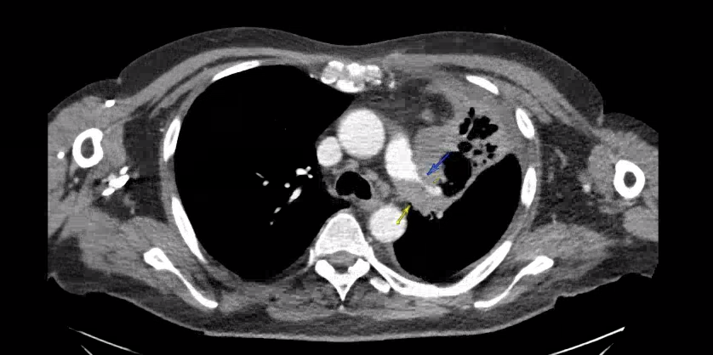
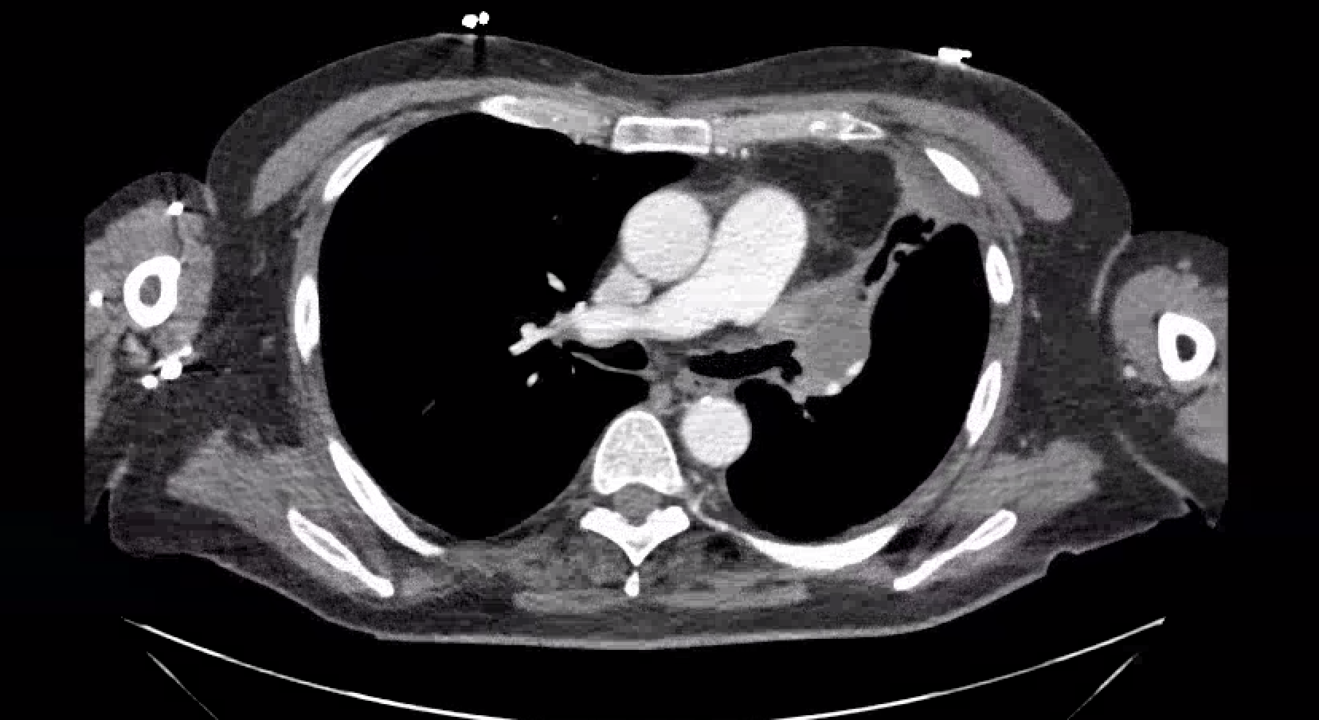
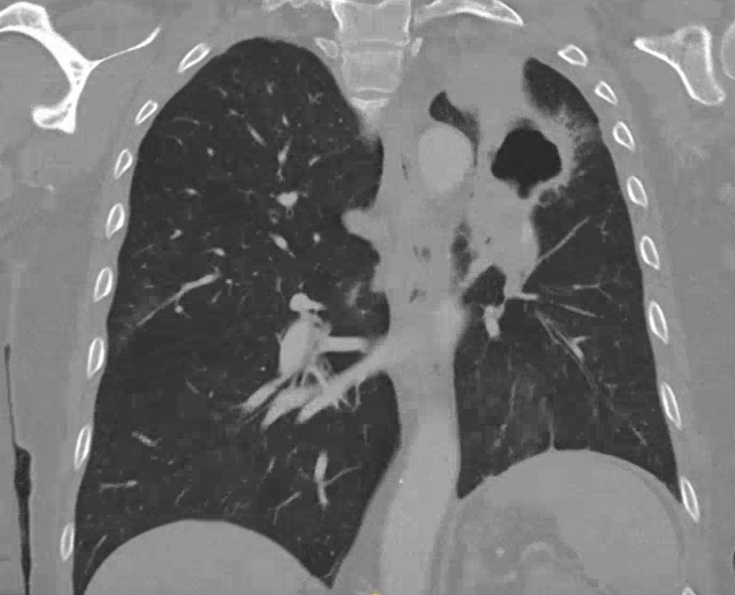
Endobronchial Squamous Cell Carcinoma Presenting as Neck and Mediastinal Abscess
Jacques du Passage; Luke Yesbeck, DO; Allison Derise, MD; Allison Pinner, MD
Introduction
Case
Squamous cell carcinoma (SCC) accounts for 30% of non-small cell lung cancer (NSCLC) [1]. While only 5% of primary lung neoplasm involve the chest wall, the presence of chest wall erosion can portend poorer outcomes [2].
A 54-year-old man with history of HTN and smoking (65 pack years) presented with a left-sided neck and chest wall mass for one week. This erythematous, fluctuant mass extending from the mandible to the chest wall was associated with a cavitary lung lesion, left hilar mass, and osseous erosion of the costomanubrial joint (Figures 1-4). Biopsy of the mass revealed well-differentiated, endobronchial SCC. Patient’s MSSA infection was treated with cefazolin, with outpatient follow up for chemotherapy and radiation.
Images and Figures
Figure 1: Contrast-enhanced chest CT showing left lung fluid collection with internal gas extending into the anterior mediastinum and chest wall, with osseus involvement of the first costomanubrial joint.
Figure 2: Contrast-enhanced chest CT demonstrating heterogenous left upper lobe thick-walled cavitary lesion with significant compression of left main pulmonary artery (blue arrow).
Figure 3: Contrast-enhanced chest CT of a 1.8 cm left upper lung mass.
Figure 4: Coronal CT demonstrating large left upper lobe cavitary mass involving the majority of the left upper hemithorax.
Summary
References
This case highlights the diagnostic complexity when malignancy is obscured by superinfection and underscores the importance of maintaining a high index of suspicion for malignancy in patients with atypical or aggressive infections. Requiring management support from medicine, infectious disease, pulmonology, and oncology, this patient’s case demonstrates the importance of multidisciplinary coordination.
1. Sabbula, B. R. (2024, February 14). Squamous cell lung cancer. StatPearls [Internet]. https://www.ncbi.nlm.nih.gov/books/NBK564510/
2. Filosso PL, Sandri A, Guerrera F, Solidoro P, Bora G, Lyberis P, Ruffini E, Oliaro A. Primary lung tumors invading the chest wall. J Thorac Dis. 2016 Nov;8(Suppl 11):S855-S862. doi: 10.21037/jtd.2016.05.51. PMID: 27942407; PMCID: PMC5124598.

