Slide 1

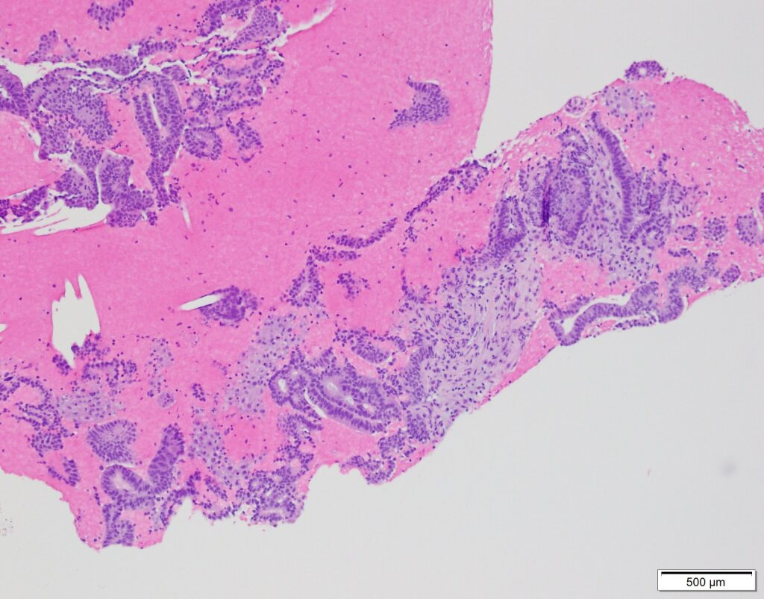
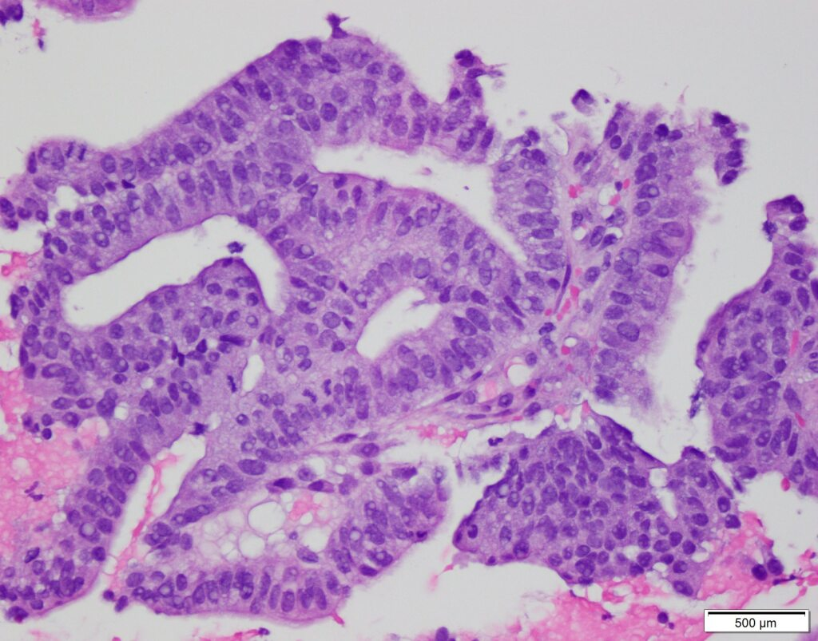
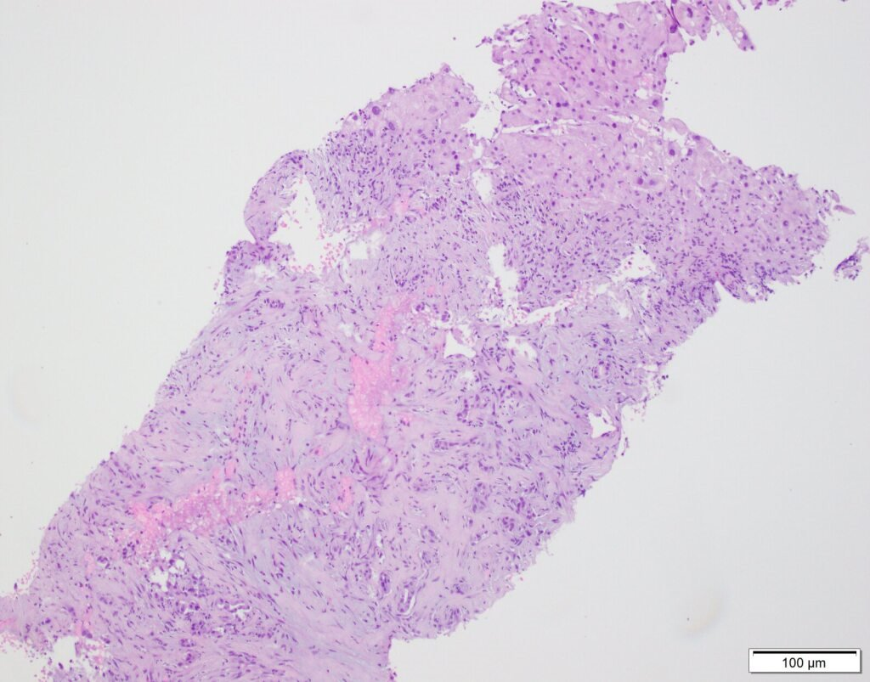
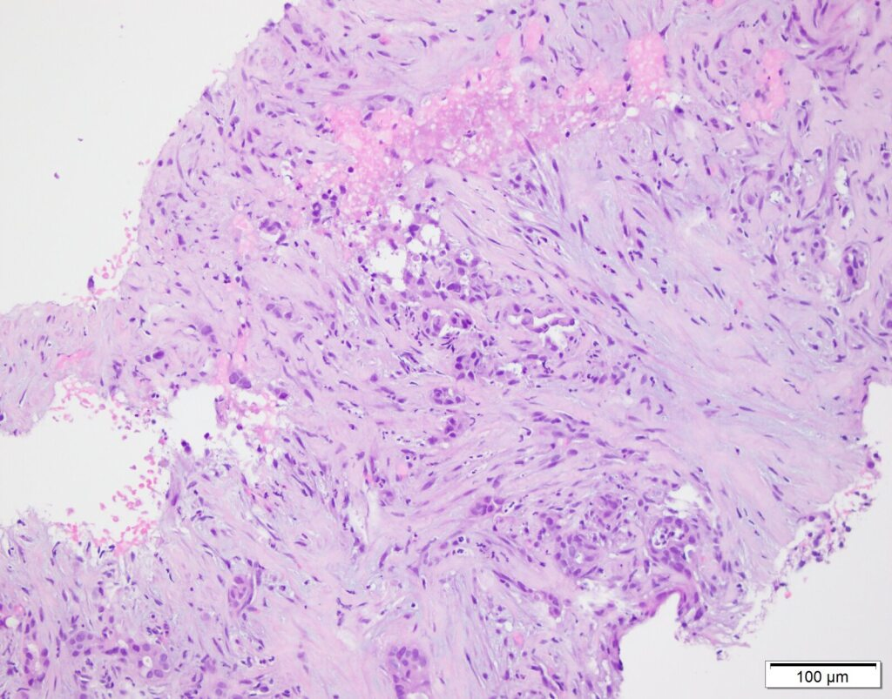
Pancreatic Ductal Adenocarcinoma with Germline ATM Mutation and Somatic NRG1 Fusion: A Rare Dual Genomic Context
¹Olivia Hart, ²Michelle M De Jesus Ortiz, ¹Carley Knudson, ³Shannon J Goodall, ²Zhiyan Fu, ³Chancellor E Donald, ⁴Lucio Miele, ⁵Omeed Moaven, ⁴Sun Young Kim
¹LSU LCMC Health Cancer Center, ²Department of Pathology, LSU LCMC Health Cancer Center, ³Division of Hematology and oncology, Department of Internal Medicine, Tulane Cancer Center, ⁴Division of Surgical Oncology, Department of Surgery, LSU LCMC Health Cancer Center, ⁵Department of Genetics and Department of Interdisciplinary Oncology, LSU LCMC Health Cancer Center, New Orleans, LA, USA
Background
Serum Biomarkers
Pancreatic ductal adenocarcinoma (PDAC) is an aggressive malignancy with poor survival and limited targeted therapies.
Most tumors are driven by KRAS mutations, but KRAS wild-type PDAC may harbor actionable drivers.
NRG1 fusions represent a rare but targetable oncogenic alteration.
Germline ATM mutations impair DNA damage repair and may influence treatment response.
The coexistence of germline ATM mutation and somatic NRG1 fusion in PDAC has not previously been reported.
Elevated AFP (284.6 ng/mL)
Normal CA 19-9 (<0.8 U/mL)
Normal CEA (2.9 ng/mL)
Molecular Profiling
KRAS wild-type
Somatic NRG1-ATP1B1 fusion
Pathogenic germline ATM variant (ATM: c.4019_4029del11, heterozygous, pathogenic)
Molecular Context
Pathologic Findings
ATM
Plays a role in orchestrating cellular response to double-stranded DNA breaks
Tumors with ATM alterations may show increased sensitivity to platinum chemotherapy
NRG1
Encodes neuregulin-1, a HER3 ligand
NRG1 fusions result in aberrant HER2/HER3 signaling activation and uncontrolled cell growth
Zenocutuzumab
Bispecific HER2/HER3 antibody
FDA accelerated approval for treatment of cancers with NRG fusions
Low and high-power H&E-stained sections from pancreatic head mass
Case Presentation
33-year-old male presenting with PDAC with metastasis to the liver
Low- and high-power H&E-stained sections of a liver needle-core biopsy
Treatment Timeline
Systemic Chemotherapy
Oxaliplatin Discontinued
Initial
Response
Biochemical Progression
Targeted Therapy
Initiated
Complete Response
Modified FOLFIRINOX
Peripheral neuropathy developed after 12
cycles of FOLFIRINOX
Pancreatic mass and hepatic lesions decreased
in size
Elevated tumor markers detected
Zenocutuzumab (HER2/3 antibody)
initiated to target
NRG1 fusion
No viable liver tumor or evidence of metastatic disease on CT
Conclusion
Key Takeaway
KRAS wild-type PDAC harboring a pathogenic germline ATM variant with a somatic NRG1 fusion represents an extremely rare tumor profile
NRG1 fusion represent a rare but highly actionable driver in PDAC
Integrating both germline and somatic testing into routine clinical care is essential for guiding personalized therapy decisions.
Acknowledgements
References
Thank you to Dr. Sun Young Kim and Dr. Omeed Moaven for their guidance and mentorship, as well as the oncology and pathology team involved in the care of this patient for their support in preparation of this case report.
Pantaleo A, et al. Understanding the genetic landscape of pancreatic ductal adenocarcinoma to support personalized medicine. Cancers. 2023;16(1).
Jiang Y, et al. Molecular characterization and prognostic implications of KRAS mutations in pancreatic cancer patients. npj Precision Oncology. 2025;9(1):299.
Hu C, et al. Association between inherited germline mutations in cancer predisposition genes and risk of pancreatic cancer. JAMA. 2018;319(23):2401–2409.
Yadav S, et al. Genomic and immune landscape of pancreatic ductal adenocarcinoma associated with germline pathogenic variants in ATM. Clinical Cancer Research. 2025;31(21):4463–4474.
Heining C, et al. NRG1 fusions in KRAS wild-type pancreatic cancer. Cancer Discovery. 2018;8(9):1087–1095.
Jones MR, et al. NRG1 gene fusions are recurrent, clinically actionable rearrangements in KRAS wild-type PDAC.Clinical Cancer Research. 2019;25(15):4674–4681.
Schram AM, et al. Zenocutuzumab, a HER2×HER3 bispecific antibody, is effective therapy for tumors driven by NRG1 rearrangements. Cancer Discovery. 2022;12(5):1233–1247.
Schram AM, et al. Efficacy of Zenocutuzumab in NRG1 fusion–positive cancer. New England Journal of Medicine. 2025;392(6):566–576.
Blair HA. Zenocutuzumab: First approval. Drugs. 2025;85(4):591–597.

