Slide 1
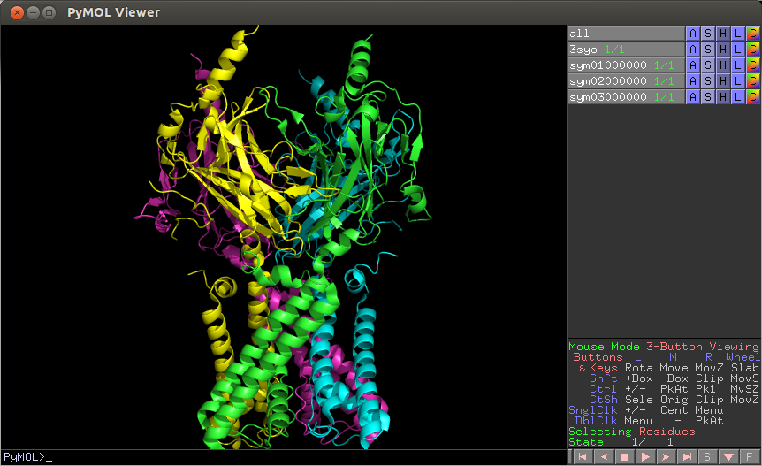
PyMol Installation
http://pymol.org/educational/

Slide 2
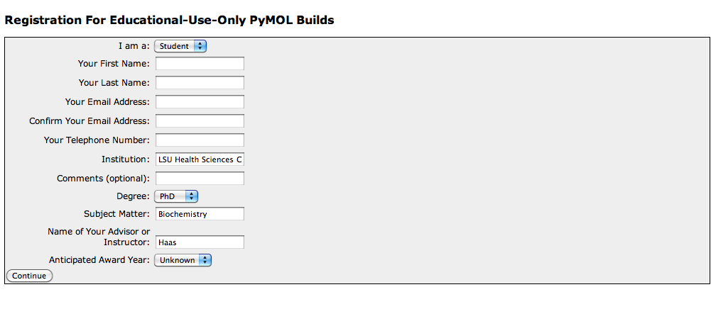
Scroll to the bottom of the Educational-Use-Only Pymol webpage and click “register here”
Fill out the requested Information:

Slide 3
Read License agreement
Scroll to the bottom of the page confirm agreement by entering the given characters:
Click “I Agree”

Slide 4
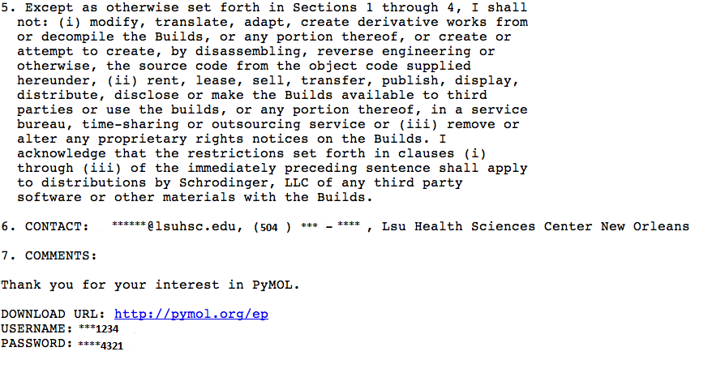
Download credentials are sent to your email address:
Follow the URL link (http://pymol.org/ep) provided at the bottom of the email
You will be prompted to enter your username and password provided in the email (Case sensitive)

Slide 5
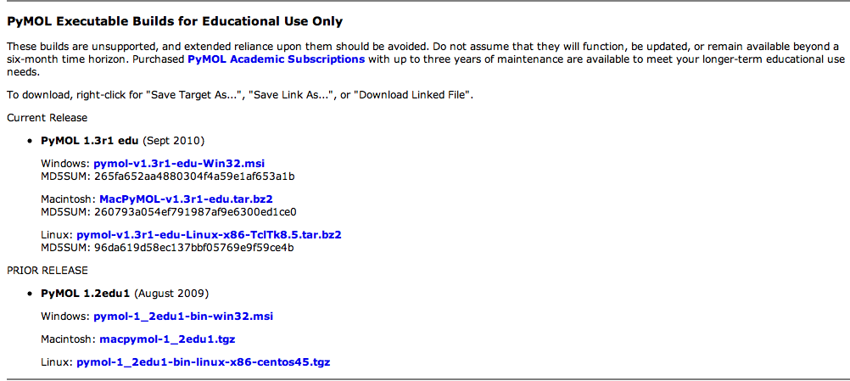
PyMol Education Products Webpage
Downloadable products are located at the bottom half of the page.
Choose the most current release that is compatible with your operating system

Slide 6
Click “Run” to begin setup
Follow the prompt and click “next” to begin installation
Click “next” to install Pymol to the default folder
Select all Pymol file types, public file types, and 3rd party file types to open by default into the Pymol install. Click “next”
**For Macintosh operating systems, Pymol will automatically install upon selecting the Macintosh compatible Pymol build

Slide 7
Complete Installation:
Click “Install” at the Ready to install Pymol window
Click “Finish” to complete Installation

