Slide 1
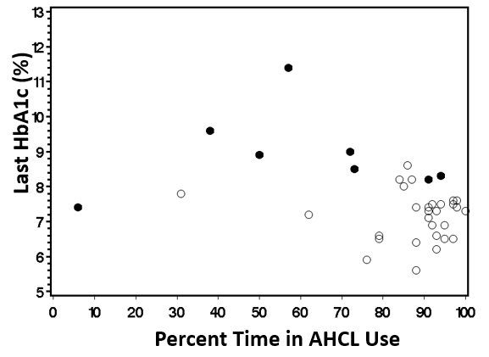
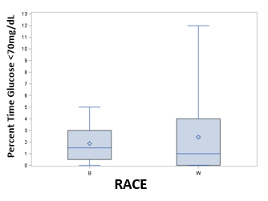
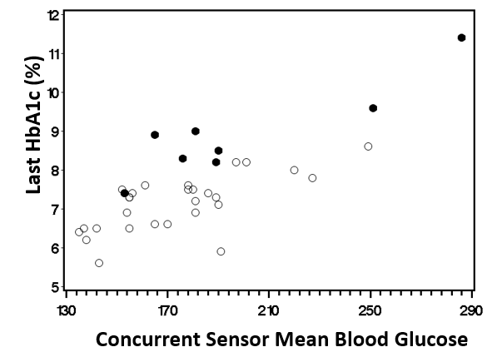
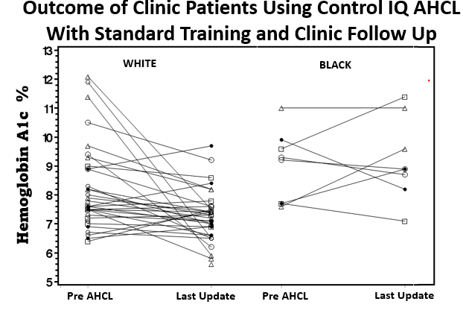
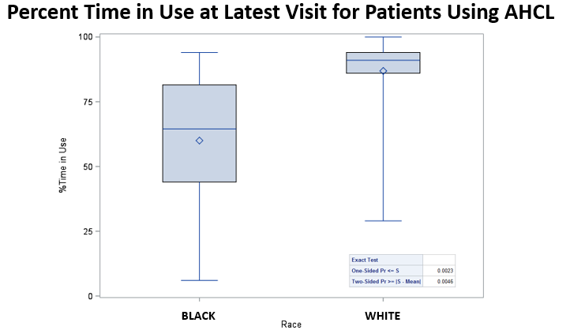
Racial Disparity in Glycemic Outcome During Real World Use of an Advanced Hybrid Closed Loop System (AHCL) Among Youth with Type 1 Diabetes (T1D) ¹Nicholas Christakis, ³Marcella Gioe, and ² ³Stuart Chalew ¹School of Medicine, Louisiana State University Health Sciences Center, New Orleans, LA, USA ²Division of Pediatric Endocrinology and Diabetes, Department of Pediatrics, School of Medicine, Louisiana State University Health Sciences Center, ³The Children’s Hospital of New Orleans, New Orleans, LA, USA
Overall, latest A1c was significantly correlated with sMBG (r=0.75, p<0.0001), % Time in AHCL Use (r=-0.38, p<0.02) and % Time in glucose target range (r=-0.36, p=0.034). See Figures 2, 3 and 5.
The influence of sMBG and race on the latest A1c was examined in a multiple variable model R²=0.61, p<0.0001 both race ( p=0.0046) and sMBG ( p<0.0001) were statistically significant. B patients tended to have HbA1c than W at any given level of MBG.
FIGURE 3
Introduction
African-American (B) youth with Type 1 Diabetes consistently have higher A1c than White (W) patients, even when using open-loop insulin pumps. AHCL technology utilizes glucose sensor data to guide automatic adjustments of insulin by the pump throughout the day to mitigate hyper and hypoglycemia. Potentially AHCL could reduce or eliminate disparity in glycemic outcome in high risk patient populations.
TABLE 1
Group | Age (y) at Last Visit | Duration T1D (y) | Pre AHCL A1c (%) | AHCL Use (Weeks) | Latest A1c(%) | sMean Blood Glucose (mg/dL) | % Time in Use AHCL | % Time in Glucose Target Range
W | 14.9±3.6 | 5.9±4.5 | 8.3%±1.6 | 49.5±27.4 | 7.2±0.6 | 173.1±28.1 | 87.6 ±13.5 | 53±19.9
B | 16.1±2.8 | 4.6±2.4 | 9.0%±1.2 | 44.6±21.1 | 8.9±1.2 | 198.9±45.6 | 60.1 ±29.1 | 45±28.4
p= |  |  |  |  | 0.0037 | 0.052 | 0.032
FIGURE 4
Methods
We performed a retrospective chart review of clinic patients who were using Tandem Control IQ (CIQ) AHCL system. Patients were trained in AHCL use by the manufacturer’s representative and then followed routinely in diabetes clinic at the Children’s Hospital of New Orleans (n=62). Data was excerpted from patient eMR and t-connect data bases. Patients were included in the analysis if they had used CIQ for more than 120 days and had officially self-identified in the eMR as either non-Hispanic White (W) or non-Hispanic Black/African-American (B) and had paired data for HbA1c and glucose sensor data at the last clinic visit. Sensor/system data stats were assessed for the 30 days prior to clinic visit.
FIGURE 5
FIGURE 1
Results
Conclusions
Eight patients self-identified as B, 12.5% formerly using pumps, 75% MDI, 12.5% mixed insulin. 49% of B youth had Medicaid, 51% commercial insurance. Twenty-nine identified as W, 60% formerly using pumps, 40% MDI. 41% had Medicaid, 59% commercial insurance.
There was a statistical and clinically significant reduction in A1c (-1.2%±1.6, p=0.0007) for W patients but not B (- 0.09±1.6, p=NS) with AHCL use. See Figure 1.
B patients had higher A1c and sensor Mean Blood Glucose (MBG) with lower percent time in use (TIU) during AHCL mode than W patients (Table 1). The percent insulin bolus, basal, units of insulin per kg per day, percent glucoses <70 mg/dL were not different between groups (Figure 4)
1 - Under real world training and clinic follow up B patients did not have improved HbA1c while W patients had clinically and statistically significant improvement.
2 - Percent time spent in CIQ mode was the salient difference between groups with W 87.6% time in use vs 60.1% for B patients.
3 -There was no difference in percent time in hypoglycemic range (BG<70 mg/dL) between groups.
4 - HbA1c over estimates sensor mean blood glucose of B patients compared to W patients.
Innovations in technology and/or patient support appear to be needed to mitigate racial disparity in glycemic outcome when using AHCL is used in high risk pediatric populations with type 1 diabetes.
FIGURE 2

