Slide 1
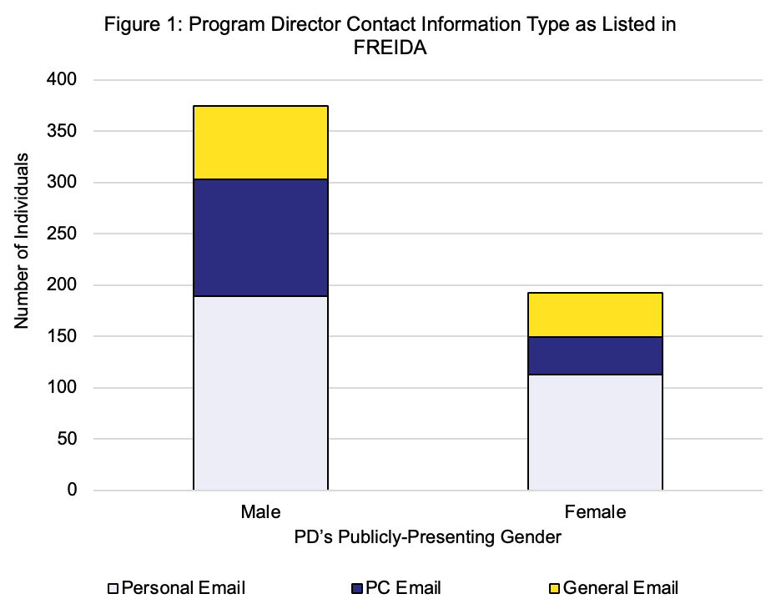
DIFFERENCES IN ACCESSIBILITY TO PROGRAM DIRECTORS INDICATES A POTENTIAL GREATER BURDEN UPON FEMALE PROGRAM DIRECTORS
¹ Tram Ngo BA; ¹ Kaylin Beiter PhD; ² Erich Conrad MD; ³ Erika Rajo PsyD
¹ LSUHSC School of Medicine - New Orleans, ² LSUHSC Department of Psychiatry, ³ LSUHSC Department of Psychology
Background & Objective
Results
Conclusion
The COVID-19 pandemic and subsequent limitations on in-person interviews and away rotations have necessitated residency program directors and prospective applicants alike to rely disproportionately upon electronic means of communication relative to years past. Program directors (PDs) play a key role in providing information about their program to applicants; however it is unknown how accessible PDs are to prospective applicants. The objective of this study was to explore differences in accessibility to PDs via their use of individual, general (programmatic), or administrative-assistant email addresses in the FREIDA database.
A total of 560 IM programs were included in this study. PDs were majority male-presenting (n=365, 65.7%) versus female-presenting (n=192, 34.3%). Male PD’s were less likely to provide their individual email address (n=183, 49.7%) and more likely to list the administrative assistant’s email instead (n=114, 31.0%) relative to female PDs (individual: n=113, 58.9%; administrative: n=36, 18.8%) (Chi-square, p=0.0081). PDs did not differ in their reliance upon general programmatic email addresses (male: n=71, 19.3%; female: n=43, 22.4%).
Female PDs are more accessible to residency applicants who use the FRIEDA database. While this may be a benefit for trainees due to increased availability of the PD to them, it also indicates a potential greater administrative burden upon female PDs relative to their male counterparts. As programs continue to receive increasing numbers of applications, a standardized approach should be considered in order to alleviate these gendered differences. Moreover, standardization should be accomplished to ensure that residency applicants may engage consistently with all programs of interest and to facilitate a successful, equitable match.
Discussion
Methods
To expand upon our study, we are looking to also include resident class size and geographic region for each internal medicine program, to see if PDs are more likely to put their own email address if they have a smaller class size or are in a less competitive region of the country. Another direction we are also interested in exploring, is collecting the same data for all US based surgery programs to investigate if similar results are seen in other types of residency programs as well.
The FRIEDA database was queried for all US-based internal medicine programs. Information was recorded for the listed PD and administrative assistant. The email address for each respective individual was classified as either an individual PD’s email address (dr.jane.doe@hospital.edu); a general program address (medicine@hospital.edu); or the administrative assistant's email address (assistant.john.smith@hospital.edu). Program-specific websites were also used to identify the public-presenting gender of PDs according to the PD’s chosen photo.
Figure 1: Of the 365 male PDs included in this data, 49.7% (183) provided their individual email address. Of the 192 female PDs, 58.9% (113) provided their individual email address.
Notes:
This study looked at the accessibility to residency program directors via the FRIEDA database and found that there was a potential greater burden upon female program directors. Because the COVID-19 pandemic placed limitations on away rotations and in-person interviews, this lead program directors and prospective applicants to rely more heavily on electronic means of communications than they did in the past. So we wanted to see how accessible PDs are to applicants. Using the FRIEDA database, which stands for the Fellowship and Residency Electronic Interactive Database, we looked at all US-based internal medicine programs and recorded the email addresses listed for the program director and administrative assistant. We then classified the email address for each respective individual as either an individual PD’s email address (dr.jane.doe@hospital.edu); a general program address (medicine@hospital.edu); or the administrative assistant's email address that was listed. Afterwards, we identify the PD as either male or female based on their public-presenting gender using the PD’s chosen photo on the program's specific website. A total of 560 IM programs were included in this study. 65.7% of the PDs were male presenting and 34.3% of PDs were female presenting. Of the male PDs, 49.7% listed their individual email address. Of the female PDs, 58.9% of them listed their individual email address. As such, this indicates female PDs are more accessible to residency applicants who use the FRIEDA database and indicates a potential greater administrative burden upon female PDs relative to their male counterparts. As programs continue to receive increasing numbers of applications, a standardized approach should be considered in order to alleviate these gendered differences. As for future directions - we are looking to include resident class size and geographic region into our study to see if PDs are more likely to put their own email address if they have a smaller class size or are in a less competitive region of the country. We are also interested in collecting the same data for all US based surgery programs to investigate if similar results are seen in different types of residency programs as well.

