Slide 1
CSI 101 Skills Lab 3
Universal Precautions,
Surgical Scrub, and
Sterile Gowning/Gloving
Daryl P. Lofaso, Ph.D., M.Ed., RRT
^{Alicia Tate, NRP}

Slide 2
Healthcare-Associated Infections (HAI) also referred to as Nosocomial Infection
NHSN* Definition:
Local or Systemic condition
Results from adverse reactions to the presence of an infectious agent (s)
Not present or incubating at the time of admission to the hospital
Infection usually becomes evident 48 hours or more after admission
*National Healthcare Safety Network
https://www.cdc.gov/nhsn/index.html

Slide 3
Healthcare-Associated Infection
Impact
Estimated 687,200 patients per yr (2015)
99,000 Deaths/year
Cost 9.8 Billion a year (2023)

Slide 4
Hand Hygiene
GOOD HAND HYGIENE CAN PREVENT INFECTIONS
35% OF HAI’s ARE PREVENTABLE!!!!
WASH A MINIMUM OF 20 SECONDS

Slide 5
Handwashing

Slide 6
Handrub

Slide 7
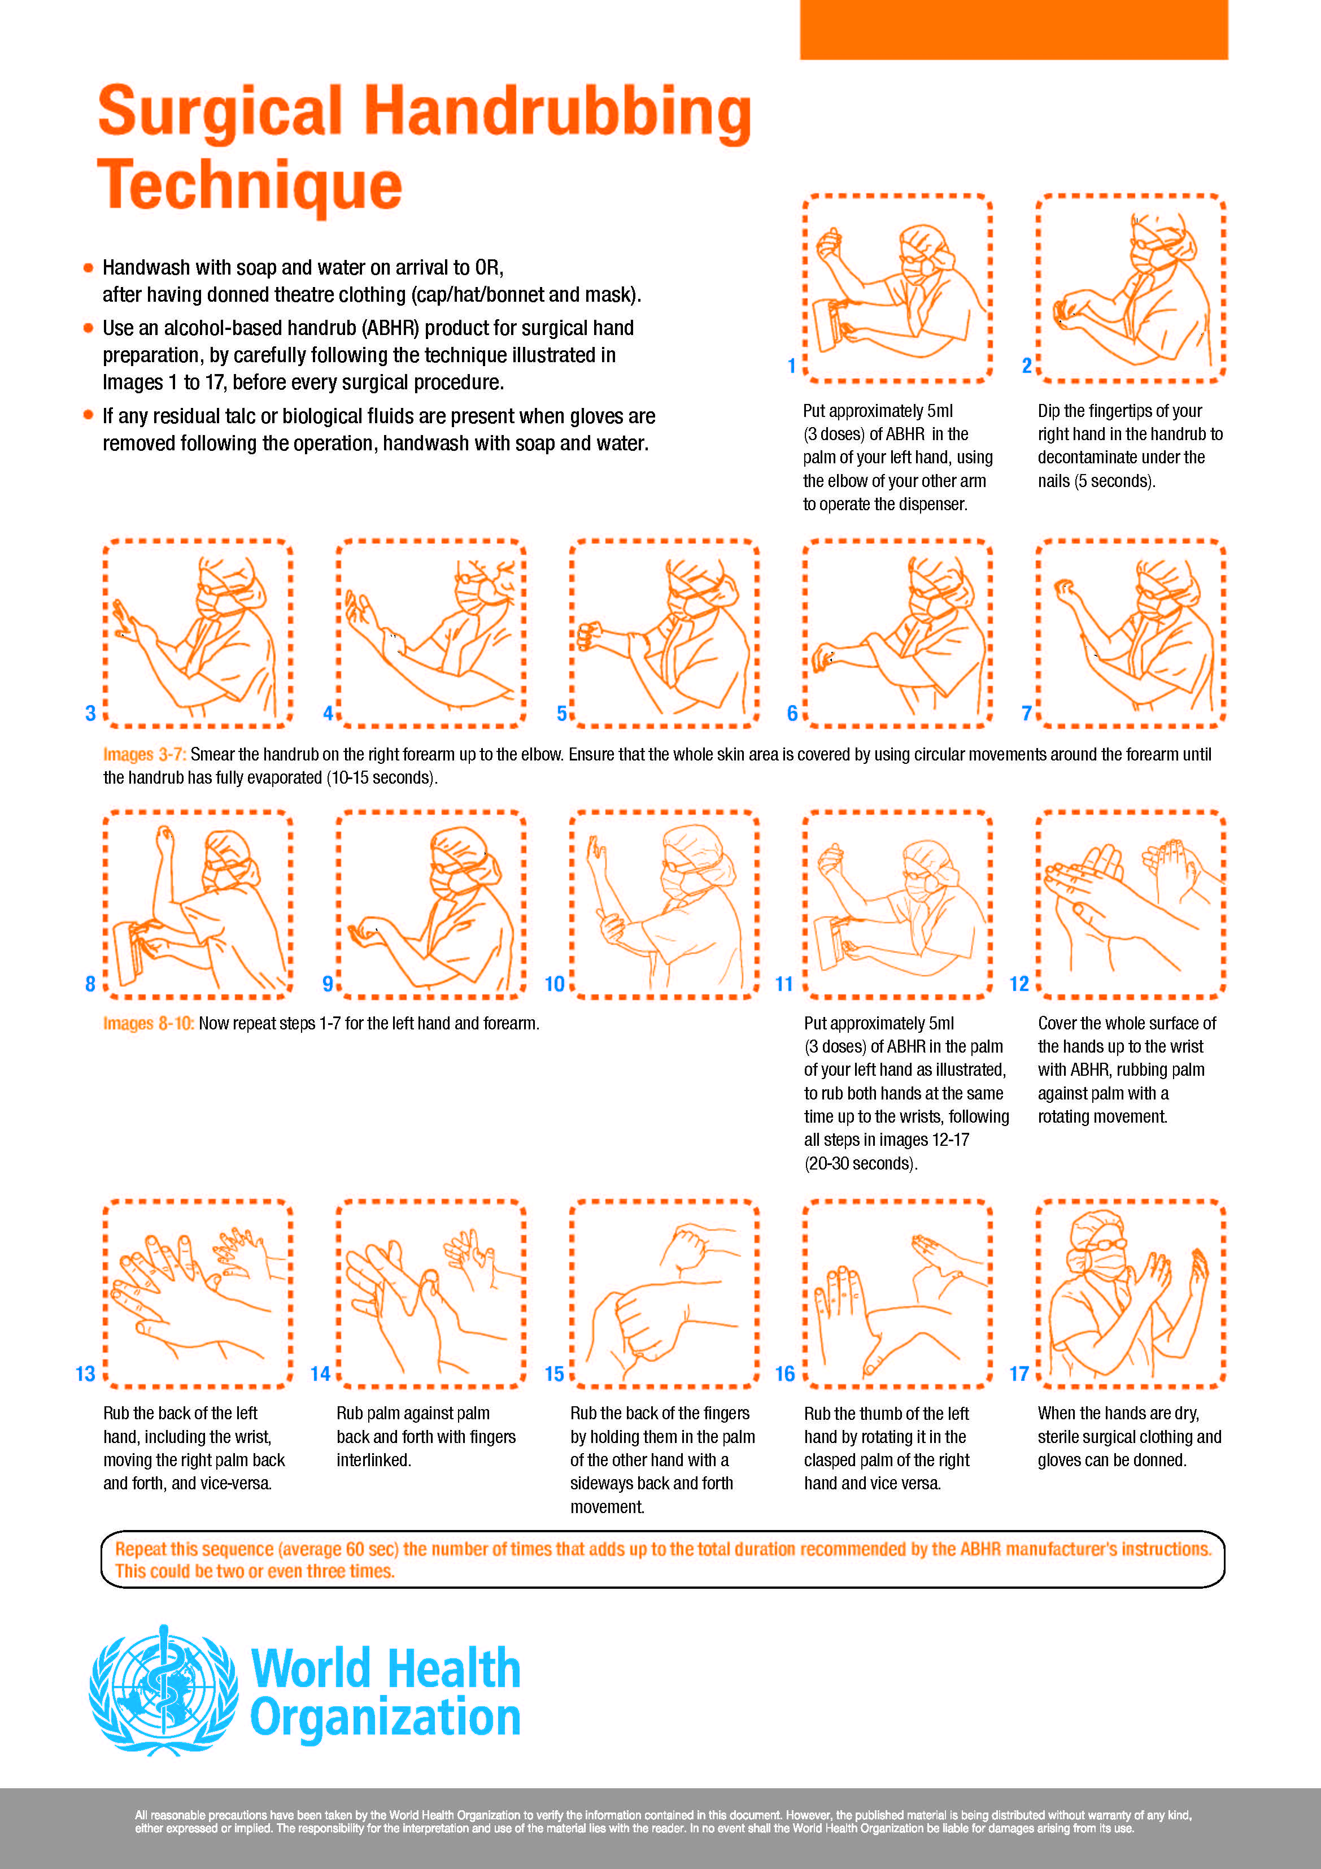
Surgical Handrubbing with alcohol-based handrub

Slide 8
Risk Factors for Infection
IV’s
Foley Catheters
Endotracheal tubes (ETT)
Central Lines
Wounds

Slide 9
Dominant HAIs (2011)
Pneumonia (21.8%)
Surgical Site Infection (21.8%)
Gastrointestinal Infections (17.1%)
Urinary Tract Infection (12.9%)
Blood Stream Infection (9.9%)

Slide 10
HAI UTI
67.7% associated w/urinary catheters
Common Organisms (2015)
E. coli (27.7%)
Klebsiella pneumoniae or K. oxytoca (23.1%)
Enterococcus species* (16.9)
Pseudomonas aeruginosa* (10.8%)
Candida albicans (4.6%)
*Antibiotic resistance may lead to increased morbidity
Multistate Point-Prevalence Survey of Health Care–Associated Infections - PMC

Slide 11
HAI Pneumonia
20-30% Mortality (2019)
Common Organisms
Staphylococcus aureus * (16.4)
Pseudomonas aeruginosa* (12.7)
Klebsiella pneumoniae or K. oxytoca (11.8)
Streptococcus species (6.4)
Enterobacter species* (2.7)
*Antibiotic resistance may lead to increased morbidity
Multistate Point-Prevalence Survey of Health Care–Associated Infections – PMC

Slide 12
HAI Blood Stream Infections
20-30% Mortality
Common Organisms
Candida species (22%)
Coag Negative Staph (18%)
Staphylococcus aureus* (14%)
Enterococcus species* (12%)
* Antibiotic Resistance may lead to increased morbidity

Slide 13
Risks To the Healthcare Worker
Blood Borne Pathogens
Hepatitis B: 2-5 % with vaccine
6-30 % without vaccine
Hepatitis C: 2-4 %
HIV: 0.3 %
Airborne Pathogens
Tuberculosis
Measles
Varicella
Influenzas / COVID -19

Slide 14
Management of Exposure
Wash immediately
Report incident to supervisor and follow proper protocols
Obtain history from the source patient via provided consent forms (HIV, Hepatitis or risk factors)
Bloodborne Pathogens Exposure Control Plan

Slide 15
Management of Exposure
Report to Employee Health or Emergency Department (UMC after 3pm)if seeking bloodwork
Counseling will be provided regarding the need for post exposure prophylaxis (see CDC recommendations)
Bloodborne Pathogens Exposure Control Plan

Slide 16
3 Types of Transmission Precautions
Airborne
Droplet
Contact

Slide 17
Pathogens Requiring Airborne Precautions
Tuberculosis
Measles (Rubeola)
Varicella (Chickenpox)
SARS (Severe Acute Respiratory Syndrome)
COVID-19

Slide 18
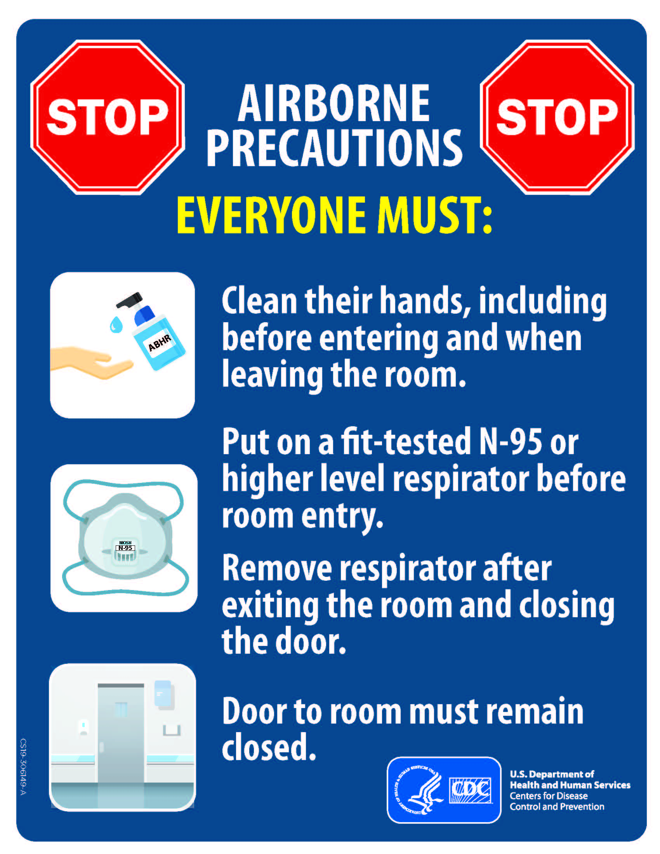
Airborne Precautions Management
Place patient in an isolation room with negative pressure
Keep door closed
Wear (N-95) mask (Mask Fit Test)
Transmission-Based Precautions | Infection Control | CDC

Slide 19
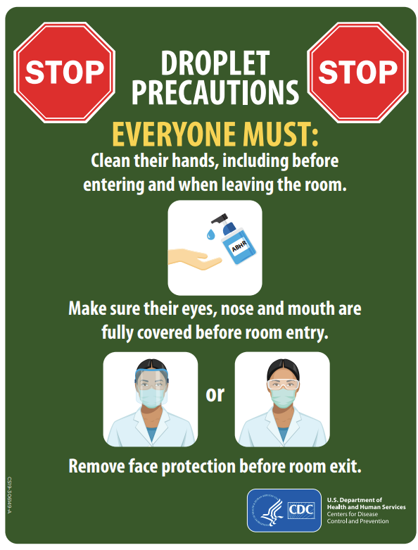
Droplet Precautions
Used for microorganisms transmitted by respiratory droplets > 5µm generated during coughing, sneezing, talking or suctioning. Can travel about 6 feet.
Place patient in private room
Pathogens requiring Droplet Precautions:
Influenza/COVID-19, Drug-resistant pneumococcus, pertussis, mumps and Neisseria meningitidis

Slide 20
Pathogens Requiring Contact Precautions
Multi-drug resistance bacteria (e.g., VRE – Vancomycin Resistant Enterococci,
MRSA - Methicillin Resistant Staphylococcus Aureus)
RSV - Respiratory Syncytial Virus
Clostridium difficile (hands must be washed with soap & water)
Scabies
Norovirus

Slide 21
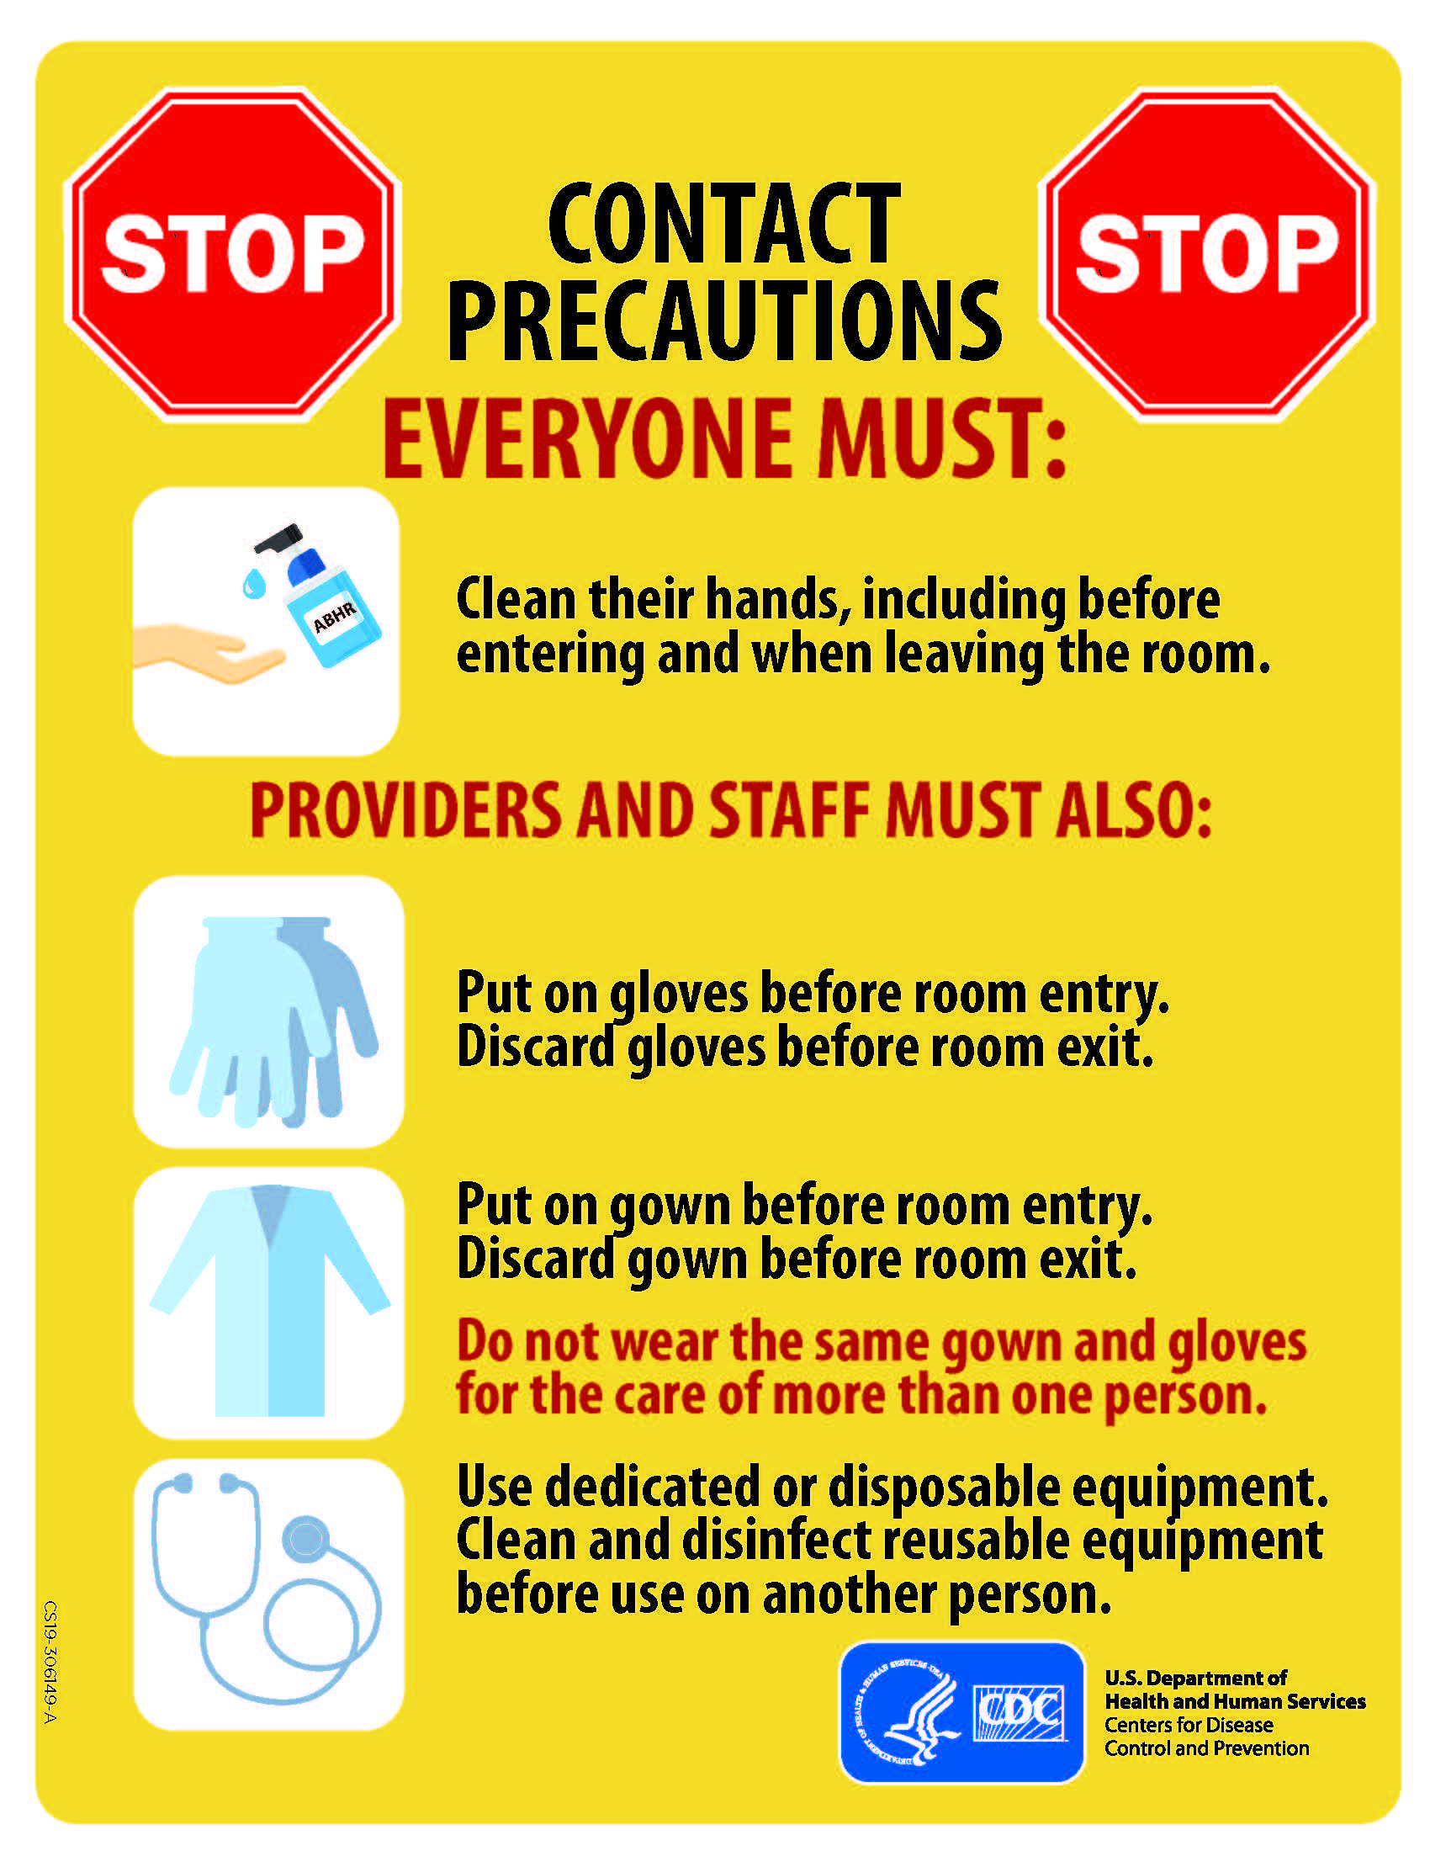
Contact Precautions
Indicated for diseases spread by contact with intact skin or surfaces.
Must wear gloves when entering room.
Wash hands before and after wearing gloves.

Slide 22
Universal Precautions
All patients are potentially infectious.
Good hand hygiene is the key
Wash before and after patient contact
Wear gloves, a mask, eye protection, face shield and gown when contact with blood or other potentially infectious material (OPIM).
(more detailed can be found at: http://www.cdc.gov/hicpac/pdf/isolation/Isolation2007.pdf )

Slide 23
Universal Precautions
When you are close to, or are handling, blood, bodily fluid, bodily tissue, mucous membranes, or area of open skin, you must use PPE.
Types of Personal Protective Equipment (PPE):
Gloves
Mask and goggles
Aprons, gowns, and shoe covers

Slide 24
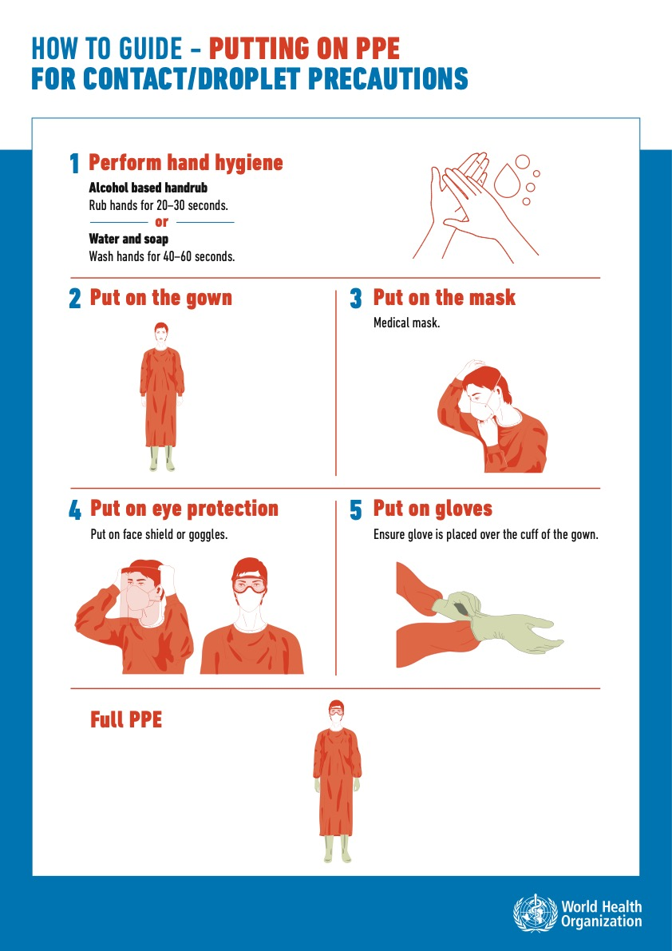
Putting on PPE (Donning)

Slide 25
Taking Off PPE (Doffing)

Slide 26
COVID-19 PPE

Slide 27
Sterile Gown and Glove
Appropriate attire – supports cleanliness and promotes patient and healthcare professionals from microbial shedding.
Sterile attire consist of the following:
Head covering – cover all hair and scalp
Surgical mask – fully cover the mouth and nose
Shoe covering – spills and splash
Eye covering – goggles or face-shield
Sterile gown - minimal lint and fits comfortably
Sterile gloves – wear over gown cuffs

