Slide 1
CSI 101
Skills Lab 2
Emergency Assessment of
Vital Signs and Pain
Daryl P. Lofaso, Ph.D., M.Ed., RRT
Alicia Tate, NRP

Slide 2
Vital Signs (VS)
Temperature
Pulse
Respiration
Blood Pressure
Pain Assessment
Pulse Oximeter

Slide 3
General Guidelines When Assessing Vital Signs
Taken by person caring for patient.
Know normal ranges
    Adult vs. Peds
Baseline data for patient
    i.e. patients norms
Patient’s Diagnosis (Dx)

Slide 4
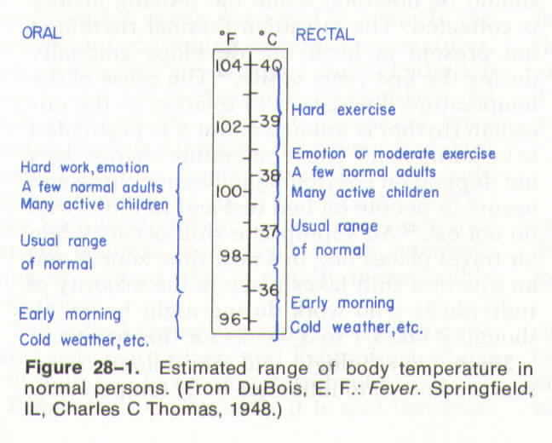
Body Temperature

Slide 5
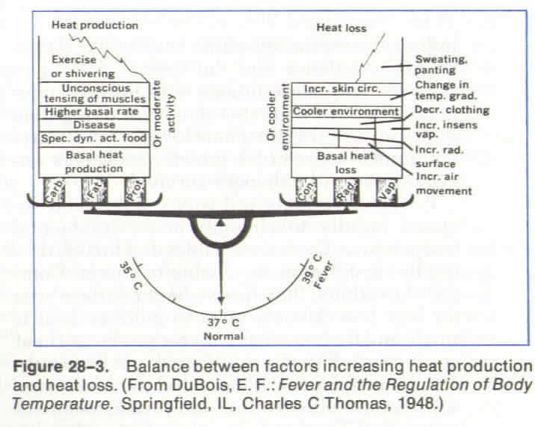
Balance of Body Temperature

Slide 6
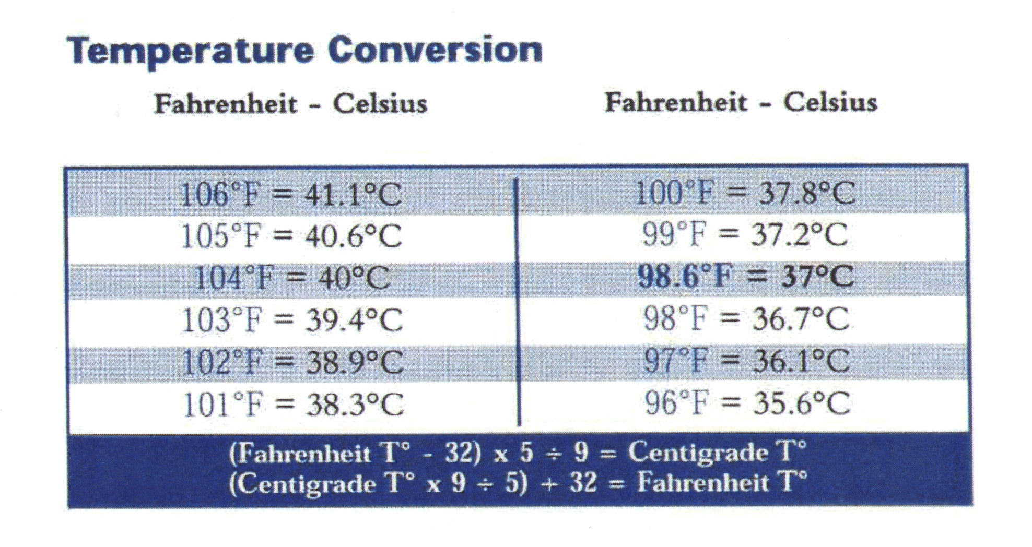
Temperature Conversion

Slide 7
Factors Influencing Body Temperature
Hypothermia (< 95ºF): decrease metabolic rate, inadequate clothing, cold environment, drug / alcohol consumption, inactivity, aging.
Hyperthermia (>100.5ºF): increase metabolic rate, inappropriate clothing, hot environment, inability to perspire, medications, infectious process, exercise.
Increased body metabolism and metabolic activity accompany elevations in body temperature and may be as high as 10 –13 percent for each 1ºC.
Pulse and respirations: increase in pulse 10-15 beats/min. with each 1ºC. Respiratory rate is increased due to the increase in oxygen demand.

Slide 8
Pulse (Heart Rate – HR)
Normal Range (Adult)
    60-100/min.
Abnormal (Adult)
    < 60/min. - Bradycardia
    > 100/min. - Tachycardia
Max Heart Rate: 220-age = ________

Slide 9
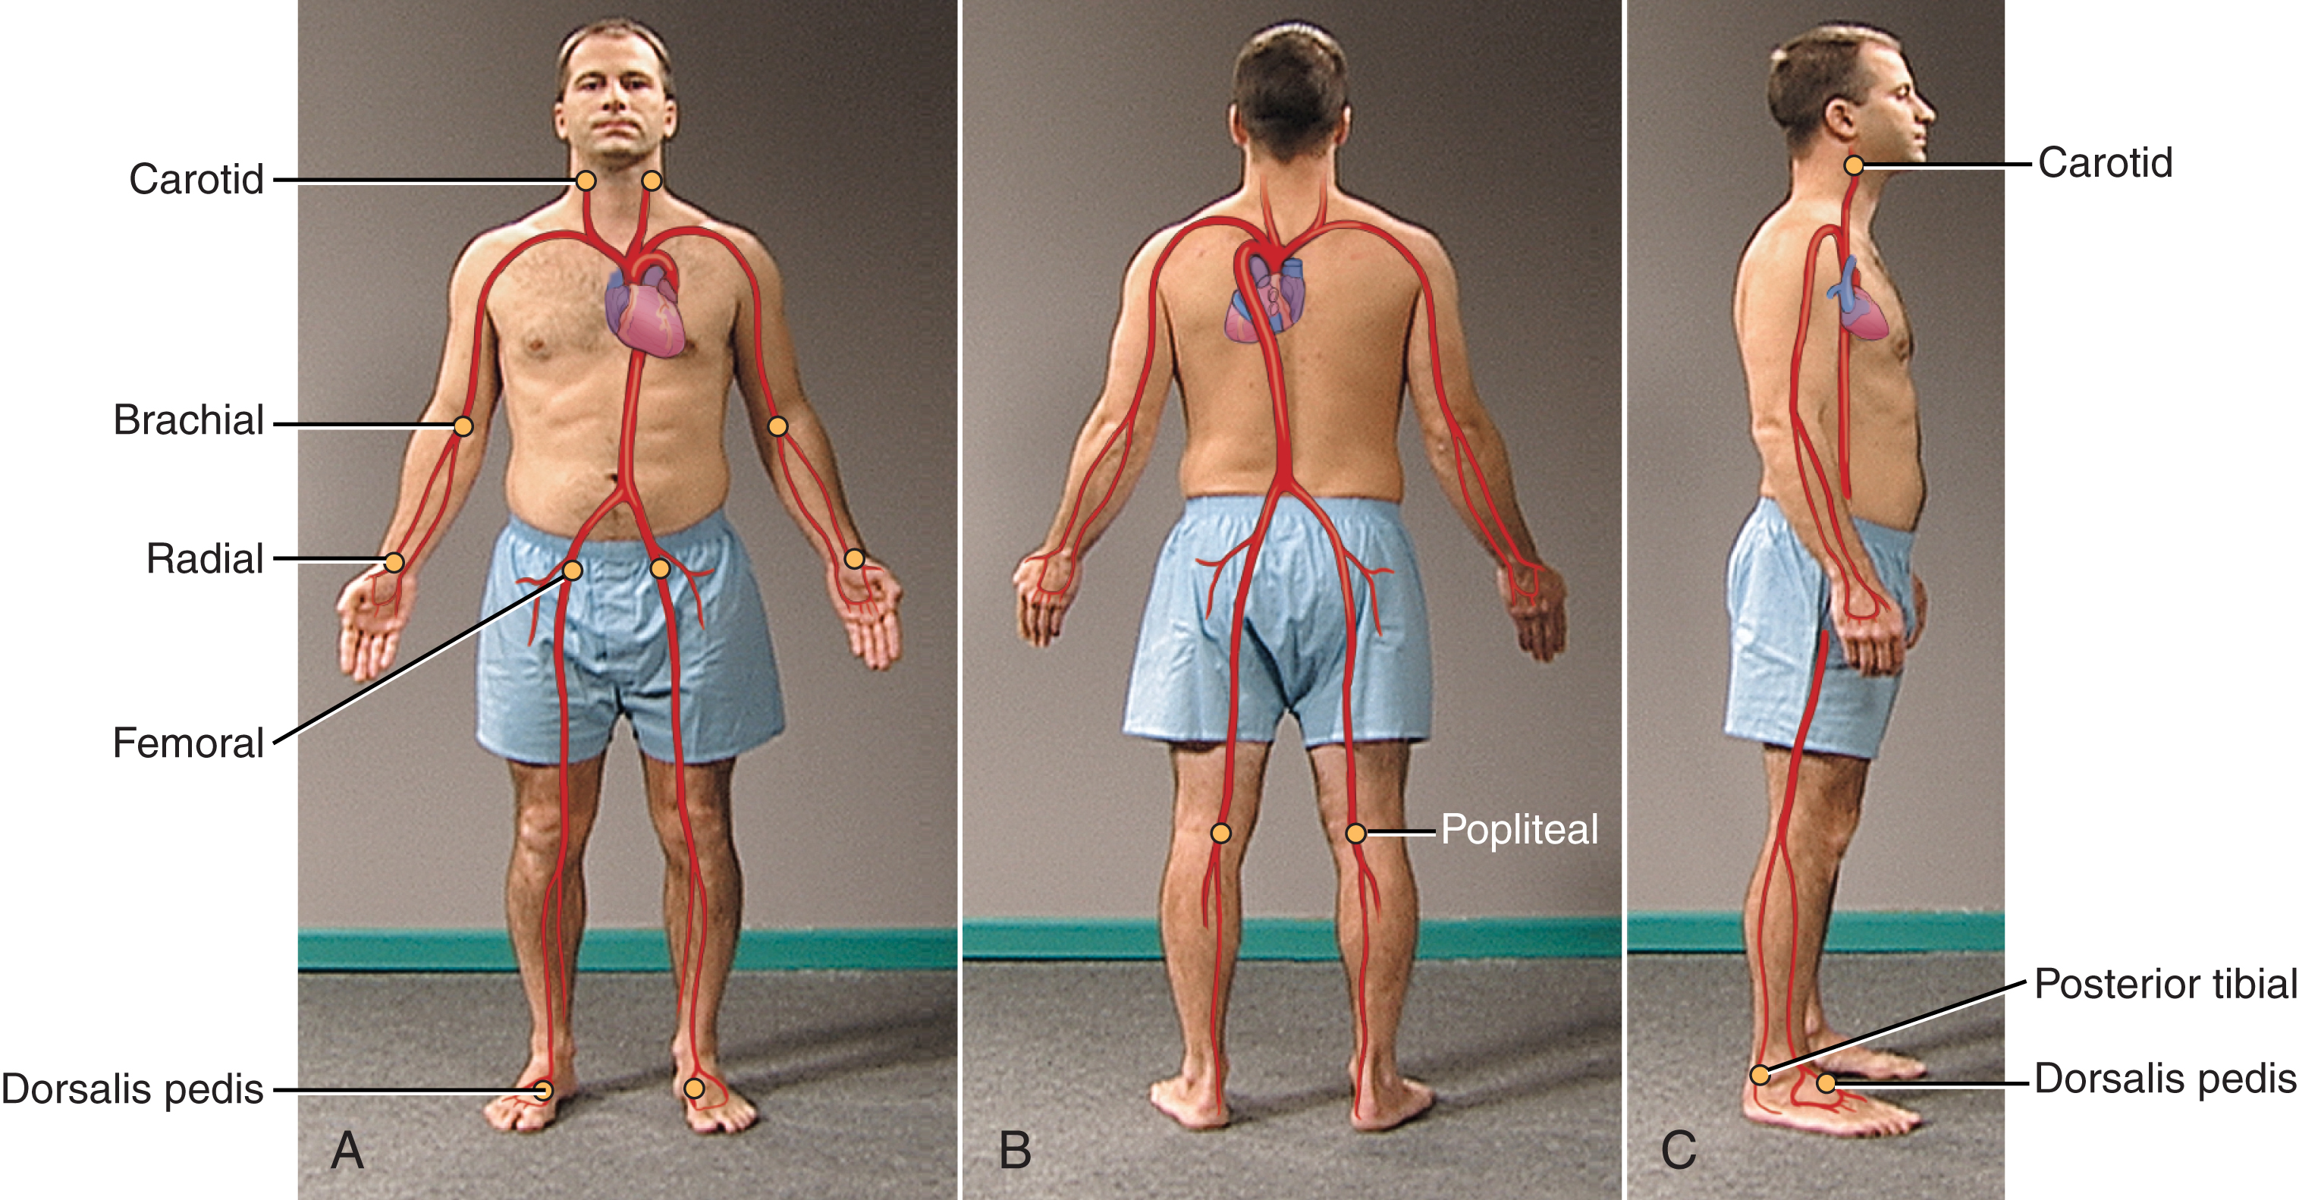
Arterial Pulse Points
Reference: Themes, U. (2020, April 12). Vital signs and pain assessment. Nurse Key. https://nursekey.com/vital-signs-and-pain-assessment-2/

Slide 10
Pulse Assessment
Pulse sites: Temporal, Carotid, Brachial, Radial, Femoral Popliteal, Dorsalis Pedis, Posterior tibal arteries and Apical (for infants).
Pulse rate: count for 30 seconds and multiply by 2. When pulse feels irregular, take for entire minute.
Pulse assessment: When taking a pulse, use the first and second fingertips of one hand, press firmly but gently on the arteries until you feel a pulse.

Slide 11
Abnormal Pulse Characteristics
Weak Pulse – ↓ stroke volume
Bounding Pulse - ↑ stroke volume
Paradoxical Pulse – change with respirations

Slide 12
Factors Influencing Pulse Rate
 | Increase | Decrease
Exercise | short-term | trained athletes
Temperature | fever & heat | hypothermia
Emotions | pain, anxiety | severe pain
Drugs | + chronotropic (epi) | - chronotropic (digitalis)
Hemorrhage | loss of blood

Slide 13
Respiratory Rate
Normal relaxed breathing is effortless, automatic, regular and even.
Normal range:
        Adult : 12-20/min.
        Child: 20-30/min.
        Infant: 35-40/min.

Slide 14
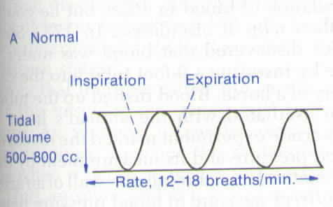
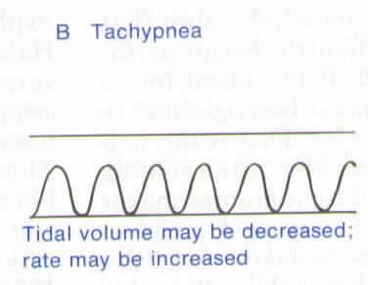
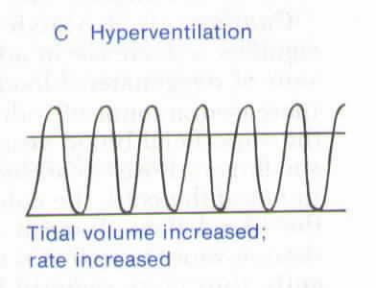
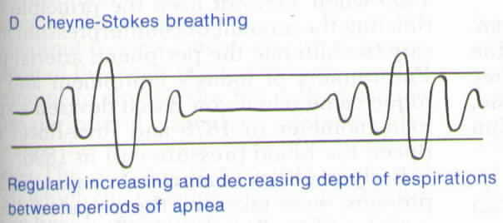
Respiratory Patterns

Slide 15
Factors Influencing Respiratory Rate
 | Increase | Decrease
Exercise | rate & depth
Acute pain | rate & depth
Anxiety | rate & depth
Smoking | rate
Narcotic |  | rate & depth

Slide 16
Blood Pressure
B/P = Systolic Pressure / Diastolic Pressure
Systolic Pressure: max. pressure exerted on the arteries with the LV
Diastolic Pressure: the elastic recoil pressure presented by the arterial walls

Slide 17
BP Formulas
Pulse Pressure = systolic pressure – diastolic pressure
    Normal: 30-50 mmHg
Mean Arterial Pressure = systolic pressure + 2(diastolic pressure) / 3
    Normal: 70-100 mmHg

Slide 18
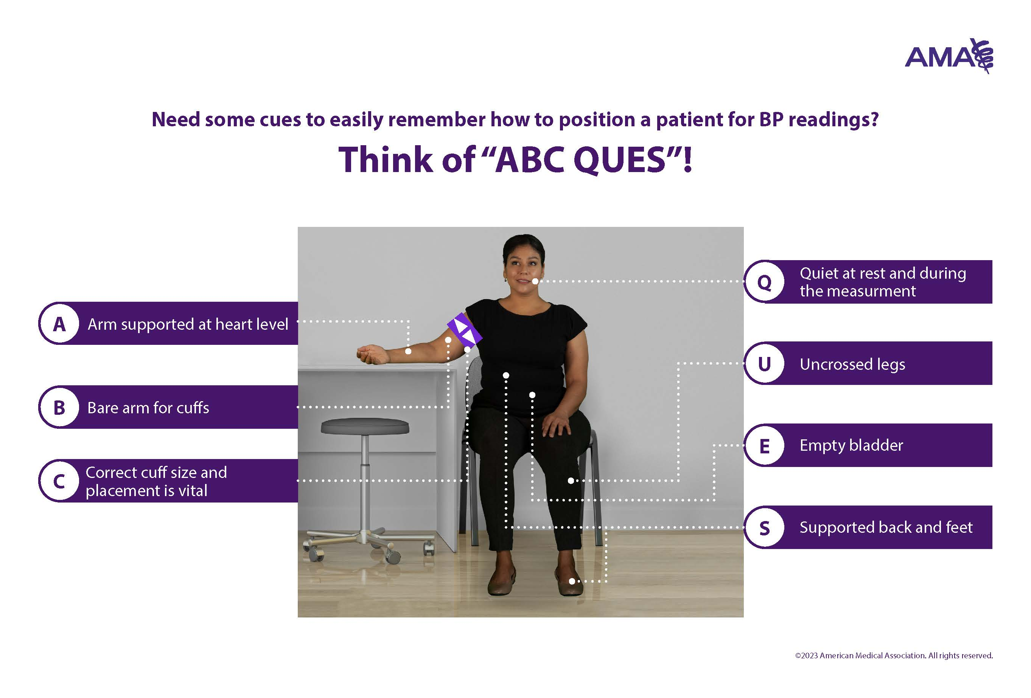
Blood Pressure

Slide 19
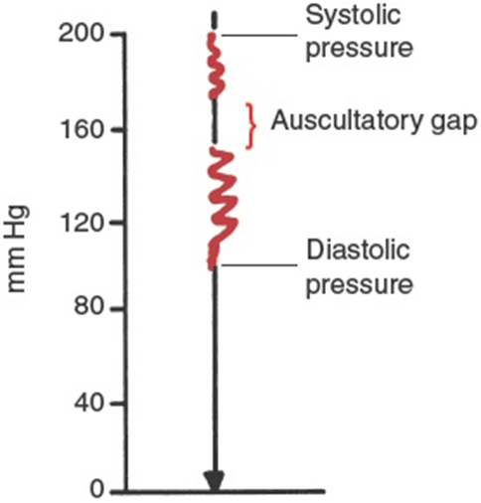
Auscultating Blood Pressure
When auscultating blood pressure, the first Korotkoff sound is the Systolic pressure and the last Korotkoff sound is the Diastolic pressure. The Korotkoff sounds in between is the Auscultatory Gap.

Slide 20
Factors Influencing Blood Pressure
 | Increase | Decrease
Pain | X
Sepsis |  | X
Anxiety | X
Smoking | X
Narcotics |  | X
Blood Loss |  | X

Slide 21
Shock Index (SI)
Define: the ratio of the heart rate to systolic blood pressure.
    SI = HR (bpm) / Systolic B/P (mmHg)
    Normal range: 0.5 – 0.7
    Elevated SI: > 0.9 - critically ill (poor outcome)
Sensitive indicator of Left Ventricular dysfunction
Used in the Emergency Department (ED) and Intensive Care Unit (ICU)

Slide 22
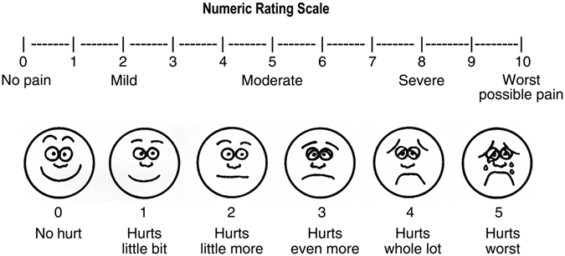
Pain Assessment
Range:
Mild: 1 – 3
Moderate: 4 – 6
Severe Pain: 7 - 10

Slide 23
Pain Management
Non-Pharmacologic
    Breathing - slowly and deeply
    Distraction
Pharmacologic
    Non-Narcotic
      Tylenol
      Ibuprofen
    Narcotic
      Morphine

Slide 24
Pulse Oximeter
Pulse oximetry is a test used to measure the oxygen level (oxygen saturation) of the blood. It is an easy, painless measure of how well oxygen is being sent to parts of the body.
  Normal Readings: > 94%
  COPD patient’s normal readings: 88 to 92%
Hypoxemia: below-normal blood oxygen level
Signs of Hypoxemia: SOB, chest pain, confusion, headache, rapid pulse.

Slide 25
Hand Hygiene
GOOD HAND WASHING CAN PREVENT NOSOCOMIAL INFECTIONS
35% OF NOSOCOMIAL INFECTIONS ARE PREVENTABLE!!!!

Slide 26
Professional Conduct
Introduce yourself
Explain the procedure / examination to the patient
Ask the patient if they have any questions
Cover the patient with a sheet. Only expose area examining while performing a procedure/examination

