Slide 1
CSI 101 Skills Lab 3
Universal Precautions,
Surgical Scrub, and
Sterile Gowning/Gloving
Daryl P. Lofaso, Ph.D., M.Ed., RRT
^{Alicia Tate, NRP}

Slide 2
Nosocomial Infection
NNIS* Definition:
  Local or Systemic condition
  Results from adverse reactions to the presence of an infectious agent (s)
  Not present or incubating at the time of admission to the hospital
  Infection usually becomes evident 48 hours or more after admission
  *National Nosocomial Infection Surveillance

Slide 3
Nosocomial Infections
Impact
  Estimated 1.7 million patients/year
  99,000 Deaths/year
  Cost 28-45 Billion Dollars (2009)

Slide 4
Hand Hygiene
GOOD HAND HYGIENE CAN PREVENT NOSOCOMIAL INFECTIONS
35% OF NOSOCOMIAL INFECTIONS ARE PREVENTABLE!!!!
WASH A MINIMUM OF 20 SECONDS

Slide 5
Handwashing

Slide 6
Handrub

Slide 7
Risk Factors for Infection
IV’s
Foley Catheters
Endotracheal tubes (ETT)
Central Lines
Wounds

Slide 8
Common Nosocomial Infections
Urinary Tract Infection (32%)
Surgical Site Infection (15-19%)
Pneumonia (15%)
Blood Stream Infection (5%)

Slide 9
Nosocomial UTI
80% associated w/urinary catheters
Common Organisms
  E. coli
  Enterococcus species*
  Pseudomonas aeruginosa*
  Candida albicans
  * Antibiotic resistance may lead to increased morbidity

Slide 10
Nosocomial Pneumonia
10-30% Mortality
Common Organisms
  Pseudomonas aeruginosa*
  Staphylococcus aureus *
  Enterobacter species*
  Streptococcus pneumoniae
  * Antibiotic resistance may lead to increased morbidity

Slide 11
Nosocomial Blood Stream Infections
20-30% Mortality
Common Organisms
  Coag Negative Staph
  Staphylococcus aureus *
  Enterococcus species*
  Candida albicans
  * Antibiotic Resistance may lead to increased morbidity

Slide 12
Risks To the Healthcare Worker
Blood Borne Pathogens
  Hepatitis B
  Hepatitis C
  HIV
Airborne Pathogens
  Tuberculosis
  Measles
  Varicella
  others

Slide 13
Hepatitis B, C & HIV
Risk after Needle Stick Exposure
  Hepatitis B: 2-5% but 6-30% before the availability of vaccine
  Hepatitis C: 2-4%
  HIV: 0.3%
https://www.ncbi.nlm.nih.gov/books/NBK493147/

Slide 14
Management of Exposure
  Wash immediately
  Report incident to supervisor (2 purple tops & file incident report)
  Obtain history from the source patient (HIV, Hepatitis or risk factors)

Slide 15
Management of Exposure
Report to Employee Health or Emergency Department (UMC after 3pm)
Counseling will be provided regarding the need for post exposure prophylaxis (see CDC recommendations)

Slide 16
3 Types of Precautions
Airborne
Droplet
Contact

Slide 17
Pathogens Requiring Airborne Precautions
Tuberculosis
Measles (Rubeola)
Varicella (Chickenpox)
SARS (Severe Acute Respiratory Syndrome)
COVID-19

Slide 18
Airborne Precautions Management
Place patient in an isolation room with negative pressure
Keep door closed
Wear (N-95) mask (Mask Fit Test)

Slide 19
Pathogens Requiring Contact Precautions
Multi-drug resistance bacteria (e.g., VRE – Vancomycin Resistant Enterococci,
MRSA - Methicillin Resistant Staphylococcus Aureus)
RSV - Respiratory Syncytial Virus
Clostridium difficile (hands must be washed with soap & water)
Scabies

Slide 20
Droplet Precautions
Used for microorganisms transmitted by respiratory droplets > 5µm generated during coughing, sneezing, talking or suctioning. Can travel about 6 feet.
Place patient in private room
Pathogens requiring Droplet Precautions:
  Influenza, Drug-resistant pneumococcus, pertussis, mumps and Neisseria meningitidis

Slide 21
Contact Precautions
Indicated for diseases spread by contact with intact skin or surfaces.
Must wear gloves when entering room.
Wash hands before and after wearing gloves.

Slide 22
Universal Precautions
All patients are potentially infectious.
Good hand hygiene is the key to reducing nosocomial infections
Wash before and after patient contact
Wear gloves, a mask, eye protection, face shield and gown when contact with blood or other potentially infectious material (OPIM).
(a more detailed description can be found at: http://www.cdc.gov/hicpac/pdf/isolation/Isolation2007.pdf )

Slide 23
Universal Precautions
When you are close to, or are handling, blood, bodily fluid, bodily tissue, mucous membranes, or area of open skin, you must use PPE.
Types of Personal Protective Equipment (PPE):
    Gloves
    Mask and goggles
    Aprons, gowns, and shoe covers

Slide 24
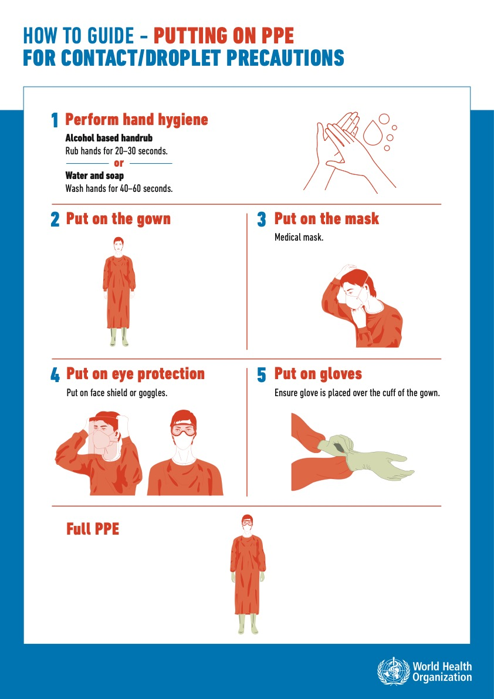
Putting on PPE (Donning)

Slide 25
Taking Off PPE (Doffing)

Slide 26
COVID-19 PPE

Slide 27
Sterile Gown and Glove
Appropriate attire – supports cleanliness and promotes patient and healthcare professionals from microbial shedding.
Sterile attire consist of the following:
  Head covering – cover all hair and scalp
  Surgical mask – fully cover the mouth and nose
  Shoe covering – spills and splash
  Eye covering – goggles or face-shield
  Sterile gown - minimal lint and fits comfortably
  Sterile gloves – wear over gown cuffs

