Slide 1
Neuroradiology Board Review
Andrew Conger, MD
10/2/2012

Slide 2
Question
1. Which of the following is a risk factor for clinically evident neurologic complications in the first 24 hours after cerebral angiography?
I. Age over 70 years
II. Duration over 90 minutes
III. History of TIA or CVA
VI. History of systemic hypertension
I, II, III
I, III
II, VI
IV
Al of the above

Slide 3
Answer
All of the above ( I, II, III, IV)

Slide 4
Neurologic complications of cerebral angiography: prospective analysis of 2,899 procedures and review of the literature.
Willinsky RA, Taylor SM, TerBrugge K, Farb RI, Tomlinson G, Montanera W.
Radiology May 2003
Lit review:
Transient and reversible deficits 0.4-2.3% mean 1.3%
Permanent deficit 0.1-0.5% mean 0.3%
Overall neurologic complication rate 1.6%
Results of this study:
Transient and reversible deficits 0.8%
Permanent deficit 0.5%
Overall neurologic complication rate 1.3%
Risk factors
Increased age (>55, >65, >70)
History of TIA/CVA
High grade arterial stenosis (>50%, >70%)
History of hypertension
SAH/ICH (urgent/emergent angio)
Long duration of procedure (>10min, >90min)
High volume of contrast

Slide 5
Question
The most common non-neurologic complication of cerebral angiography via a femoral approach is
Angina
Allergic reaction
Hematoma
MI
Pseudoaneurysm

Slide 6
Answer
C. Hematoma

Slide 7
Complications of cerebral angiography: a prospective analysis of 2,924 consecutive procedures.
Dawkins AA, Evans AL, Wattam J, Romanowski CA, Connolly DJ, Hodgson TJ, Coley SC.
Neuroradiology 2007
Hematoma 0.4%
Arterial dissection 0.44%
Allergic reaction 1/2924
Neurologic complications 0.34% (none permanent)

Slide 8
Complications of modern diagnostic cerebral angiography in an academic medical center.
J Vascular Interventional Radiology, 2009
3636 angios, complication data prospectively collected
CVA 1/3636
Dissections 0.14%
Puncture site complications 0.14%
1 retroperitoneal hemorrhage
1 femoral abscess
2 CFA occlusions with LE ischemia
1 pseudoaneurysm

Slide 9
Question
3. Branches of the meningohypophysial trunk include the
I. Tentorial artery
II. Inferior hypophysial artery
III. Dorsal meningeal artery
IV. Superior hypophysial artery
A. I, II, III
B. I, III
C. II, IV
D. IV
E. all of the above

Slide 10
Answer
I, II, III

Slide 11
Meningohypophyseal trunk
Meningohypophyseal trunk is largest and most proximal branch of cavernous ICA (C4), usually comes of posteriorly
Three branches are:
inferior hypophyseal artery (D)
tentorial artery (of Bernasconi and Cassanari) (C)
dorsal meningeal artery (B) (lateral tentorial artery?)
Highly variable
Can include a persistent trigeminal artery

Slide 12
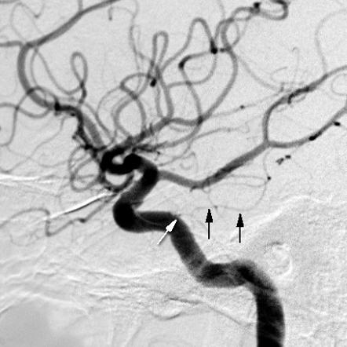

Slide 13
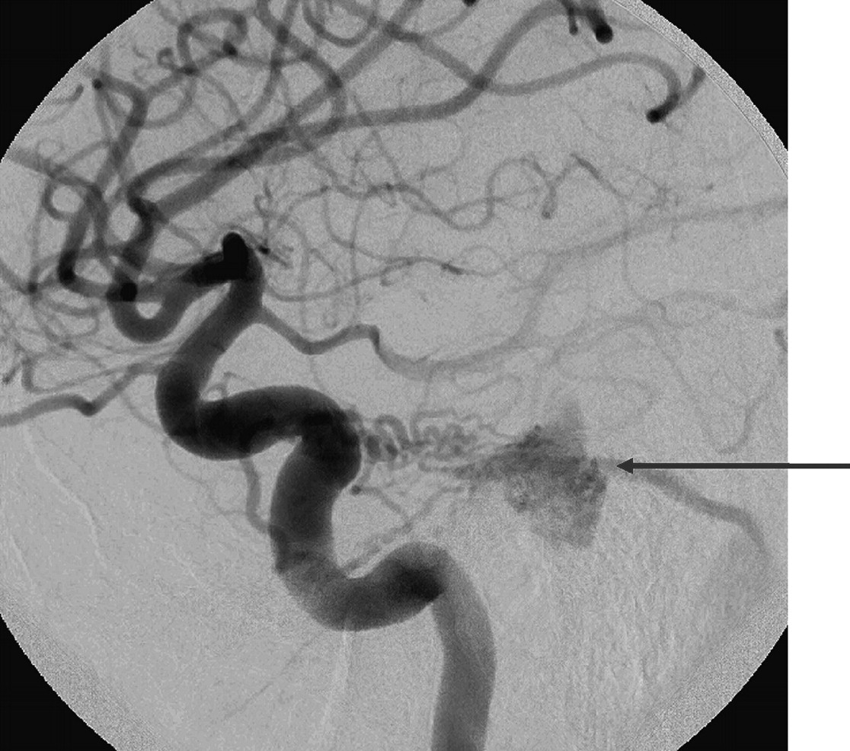

Slide 14
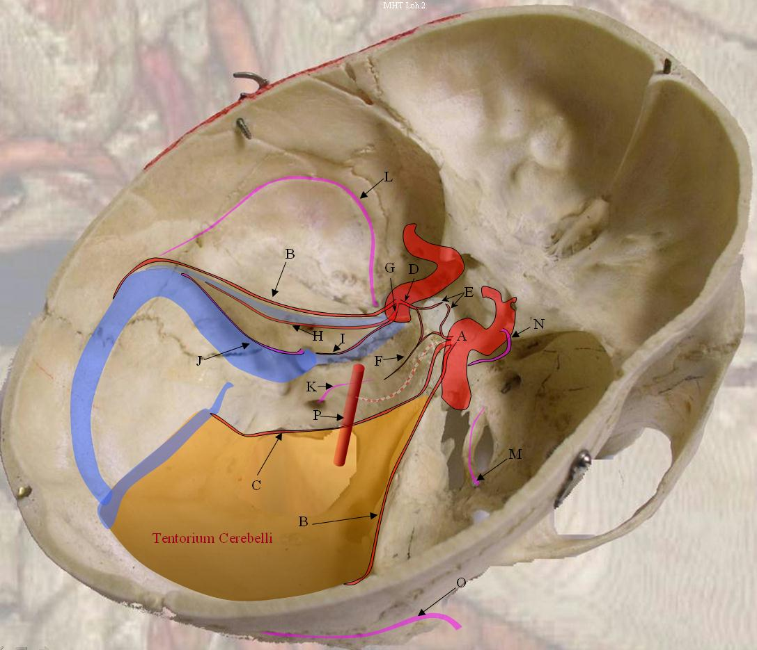

Slide 15
4. Which of the following is the most common of the persistent anastomoses?
A. cervical intersegmental artery
B. proatlantal intersegmental artery
C. primitive hypoglossal artery
D. primitive otic artery
E. primitive trigeminal artery

Slide 16
E. Persistent trigeminal artery

Slide 17
Which of the following connects the petrous ICA to basilar artery?
A. cervical intersegmental artery
B. proatlantal intersegmental artery
C. primitive hypoglossal artery
D. primitive otic artery
E. primitive trigeminal artery

Slide 18
D. Primitive otic artery

Slide 19
6. Which of the following connects the proximal cavernous ICA to the basilar artery?
A. cervical intersegmental artery
B. proatlantal intersegmental artery
C. primitive hypoglossal artery
D. primitive otic artery
E. primitive trigeminal artery

Slide 20
E. Persistent trigeminal artery

Slide 22
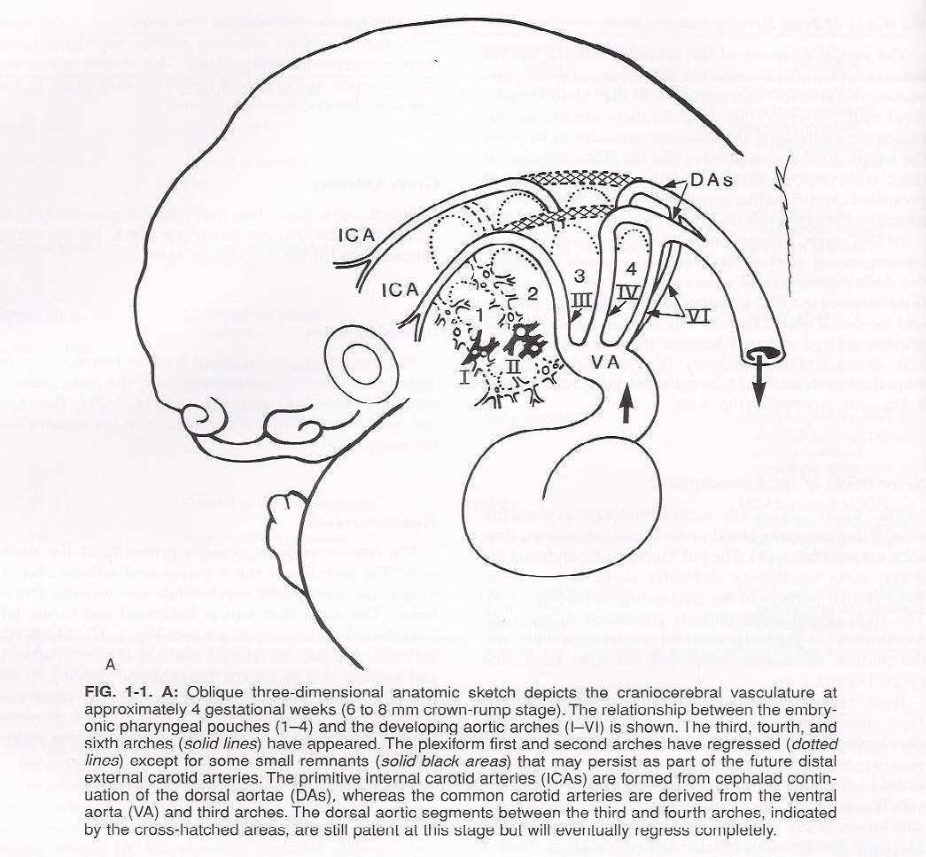

Slide 41
7. The precentral cerebellar vein usually drains into the:
A. internal cerebral vein
B. lateral mesencephalic vein
C. posterior mesencephalic vein
D. straight sinus
E. vein of Galen

Slide 44
E. Vein of Galen
The precentral cerebellar vein is a midline vessel that courses medially over the brachium pontis, parallels the roof of the fourth ventricle, and curves upward behind the inferior colliculus and precentral lobule of the vermis to drain into the vein of Galen

Slide 45
8. Anterior temporal lobe masses characteristically displace the
A. anterior choroidal artery laterally
B. anterior choroidal artery medially
C. anterior choroidal artery upward
D. posterior choroidal artery downward
E. posterior choroidal artery upward

Slide 46
B. Anterior choroidal artery medially

Slide 52
36 year old female presents with 2 weeks of HA and new onset seizures. Contrasted T1 MRI reveals the following. Pt started on AED and referred to you. What is the next most appropriate step in this patient’s management?
Stereotactic radiosurgery
Cerebral angiogram
Evaluate gradient echo MRI sequence
Surgical resection

Slide 53
C. Evaluate gradient echo MRI sequence
10-30% of venous angiomas have an associated cavernous malformation

Slide 54
Venous angioma or developmental venous anomaly
“Medusa-like” collection of dilated medullary veins near the angle of a cerebral ventricle seen best on contrasted T1 MRI
Non-hereditary congenital anomaly, incidence may be as high as 2% of general population, usually solitary, multiple in blue rubber nevus syndrome
Typically asymptomatic, may be associated with seizures, may cause HA when thrombosed
Hemorrhage has been reported but very rare
Drain normal brain parenchyma. Surgery does not improve symptoms, and can cause venous infarcts
10-30% have an associated cavernous malformation

Slide 55
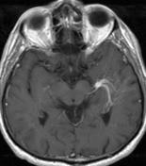
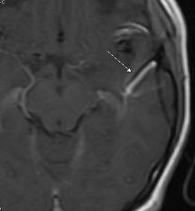
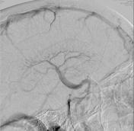
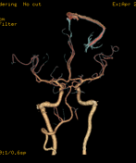
Venous angioma

Slide 56
Venous angioma--pathology
Compensatory dilatation of venous channels secondary to hypoplasia of the regional venous circulation.
Variably dilated venous structures separated by normal white matter. There is no microscopic evidence of recent or old bleeding.

Slide 57
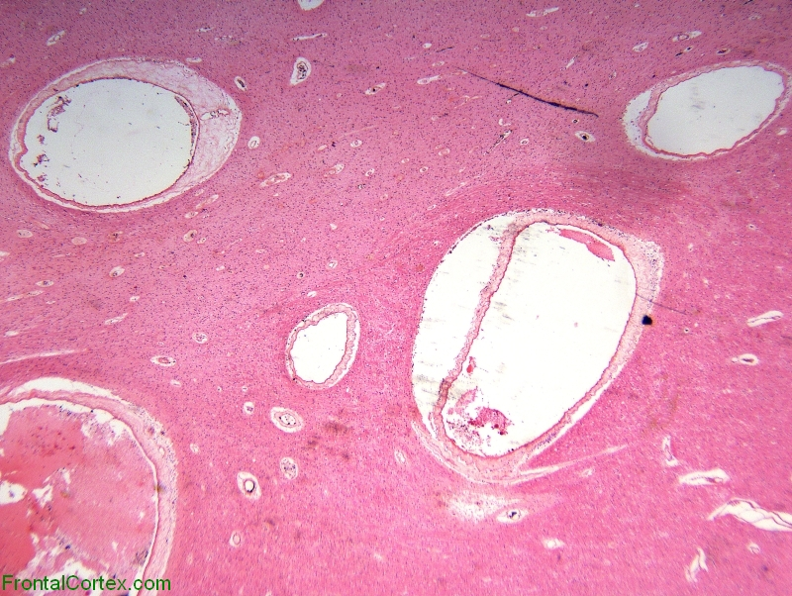
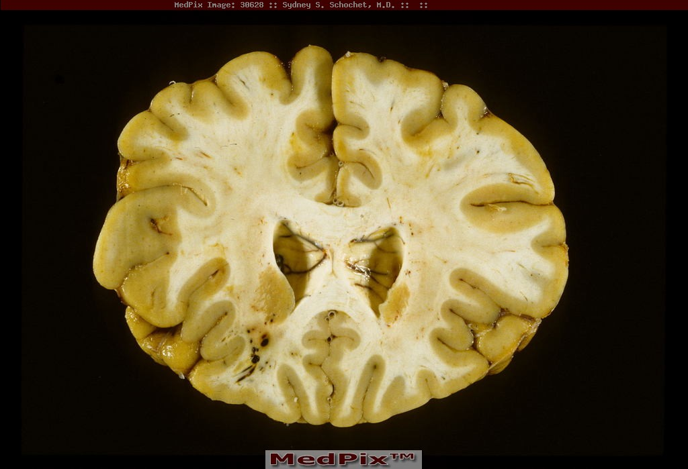
Venous angioma

Slide 58
Cavernous malformation
Aka cavernoma, cavernous angioma, cavernous hemangioma, CCM
Typically sporadic, but familial forms exist (5%), associated with chromosome 7 in some Mexican populations
Many are asymptomatic. Can present with seizures, HA, progressive neurologic deficit, hemorrhage
0.5% per year rate of hemorrhage for sporadic cases, 1% for familial
“Popcorn” appearance on GRE MRI sequence with hypointense hemosiderin rim, sometimes contrast enhancing on T1 sequence
Appearance on CT, T1 MRI and T2 MRI depends on acuity of hemorrhage
Do not show up on angiogram
Histologically cavernous malformations are composed of a "mulberry-like" cluster of dilated thin-walled capillaries, with surrounding hemosiderin, no feeding artery

Slide 59
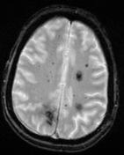
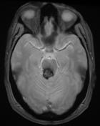
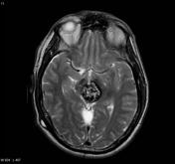
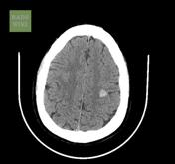
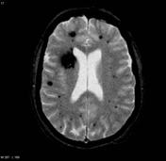
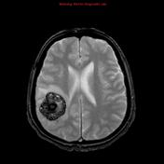

Slide 60
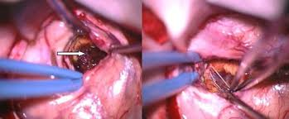
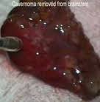
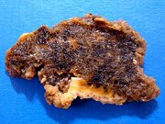

Slide 61
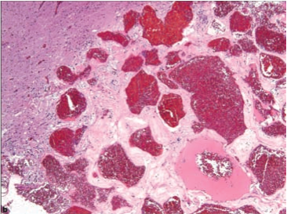
Cavernous malformation
Classically described as a tightly packed array of ectatic vessels with variable hyalinization of the walls. Often surrounded by abundant old hemorrhage and reactive gliosis.

Slide 62
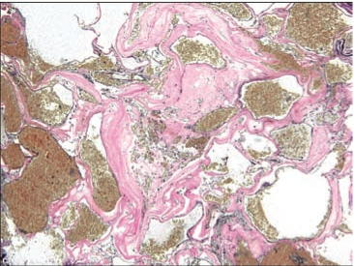
Cavernous malformation
Lack of arterial component as evidenced by this EVG stain helps to distinguish from AVM

Slide 63
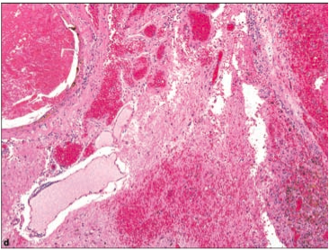
Cavernous malformation
They usually lack intervening brain tissue between abnormal blood vessels, however, exceptions exist.

Slide 64
Acute SAH is more difficult to diagnose on MRI than on CT because….
Extracellular methemoglobin is isointense on T1 and T2
Hemosiderin is isointense on T1 and T2
Most radiologists are not familiar with the appearance of acute SAH on MRI
The high oxygen tension in the SA space prevents conversion of oxyhemoglobin to deoxyhemoglobin
The low oxygen tension in the SA space prevents the conversion of deoxyhemoglobin to oxyhemoglobin

Slide 65
Answer
D. The high oxygen tension in the SA space prevents conversion of oxyhemoglobin to deoxyhemoglobin

Slide 66
Evolution of hemorrhage on MRI
Hyperacute stage (4-6 hours after hemorrhage)
Hemostatic plug is formed and RBCs become spherocytes, oxyhemoglobin present
T1—isointense to parenchyma with mild edema around clot
T2—hyperintense to parenchyma with mild edema

Slide 67
Hyperacute hemorrhage

Slide 68
Evolution of Hemorrhage on MRI
Acute stage (7-72 hours)
Clot retraction, RBCs degenerate into echinocytes, oxyhemoglobin converts to deoxyhemoglobin, significant edema
T1—isointense
T2—hypointense

Slide 69
Acute hemorrhage

Slide 70
Evolution of Hemorrhage on MRI
Early subacute phase (4-7 days)
RBCs lose spicules and degenerate into tiny spherocytes, intracellular deoxyhemoglobin converts to methemoglobin (from periphery of clot to core), significant edema
T1—isointense with hyperintense ring
T2—hypointense

Slide 71
Early subacute hemorrage

Slide 72
Evolution of Hemorrhage on MRI
Late subacute phase (1-4 weeks)
RBC lysis occurs, extracellular methemoglobin, edema diminishes neovascular proliferation occurs and reactive inflammatory changes occur around hematoma, no BBB around clot
T1—hyperintense
T2—hyperintense

Slide 73
Late subacute hemorrhage

Slide 74
Evolution of hemorrhage on MRI
Early chronic stage (weeks to months)
Cavity shrinks, inflammatory changes diminish, edema resolves, clot wall contains macrophages loaded with ferritin and hemosiderin
T1-hyperintense with iso to hypointense ring
T2-hyperintense with hypointense ring

Slide 75
Early chronic hemorrhage

Slide 76
Evolution of hemorrhage on MRI
Late chronic stage (months to years)
Fibrotic scar containing macrophages with iron storage products
T1—hypointense
T2—hypointense

Slide 77
Late chronic hemorrhage

Slide 78
Evolution of Hemorrhage on MRI
Stage Iron product T1 T2
Hyperacute oxyhemoglobin isointense hyperintense
(4-6 hrs)
Acute deoxyhemoglobin isointense hypointense
(7-72 hrs)
Early subacute intracellular methemoglobin isointense with hyper ring hypointense
(4-7 days)
Late subacute extracellular methemoglobin hyperintense hyperintense
(1-4 weeks)
Early chronic methemoglobin, ferritin/hemosiderin hyperintense with hyperintense
(weeks to months) in macrophages iso to hypo ring with hypo ring
Late chronic ferritin/hemosiderin
(months to years) in macrophages hypointense hypointense

Slide 79
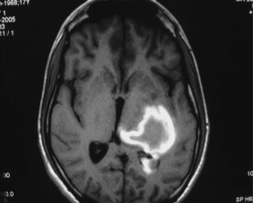
What is the approximate age of the hematoma depicted on this nonenhanced axial T1 MRI?
Hyperacute
Acute
Early subacute
Late subacute
Chronic

Slide 80
Answer
C. Early subacute

Slide 81
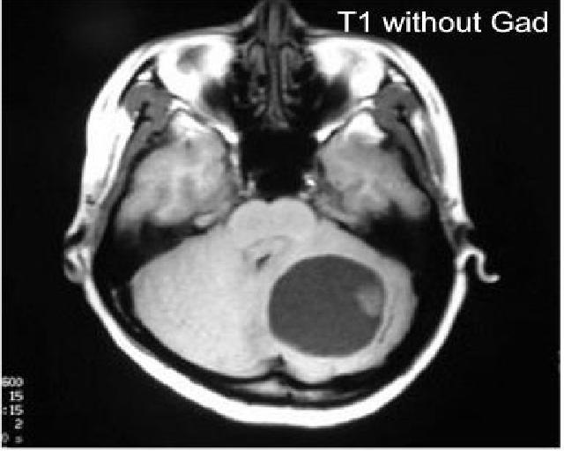
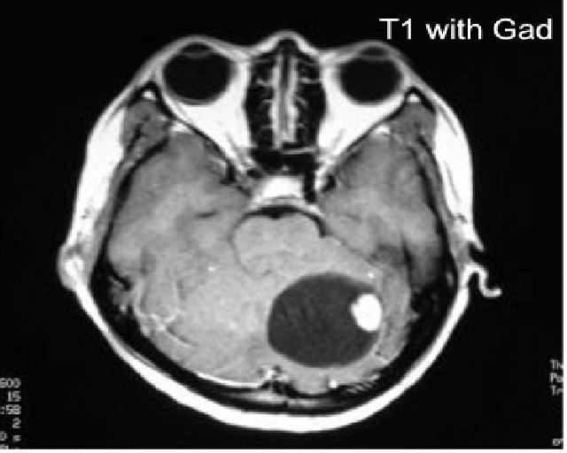
29 year old male with family history of brain tumors presents with HA, coordination difficulty, and problems with walking. He has the following MRI. Also of note his H/H is 16/62. Which of the following abnormalities is NOT likely related to his diagnosis?
A. Renal mass seen on CT abdomen
B. Occasional surges in blood pressure
C. Lung AVMs
D. Retinal tumor

Slide 82
C. Lung AVMs

Slide 83
Von Hippel-Lindau disease
Autosomal dominant mutation of VHL tumor suppressor gene on chromosome 3, inadequate regulation of VEGF, PDGF, TGFs
CNS Hemangioblastomas (60% of cases): cerebellum 65%, brainstem 20%, spinal cord 15%,
Retinal hemangioblastomas (50% of cases)
Renal cell carcinoma (30% of cases)
Pheochromocytomas (10% of cases)
Endolymphatic sac tumors
Epididymal cystadenoma
Erythropoeitin production can result in polycythemia vera
Diagnosis—multiple CNS hemangioblastomas or one CNS hemangioblastoma + one visceral lesion + one first order relative with VHL disease.

Slide 84
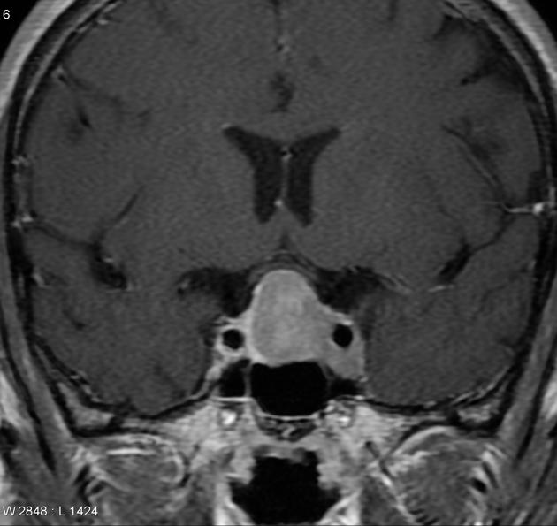
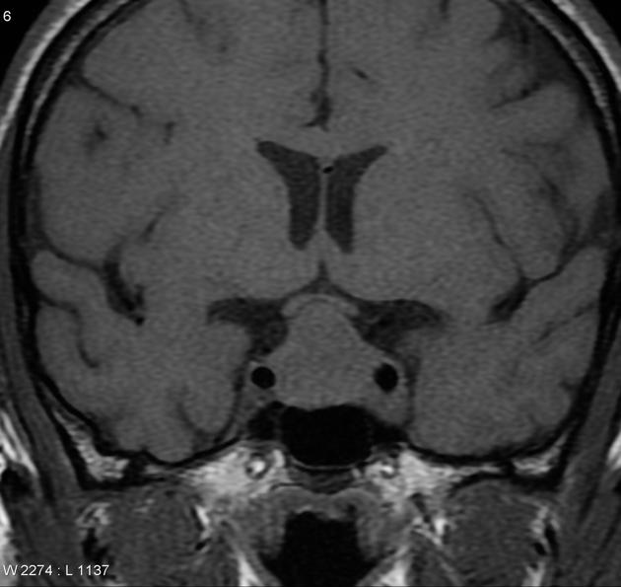
59 year old male presents with progressive visual loss. PMHx reveals kidney stones and multiple peptic ulcers. Labs show Ca=13. MRI below. Most likely diagnosis? A. meningioma, b. craniopharyngioma, c. MEN type 1
d. MEN type 2

Slide 86
C. MEN type 1

Slide 87
Multiple Endocrine Neoplasia type 1 (Wermer syndrome)
Pituitary, pancreatic, parathyroid tumors
Typically pituitary adenomas (prolactinoma 30%, non-functional 26%, GH secreting 13%, ACTH secreting 10%, FSH/LH secreting 9%, TSH secreting 1%)
Pancreatic tumors:
Islet cell tumors (60% of MEN 1 pt) secretory
Beta cell or insulinoma (40% of islet cell tumors) cause hypoglycemia
Non-beta cell (60%)
Gastrinoma—increased gastric acid, ZE syndrome (refractory PUD diarrhea/steatorrhea)
Glucagonoma--hyperglycemia
VIPoma—severe secretory diarrhea, hypokalemia
Parathyroid—diffuse hyperplasia, mulitple adenomas, solitary adenoma
Hyperparathyroidism: hypercalcemia, osteoporosis, nephrolithiasis, high blood pressure

Slide 88
MEN
2a (Sipple synd): medullary thyroid, pheochromocytoma, parathyroid
2b: medullary thyroid, pheochromocytoma, mucocutaneous neuromas
MEN 1= PPP
MEN 2a=MPP
MEN2b=MMP

Slide 92
19 year old female presents with exophthalmos and the MRI below. There is a family history of brain tumors and “skin spots”. Which of the following chromosomes most likely contains the genetic defect?
a. 7
b. 22
c. 17
d. 3
e. 11

