Slide 1
Walid Radwan
Normal Pressure Hydrocephalus
Department of Neurosurgery LSU-HSC New Orleans

Slide 2
Learning Aims:
Understand the typical clinical and radiological features of normal-pressure hydrocephalus and how to differentiate it from other diseases in the differential diagnosis
Understand the current standards for the diagnosis and treatment of NPH
Review complications with Shunting
Review and management of Slit Ventricle Syndrome

Slide 3
History
NPH was first described by S. Hakim and Adams in 1965
Their reports were based on pneumoencephalography
Pointed out that it is often difficult to differentiate NPH from cerebral atrophy (still an issue today)
Described Classic triad of:
Dementia
Urinary incontinence
Gait disturbance

Slide 4
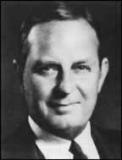
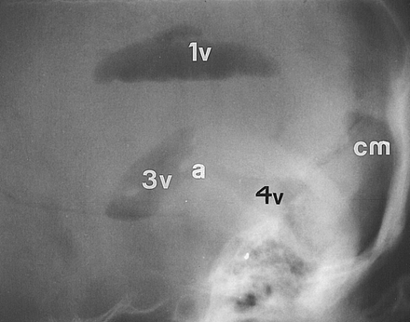
Pneumoencephalography
First introduced by Walter Dandy in 1919
Successively injecting small volumes of air via lumbar puncture and then removing small volumes of cerebrospinal fluid with the patient sitting upright and the head flexed
This method is no longer used

Slide 5
Presentation
Usually > 60 years of age
Triad not pathognomonic (Vascular dementia can present same way).
Gait:
Usually first symptom to show up
Wide based gait, shuffling, unsteady on turning
Feel “glued to the floor”
Dementia:
Mostly memory problems
Bradyphrenia “slowness of thoughts”
Urinary incontinence

Slide 6
Types of NPH
Primary (idiopathic) NPH is distinguished from secondary NPH which is develops secondary to subarachnoid hemorrhage (23%), meningitis (4.5%), and traumatic brain injury (12.5%)
A common feature of iNPH and sNPH is that neither involves any obstruction to the flow of CSF within the ventricular system of the brain
iNPH primarily a disease of the elderly
sNPH can occur in all ages

Slide 7
Diagnostic Studies
No test or radiologic study is pathognomonic for NPH
CT or MRI:
Disproportionate widening of the ventricles in comparison to the cerebral sulci (inner and outer CSF spaces)
Lumbar Puncture:
Shows normal opening pressure (OP) should be < 180 mm H2O
Response to single LP or serial LP has good predictive value
Patient’s whose OP is >100 have better response to shunting
Continuous CSF pressure monitoring:
Patients with normal OP may have LP peaks of > 270 mm H2O and recurrent B-waves (amp 10-11mm Hg lasts 30s-2min)

Slide 8
Diagnostic Studies cont.
Ambulatory Lumbar Drainage:
A 5 day trial is recommended (mean time to improvement: 3 days)
Send CSF cell count and culture daily
CT and MRI:
Communicating hydrocephalus
Findings that correlate with good response:
Transependymal flow (may resolve with shunting)
Compression of convexity sulci
Rounding of the frontal horns

Slide 9
Diagnostic Studies cont.
Other imaging modalities to assess cerebral blood flow and metabolism or of CSF dynamics (PET, SPECT, scintigraphy, CSF biomarkers, and newer functional MRI techniques) so far play no role in routine clinical evaluation

Slide 10
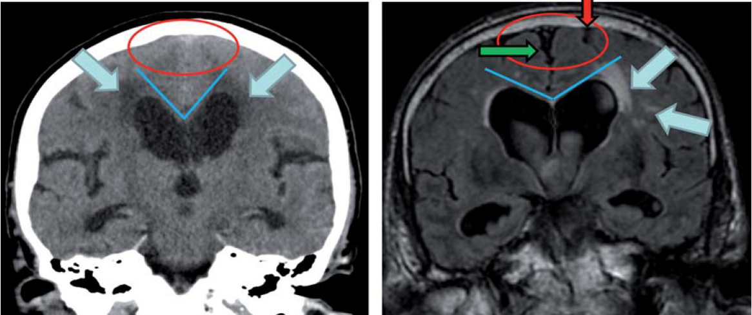
Tight convexity (red circle) typical findings of NPH.
Callosal angle (blue line); an angle less than 90° is typical of NPH (right image).
Symmetrical transependymal flow (blue arrows) suggests NPH.
The convexity near the vertex (red arrow) and the medial cisterns (green arrow) are widened, a finding consistent with brain atrophy.
Callosal angle (blue line); angle greater than 90° is typical of brain atrophy.

Slide 11
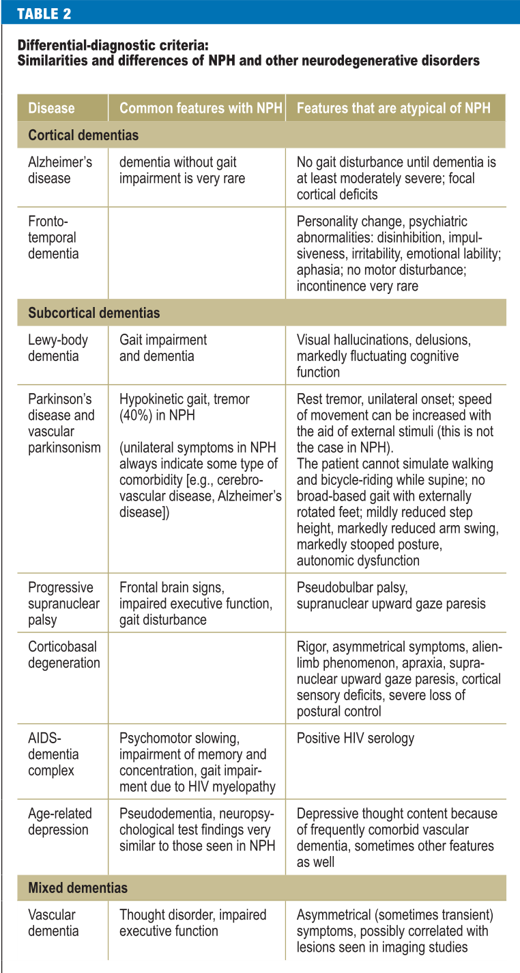
75% of patients with NPH also have Alzheimer's or Vascular dementia
Findings that make NPH less likely:
• Asymmetrical findings
• Cortical deficits, e.g., aphasia, apraxia,
paresis
• Progressive dementia without gait
disturbance
• Lack of progression of symptoms

Slide 12
Treatment
The standard treatment of NPH is the implantation of a Ventriculoperitoneal (VP) Shunt
Lumbar-peritoneal shunts have been used, but they tend to overshunt
Medium pressure valve (closing pressure 65­-90 mm H20) to minimize the risk of subdural hematomas
Fol­low patients clinically and with CT for 6-12 months

Slide 13
Complications
35 % of VP shunts are associated with complications

Slide 14
Complications: Shunt Malfunction
Most common complication 40% of procedures
Most commonly caused by simple obstruction:
Debris, fibrosis, parenchymal occlusion of catheter, choroid plexus obstruction of the proximal catheter (first 2 years after placement in general)

Slide 15
Signs and Symptoms of Malfunctioning Shunt
Headache
Irritability
Seizures
Vomitting
Lethargy
Gait problems, ataxia
Neck pain, back pain
Papilledema
Blurred vision
Blurred vision
Behavioral changes
Sun setting eyes (infants and young children)
Field cut
Blindness

Slide 16
Complications: Obstruction of peritoneal catheter
May be more likely with distal slit openings ("slit valves") due to oc­clusion by omentum or by trapping debris from the shunt system
By peritoneal cyst (or pseudocyst):
Usually seen with infection, may also be due to reaction to talc from surgical gloves.
Could be urine from rupture of overdisented bladder in patients with neurogenic bladder
Fluid can be aspirated percutaneously and analyzed for BUN and creatinine (which should be absent in CSF)
Severe peritoneal adhesions which decrease surface area for CSF resorption
Malposition of catheter tip: at time of surgery: e.g. in preperitoneal

Slide 17
Complications: Infection
Second most common complication 2-30% of procedures
Increased risk in children under 1 year of age
Most common organisms:
Coagulase-negative Staph species (Staph epidermidis)
Staph aureus
Enterococcus
E. coli
Pseudomonas

Slide 18
Signs and Symptoms Infected Shunt
Shunt malfunction
Fever, erythema, cellulitis, wound infection around shunt
Nausea, Vomiting
Lethargy, Irritability
Headache
Abdominal pain
Diarrhea
Peritonitis
Feeding problems (young ones)

Slide 19
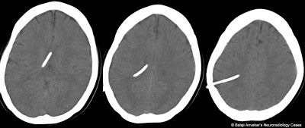
Slit Ventricles
Totally collapsed lateral ventricles seen on CT of 3-80% of patients after shunting
Most asymptomatic
Slit Ventricle Syndrome:
Overdrainage of CSF leads to collapse of ventricles, blocking fenestrations in proximal catheter, leading to increased ICP
Found in less than 12%
Intermittent headaches unrelated to posture, often with NN, drowsiness, irritability and impaired mentation
Signs may include 6th cranial nerve palsy.

Slide 20
Slit Ventricles Treatment
Asymptomatic:
Prophylactic upgrading to a higher pressure valve or insertion of an antisiphon de­vice has largely been abandoned.
Slit ventricle syndrome:
If total shunt malfunction is the cause, then shunt revision is indicated.
For inter­mittent occlusion, treatment options include:
1.If symptoms occur early initial expectant man­agement, most spontaneously resolve
2. revision of the proximal shunt. This may be difficult due to the small size of the ventricles. Attempt to follow existing tract and place longer tubing or leave old catheter in place and insert new shunt
3. patients may "respond" to either of the following interventions because the slight ventricular enlargement elevates the ependyma off of the inlet ports:
4. Subtemporal decompression". sometimes with dural incision". This results in dilatation of the temporal horns
5. Third ventriculostomy

Slide 21
Complications: Other
Subdural hematomas or hygroma:
Higher risk with low pres­sure valve and older patients
Usually accom­panied by headache, most resolve spontaneously or remain stable
One third require evacuation and tying off of shunt
Risk may be reduced by gradual mobilization post-op
Shunt infection
Intraparenchymal hemorrbage in the brain
Seizures
Delayed complications include: shunt obstruction or disconnection

Slide 22
Radiographic studies
Shunt series:
Plain radiographs of skull, neck, chest, abdomen
Used to detect disconnections, kinks, and migration of catheters – Proximal and distal catheters are radiopaque, reservoirs are radiolucent
Head CT
Demonstrates location of proximal catheter tip and size of ventricles
Comparison to prior study is critical
Radionucleotide clearance study
Radionucleotide is injected into shunt reservoir and observed as it
Flows proximally and distally
Ultrasound
For children with open fontanel

Slide 23
Further Diagnostic Studies
Pumping the shunt reservoir
Assesses proximal and distal shunt function
Tapping the shunt
Assess shunt function and diagnoses shunt infection

Slide 24
Outcomes
Symptoms usually improve in this order incontinence, then gait dis­turbance, and lastly dementia
Predictors for good outcome:
Clinical: presence of the classic triad
Also 77% of patients with gait disturbance as the primary symptom improved with shunting
Patients with dementia and NO gait disturbance rarely respond to shunting
LP: OP > 100 mm H20
Isotope cisternogram: typical NPH pattern
Continuous CSF pressure recording: pressure> 180 mm H20 or frequent Lund­berg B waves
CT or MRI: large ventricles with flattened sulci
Symptoms have been present for short period of time

Slide 25
Patients with suspected co-existing Alzheimer's disease (AD) may still improve with VP shunts, thus AD should not exclude these patients from shunting
Some responders may subsequently deteriorate. Shunt malfunction and subdural, collections must be ruled out before ascribing this to the natural course of the condition

Slide 26
Question 1
What are the cardinal symptoms of idiopathic normal pressure hydrocephalus (iNPH)?
a) Apathy, tremor, and rigidity
b) Reduced muscle tone, urinary and fecal retention, and dementia
c) Gait impairment, incontinence, and dementia
d) Gait impairment, tremor, and akinesia
e) Difficulty initiating gait, affect incontinence, organic brain syndrome

Slide 27
Question 2
What constellation of changes in imaging studies (CT, MRI) definitively establishes the diagnosis of NPH?
a) Narrow cisterns near the vertex and a callosal angle <90°
b) Enlarged insular cisterns and inner CSF spaces
c) Enlarged insular cisterns and narrow cisterns near the vertex
d) A callosal angle <90° and enlarged inner CSF spaces
e) There is no such constellation of changes

Slide 28
Question 3
What percentage of patients with iNPH also have vascular dementia or Alzheimer’s disease?
a) 15%
b) 30%
c) 45%
d) 60%
e) 75%

Slide 29
Question 4
True or False?
The lack of gait disturbance and presence of dementia makes patient less likely to benefit from shunting

Slide 30
References
The Differential Diagnosis and Treatment of Normal-Pressure Hydrocephalus Michael Kiefer, Andreas Unterberg.
Relkin N, Marmarou A, Klinge P, Bergsneider M, Black PM: Diagnosing idiopathic normal-pressure hydrocephalus. Neurosurgery 2005; 57: 4–16.
Deutsche Gesellschaft für Neurologie: Leitlinie Normal hydrocephalus. www.dgn.org/images/stories/dgn/leitlinien/LL2008/ll08kap_017.pdf.
Ishikawa M, Hashimoto M, Kuwana N, et al.: Guidelines for management of idiopathic normal pressure hydrocephalus. Neurol Med Chir (Tokyo) 2008; 48(Suppl): S1–23.
Greitz D: Radiological assessment of hydrocephalus: new theories and implications for therapy. Neurosurg Rev 2004; 27: 145–65.
Greenberg: Handbook of Neurosurgery

