Slide 1
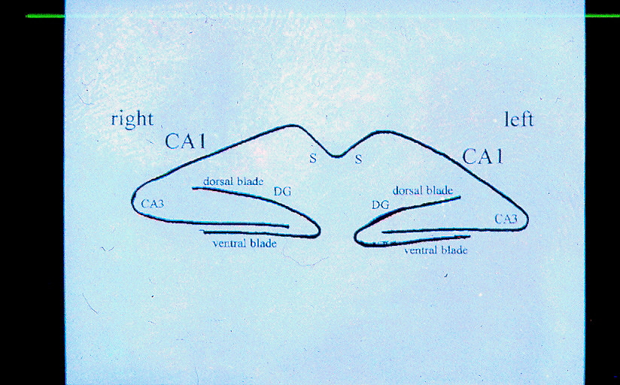


Title authors
School of
Louisiana State University Health Sciences Center, New Orleans, LA
title
__________________________
text
title
_______________________________________________
text
title
__________________________
text

