Slide 1
OSIG-Musculoskeletal Research Committee
*PLEASE SIGN IN & EAT UP*
Month day, year
Your Name
Class Name
Jacob Neary
L3 Chairman
9.25.18

Slide 2
Goals for Today
Brief overview of Orthopaedic Match Statistics
Types of Research
Access and utilization of website
Step by step guide
Accessing and choosing the project for you
Routing Form
1-year student research position

Slide 3
Academic Characteristics of Orthopaedic Surgery Residency Applicants from 2007 to 2014.
J Bone Joint Surg Am. 2016 May 4;98(9):788-95. doi: 10.2106/JBJS.15.00222. DePasse JM1, Palumbo MA1, Eberson CP1, Daniels AH1.
Number of applicants who matched in 2018 → 678

Slide 4
Mean Publications, Abstracts, & Presentations
Matched in Ortho
Matched in Other Specialties
Unmatched in Ortho

Slide 5
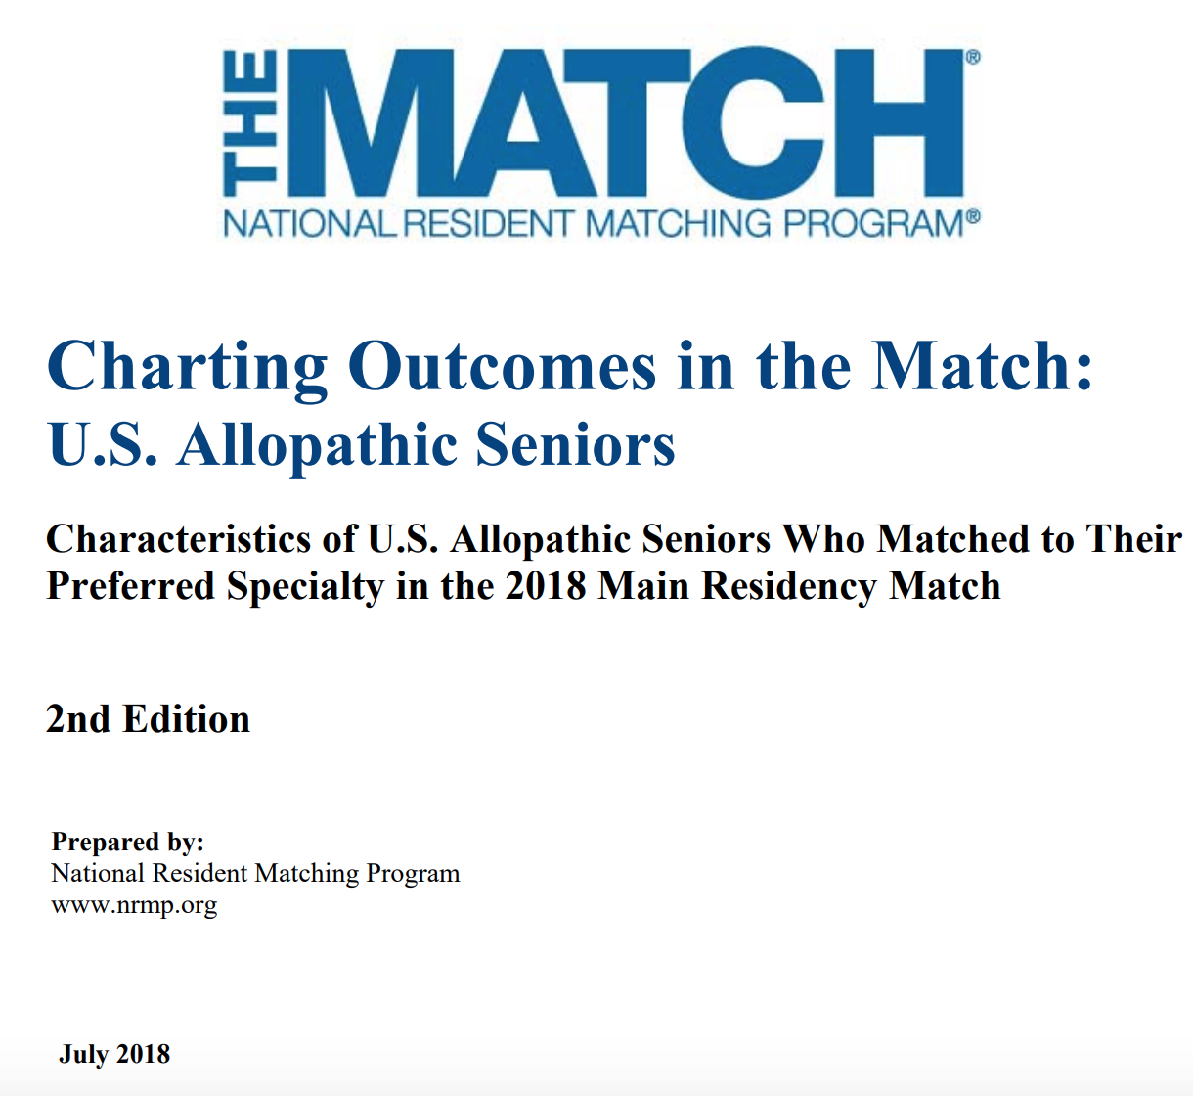

Slide 6
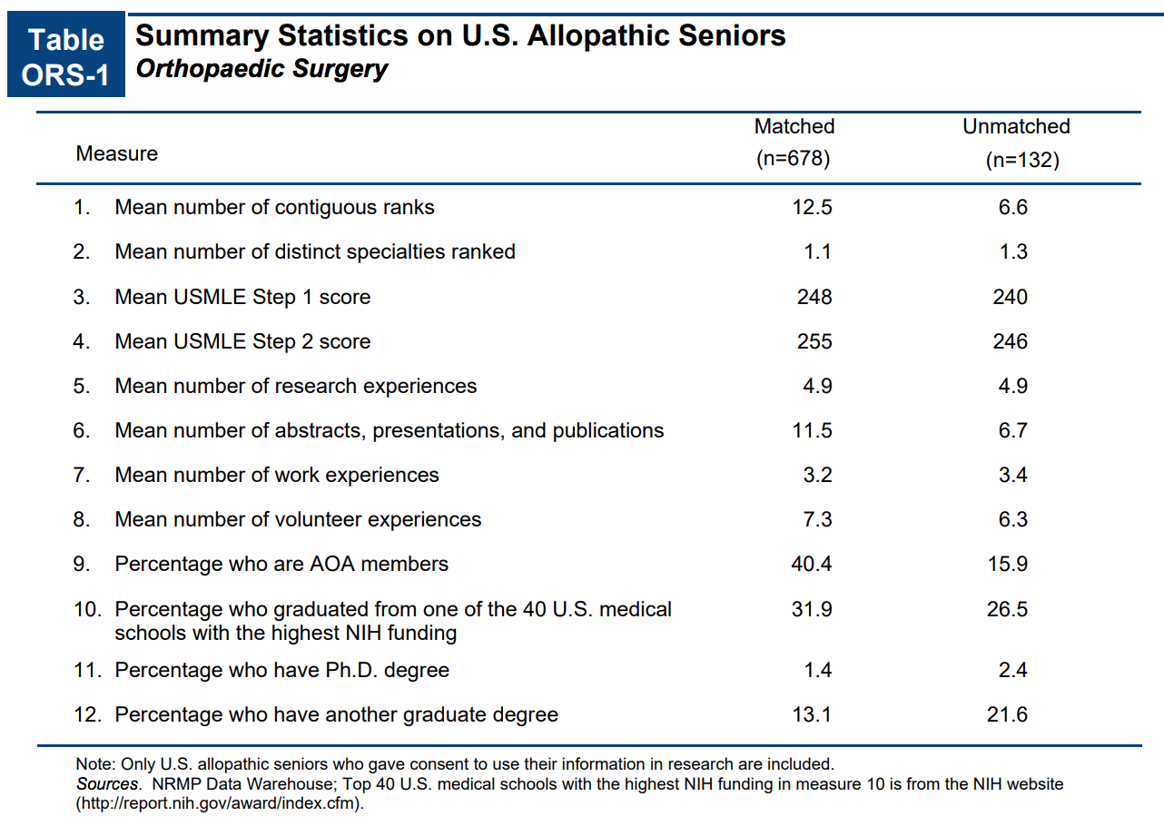
2018 Match Stats

Slide 7
Explaining the Numbers
Publications, abstracts, and presentations
Research Experiences
This number is higher because one project can lead to a couple of these.
This is the project in and of itself.

Slide 8
“Nevertheless, research experience and board examination performance (particularly USMLE Step 1) remain among the most important predictors of match success.”
Work Cited: DePasse JM1, Palumbo MA1, Eberson CP1, Daniels AH1. Academic Characteristics of Orthopaedic Surgery Residency Applicants from 2007 to 2014. J Bone Joint Surg Am. 2016 May 4;98(9):788-95. doi: 10.2106/JBJS.15.00222.

Slide 9

Common Problems to Starting Research
“Just get into research.”
Finding research through word of mouth.
Faculty and Residents not responding back to students.
Never knowing what’s available

Slide 10
Mission Statement
To provide students with the information, guidance, and faculty connections needed to choose, start, and complete research of the highest quality while maximizing medical students’ time.

Slide 11
Committee Includes
  Faculty Leader = Dr. Vinod Dasa (vdasa@lsuhsc.edu)
  Faculty Leader = Dr. Robert Zura (rzura@lsuhsc.edu)
  Committee Director = Ms. Cara Rowe (cjoh26@lsuhsc.edu)
  Statistician = Dr. Claudia Leonardi (cleon1@lsuhsc.edu)
  Writing Director = Dr. Amy Bronstone (amy@abmedcom.com)
  Committee Chair = Jacob Neary (L3)(jnear1@lsuhsc.edu)
  Senior Advisor = Hunter Starring (L4) (hstarr@lsushc.edu)
  Chair Elect = Harry Schwartzberg (L2)(hschw1@lsuhsc.edu)

Slide 12
Committee Meetings are held quarterly
Q1 - Aug. – Oct. Find/Start a study
Q2 - Nov. – Jan. Research Design/Lit Review
Q3 - Feb. – Apr. Data Collection/Analysis
Q4 - May – July How to Write Manuscript

Slide 13
Types of Medical Research
Prospective
Retrospective
Case Control
Current ongoing analysis of patients/interventions over a period of time
Takes the most time and effort (Years)
The most prestigious type
L1’s
Looking through medical charts to analyze the past.
Takes less than Prospective (≈ 1 Year)
Not as prestigious
L2’s
Reports an individual patient case or set of cases.
Takes the least amount of time
Hard to get published
Not as prestigious
L3’s

Slide 14
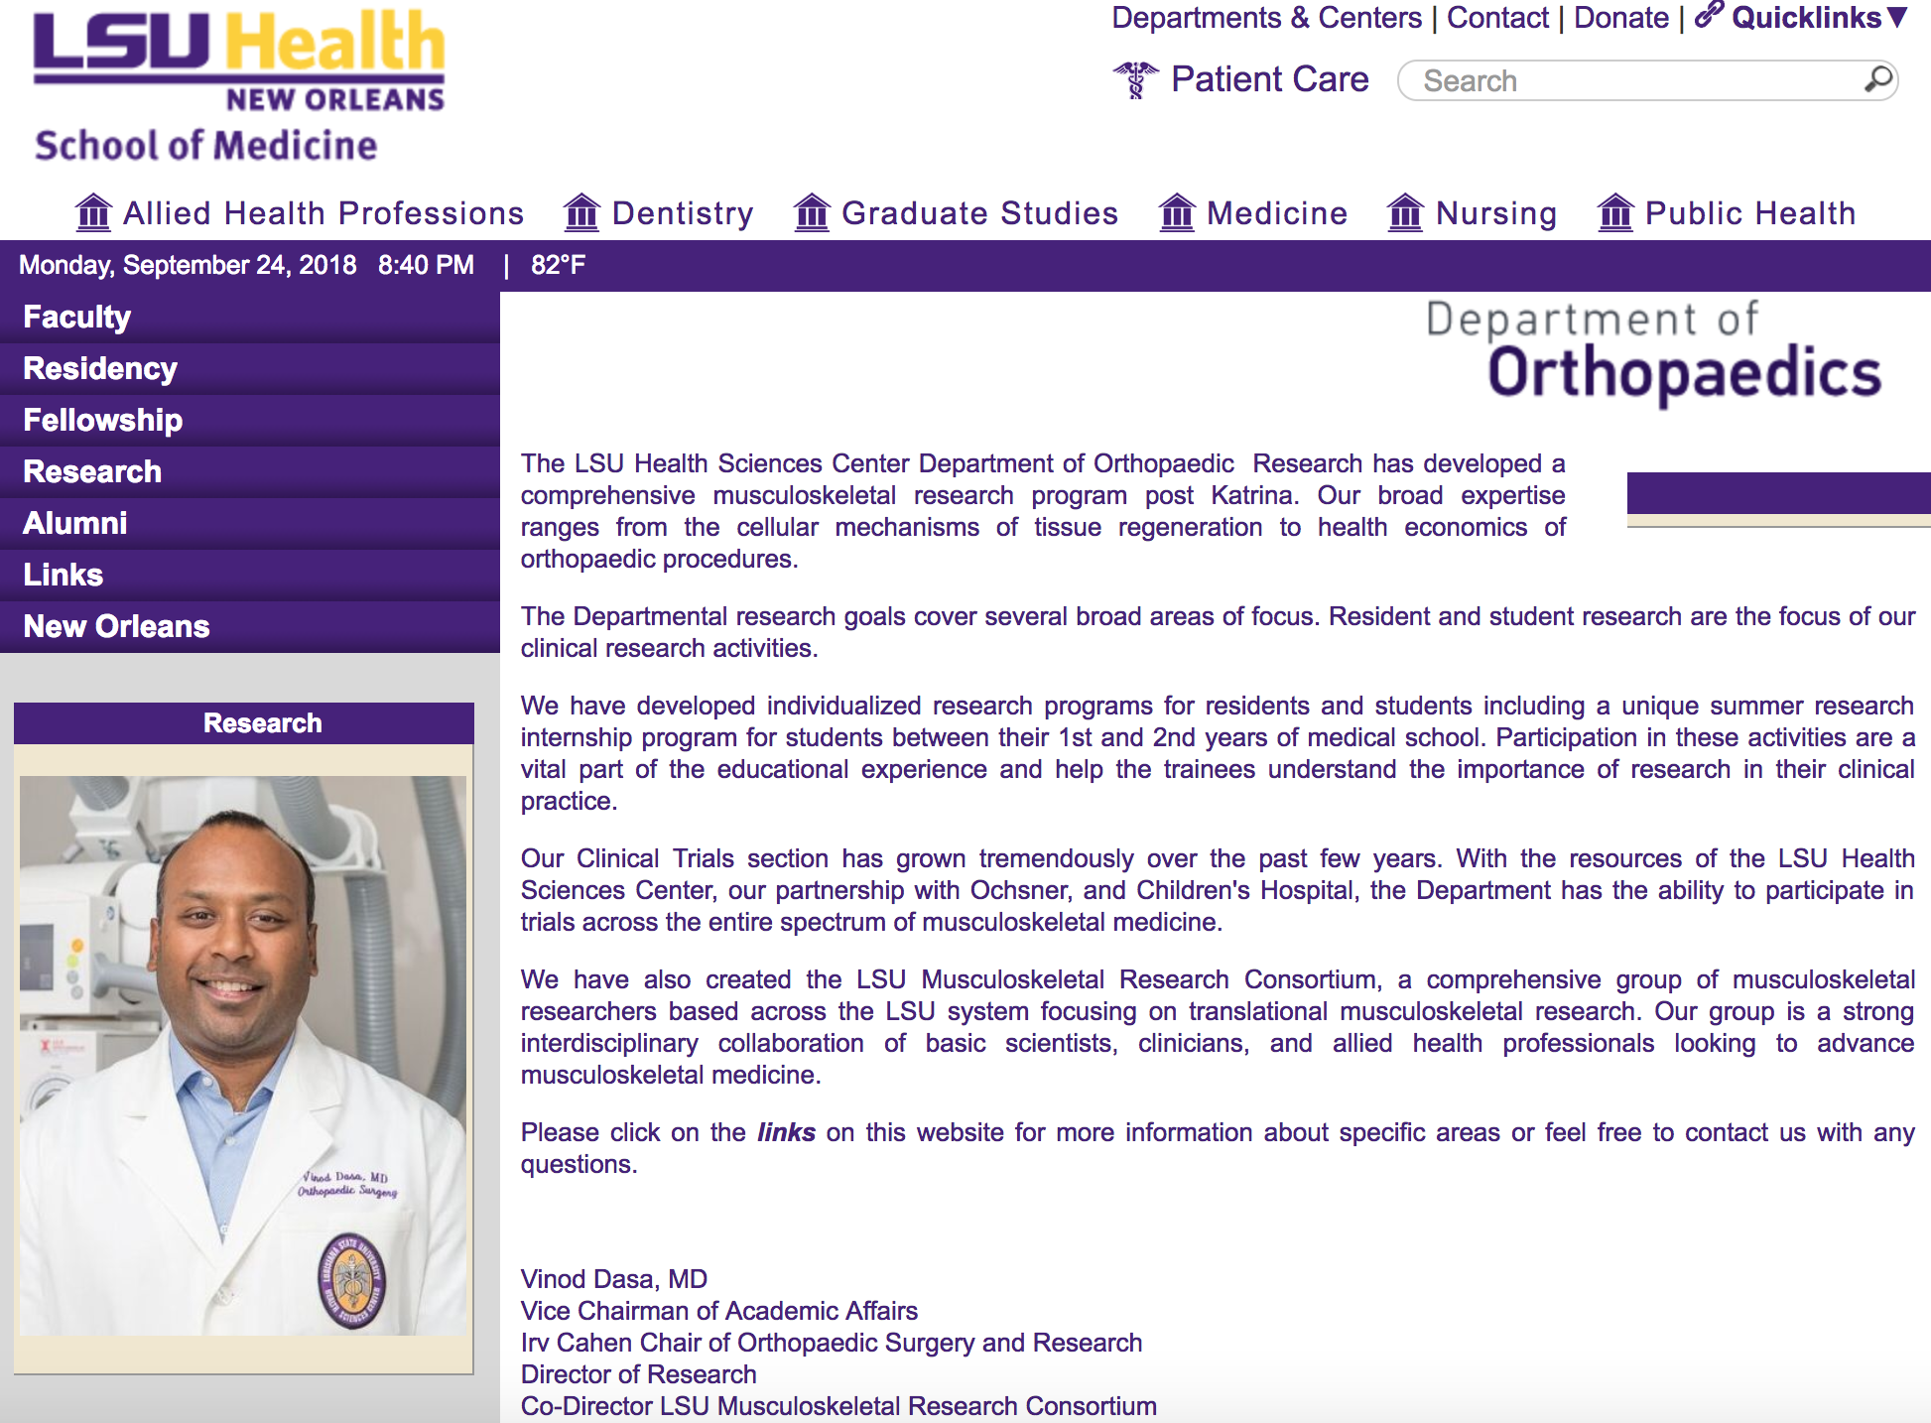
Resources
Search: LSUHSC Ortho research
Medical Students tab on LSUHSC Dept. of Orthopaedics website
  Step By Step Guide To Starting Research

Slide 15
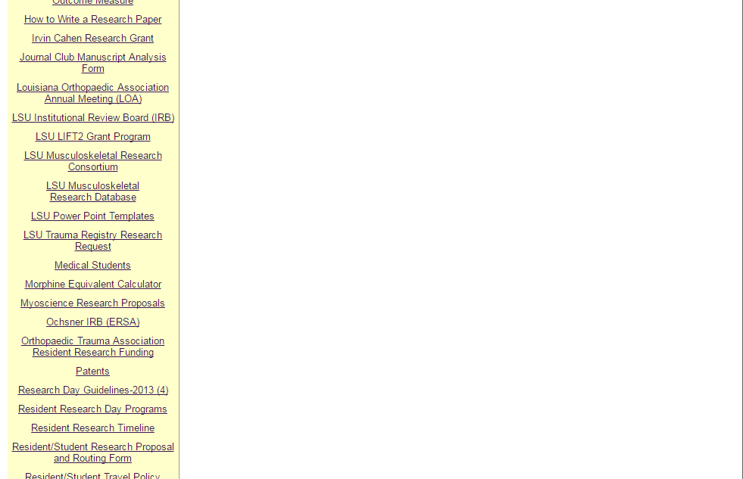
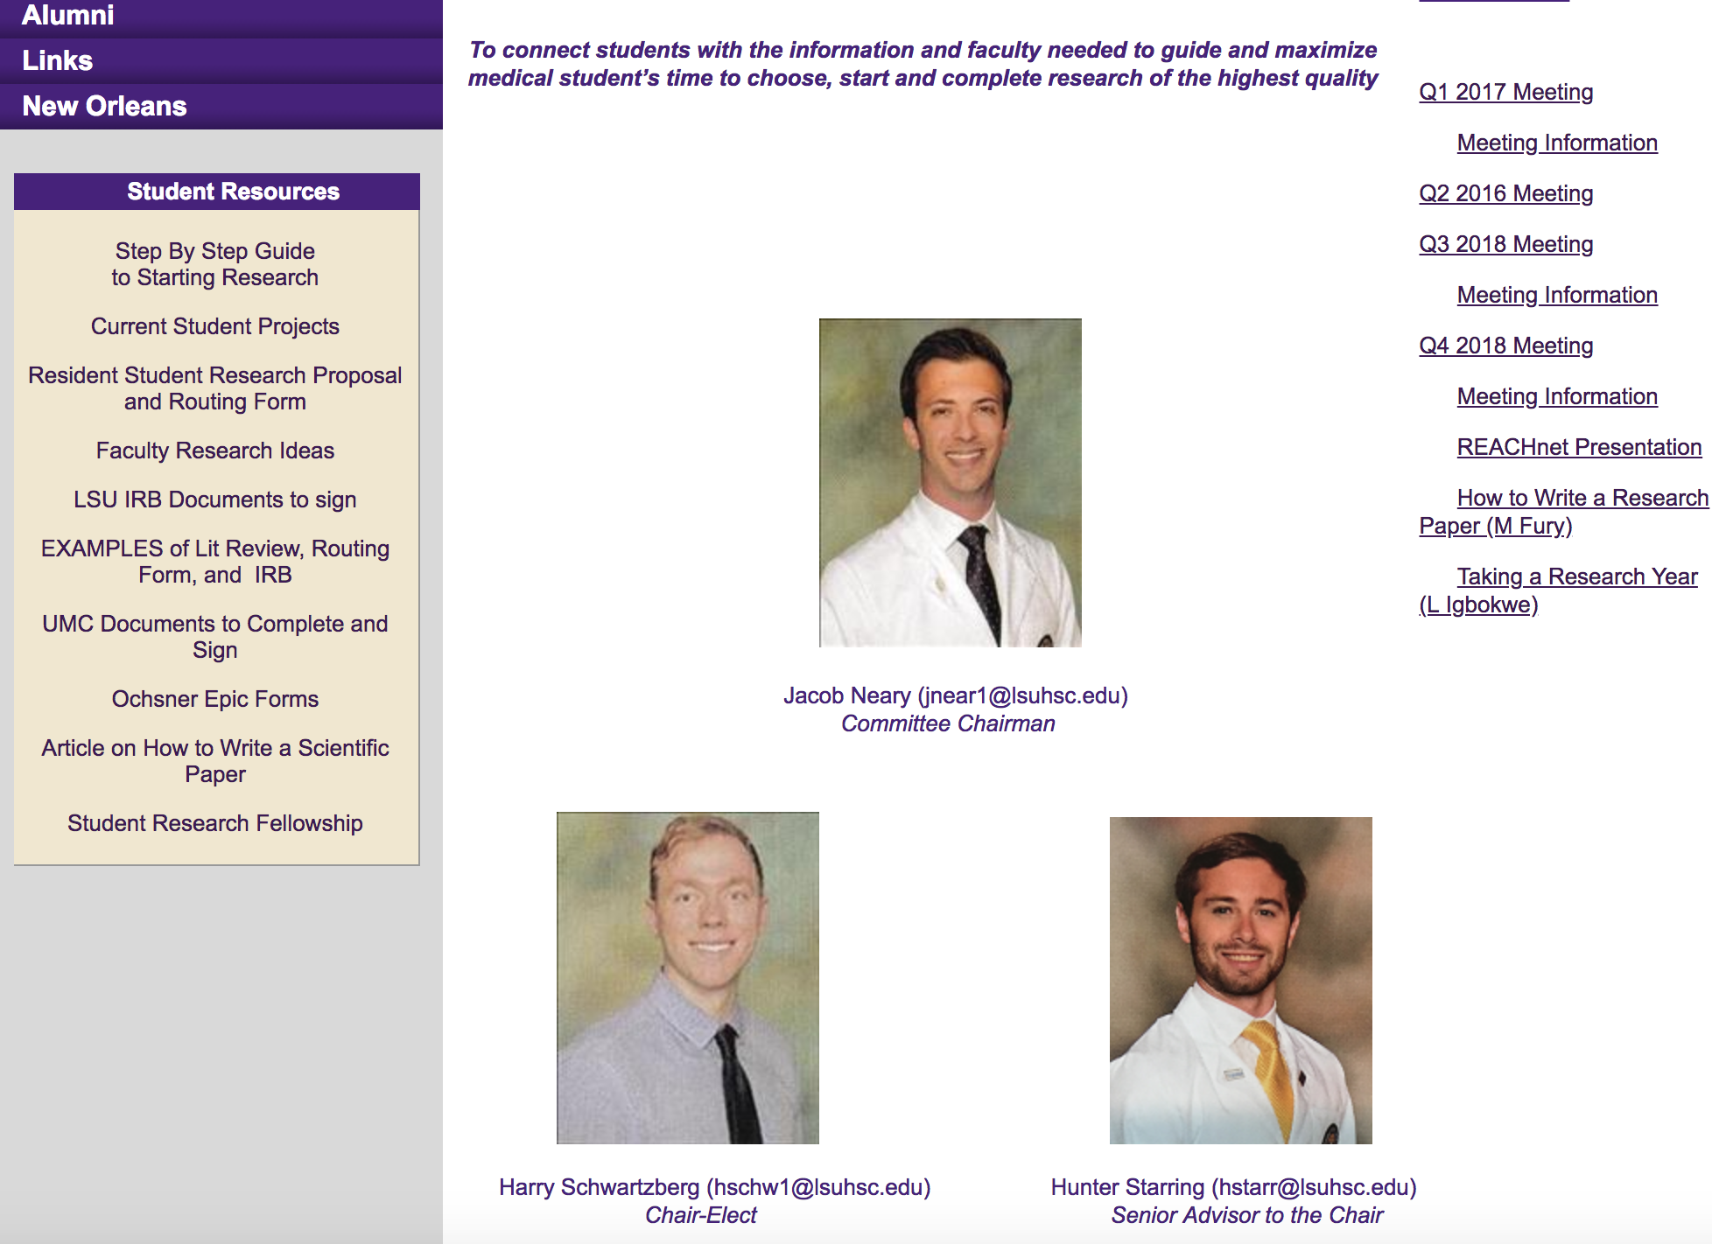
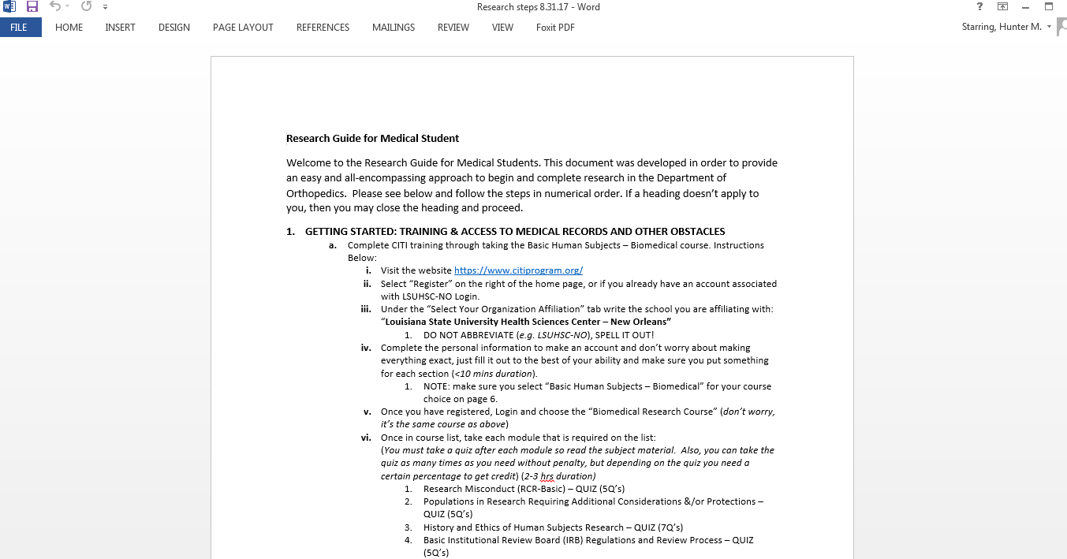

Slide 16
Resources
Medical Students tab on LSUHSC Dept. of Orthopaedics website
  Step By Step Guide To Starting Research
  Pool of project proposals

Slide 17
What happens to bone on bone patients who don't receive a TKA? | Retrospective chart review | Patients with severe bone on bone knee osteoarthritis who are candidates for TKA and do not receive one become less healthy and more costly compared to patients who receive a TKA.
How do narcotics impact outcomes in total knee arthroplasty? | Retrospective chart review | Patients with higher narcotic use will have worse Patient Reported Outcomes scores? African American, young, and male patients will have lower scores and higher narcotic use
Accuracy of xrays with measuring limb alignment in TKA? | Retrospective chart review | >75% of our x-rays will be unable to appropriately measure limb alignment using a well done x-ray on that same patient as a control
How much therapy post TKA is enough? | Retrospective chart review | After 12 sessions of therapy within 1 mo of tka using a rapid recovery protocol (APRIL 2014-PRESENT) there is
Hip injuries higher risk for OA than knee? | Retrospective chart review | Hip based fractures have higher risk of severe post traumatic oa than knee based fractures
Can heating a prosthesis be a disinfectant? | Other | heating the prosthesis in situ to a high enough temp will disrupt biofilm formation and allow for maintenance of the implant

Slide 18
Resources
Medical Students tab on LSUHSC Dept. of Orthopaedics website
  Step By Step Guide To Starting Research
  Pool of project proposals
  Routing Form and Examples

Slide 19
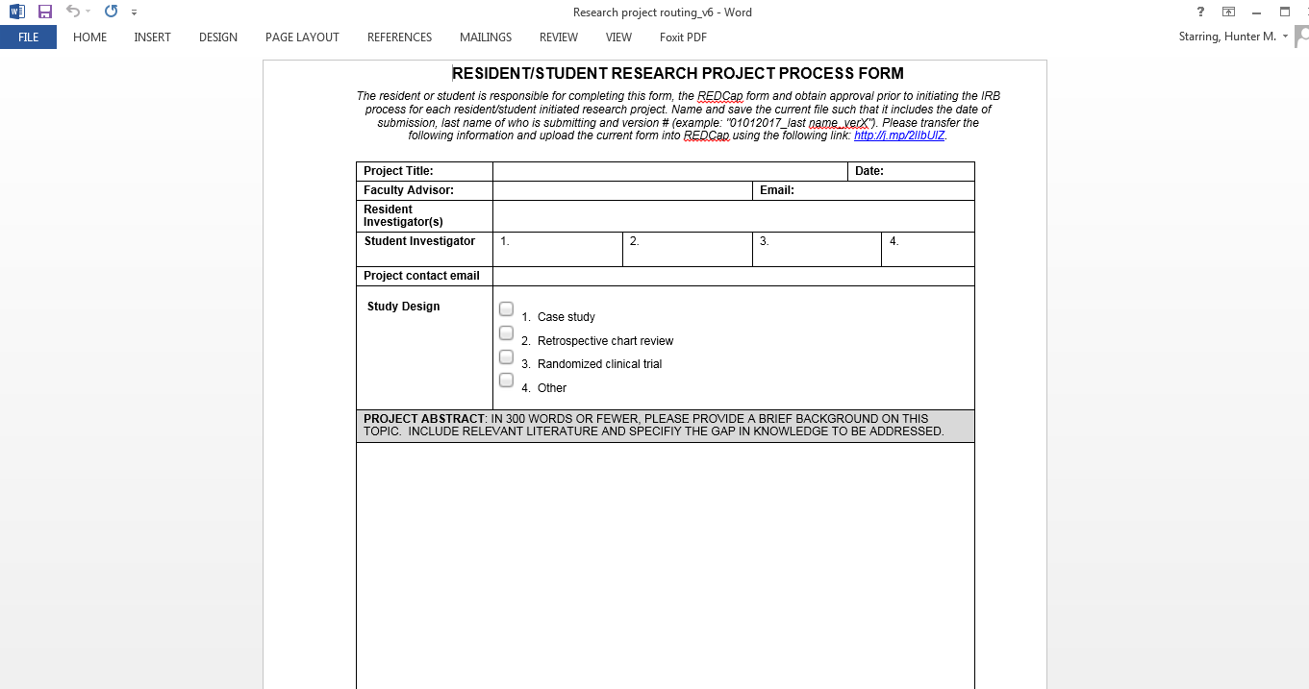

Slide 20
Routing Form REDCap Submission and Approval
REDCap is an online HIPPA approved database for research
Fill in Routing Form information into REDCap (Info in Step by Step Guide)
Approval:
  Faculty on the Study
  Dr. Dasa
  Dr. Bronstone
  Dr. Leonardi
  Ms. Rowe → IRB completion

Slide 21
1-Year Medical Student Research Position
The department has created a 1 y part time student research position to promote scholarly activity for students interested in orthopedics. This position will enable students to work with and integrate into an academic orthopedics department allowing students to engage the faculty, residents, and department researchers. The student will learn the basic principles of research design, methodology, data analysis and navigating the process from IRB submission to manuscript submission. The productivity and output from this fellowship will be based on the student’s motivation and self-initiative to make the most of this experience.

Slide 22
1-Year Medical Student Research Position
1 academic year (fall to summer) commitment
Facilitate ongoing student/resident research projects where needed
Develop and complete 2-3 independent research projects w various Orthopedic faculty using departmental processes
Attend all dept didactic/teaching sessions
Presentation of research project of choice at the dept research day
Stipend: $339/mo

Slide 23

Goals for Today
Brief overview of Orthopaedic Match Statistics
Types of Research
Show you how to access and utilize website
Step by step guide
Accessing and choosing the project for you
Routing Form
1-year student research position

Slide 25
Questions & Discussion
Jacob Neary
jnear1@lsuhsc.edu
(330) 328-6884
Harry Schwartzberg
hschw1@lsuhsc.edu
(337) 540-2128
Hunter Starring
hstarr@lsuhsc.edu
(985) 237-3009

