Slide 1
OSIG-Musculoskeletal Research Committee
*PLEASE SIGN IN & EAT UP*
Month day, year
Your Name
Class Name
Harel Schwartzberg
L3 Chairman
10-16-19

Slide 2
Goals for Today
Harry:
  What is the musculoskeletal Research committee?
  Research expectations for 1st year medical students
  Types of Research
  Access and utilization of website
    Step by step guide
    Accessing and choosing the project for you
    Routing Form
  1-year student research position
Dr. Vinod Dasa
  Why research is necessary to match in competitive residencies

Slide 3
Mission Statement
What is the MSK Research committee?
To provide students with the information, guidance, and faculty connections needed to choose, start, and complete research of the highest quality while maximizing medical students’ time.
Notes:
Basically this is a streamlined process for completing research and making you as medical students better applicants not just to orthopedic residencies but to all competitive residencies

Slide 4
Committee Includes
What is the MSK Research committee?
  Faculty Leader = Dr. Vinod Dasa (vdasa@lsuhsc.edu)
  Faculty Leader = Dr. Robert Zura (rzura@lsuhsc.edu)
  Committee Director = Ms. Collete Hilliard(chilli@lsuhsc.edu)
  Statistician = Dr. Claudia Leonardi (cleon1@lsuhsc.edu)
  Writing Director = Dr. Amy Bronstone (amy@abmedcom.com)
  Committee Chair= Harry Schwartzberg(L3)(hschw1@lsuhsc.edu)
  Senior Advisor = Jacob Neary (L4)(jnear1@lsuhsc.edu)
  Chair Elect = John Valentino (L2) (Jvale5@lsuhsc.edu)
Notes:
Main point: John is the 1st person you email for a question

Slide 5
Committee Meetings are held quarterly
What is the MSK Research committee?
Q1 - Aug. – Oct. Find/Start a study
Q2 - Nov. – Jan. Research Design/Lit Review
Q3 - Feb. – Apr. Data Collection/Analysis
Q4 - May – July How to Write Manuscript
Notes:
Disclaimer: These do not necessarily correlate with where you are in the research process, it is just a lot of information to go over so we split it up into multiple meetings.

Slide 6
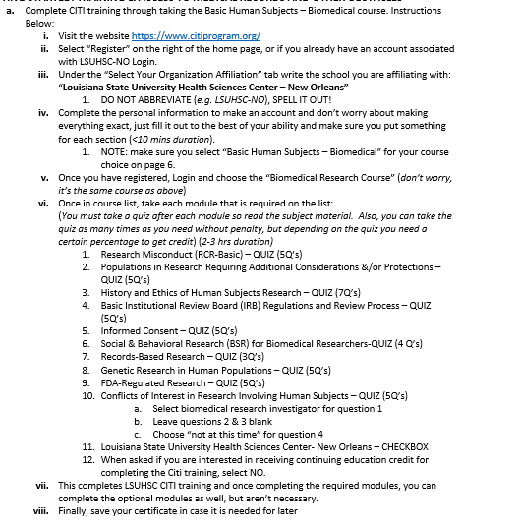
  Research expectations for 1st year medical students
1: Adjust to the increased workload of medical school
2: Citi training
Bottom Line: Do not feel like you are falling behind if you haven’t started working on a project by the end of the 1st semester.
Notes:
Citi training is an online module which you need to complete to be allowed to preform research. Make sure this is completed before meeting with a physician to discuss research b/c the first thing they will ask is “Are you citi training certified” and that answer should be yes 100% of the time. The details for completing citi training can be found on the first page of the step-by-step guide to starting research which will be sent to everyone after the meeting.

Slide 7
Types of Medical Research
Prospective
Retrospective
Case Study
Current ongoing analysis of patients/interventions over a period of time
Takes the most time and effort (Years)
The most prestigious type
L1’s
Looking through medical charts to analyze the past.
Takes less than Prospective (≈ 1 Year)
Not as prestigious
L2’s
Reports an individual patient case or set of cases.
Takes the least amount of time
Hard to get published
Not as prestigious
L3’s
Notes:
Pay attention to the highlighted areas: My recommendation to you as an L1 is to begin with a prospective and a retrospective study which is what I did.

Slide 8
Access/Utilization of Resources
Email to be sent to everyone in attendance which includes:
  This PowerPoint
  The MSK research database
  A copy of the MSK routing form
  Step by Step guide to completing research

Slide 9
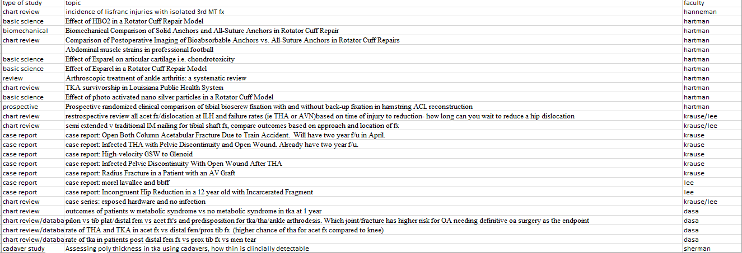
Access/Utilization of Resources: Database
Notes:
Very simple database, contains the type of study whether it be retrospective, prospective or case-study , a brief description of the project and the attending who thought of the project.
Pick something your interested in or have some background in
When you pick a project:
email john so we can update the list/Make sure no one else has that project
Schedule meeting with faculty who thought of the project.
Do some reading on the subject via Pubmed, and bring some plan on how you are going to conduct your study, DO NOT GO INTO A MEETING WITH AN ATTEDNING THINKING THEY ARE GONNA TELL YOU EVERYTHING TO DO. easiest game plan= find a similar project and present it to the attending using it as a model for your project for example: (I was preforming a project comparing knee injections and found a project from 1999 which only has white participants my study compared race so I just used al the criteria from the 1999 study for my new study and changed the ptt. population)
Meet w/ the Faculty

Slide 10
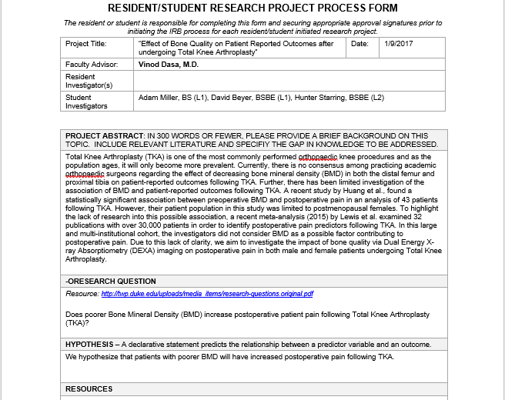
Access/Utilization of Resources: Routing form
Abstract
What are you investigating?
How is your project different from prior research on the subject?
Why is this research clinically relevant?
Notes:
The routing form is a very straightforward checkpoint which ensures that you have all the necessary elements to move forward into data gathering with your project. It is reviewed by Dr. Bronstone and Leonardi and typically sent back and forth between the students and the staff multiple times for edits before the project is approved to begin data gathering. The form is very straightforward but the most common question I get is what to put in the abstract so there are the 3 questions you need to answer in your abstract. Keep in mind to complete this form you will definitely have to do some reading on the topic you have chosen to do research on.

Slide 11
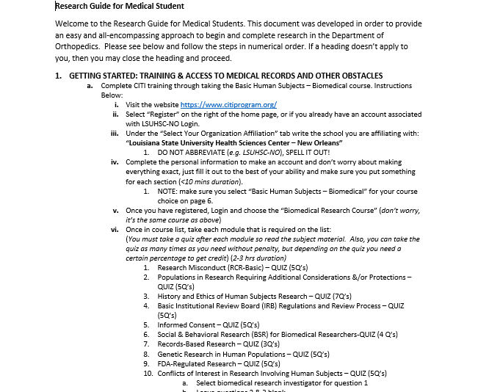
Access/Utilization of Resources: Step-by-Step guide to completing research
Extremely helpful if ever in need of instruction or are confused reference this document
Notes:
So straightforward and helpful its ridiculous

Slide 12
1-Year Medical Student Research Position
The department has created a 1 y part time student research position to promote scholarly activity for students interested in orthopedics. This position will enable students to work with and integrate into an academic orthopedics department allowing students to engage the faculty, residents, and department researchers. The student will learn the basic principles of research design, methodology, data analysis and navigating the process from IRB submission to manuscript submission. The productivity and output from this fellowship will be based on the student’s motivation and self-initiative to make the most of this experience.

Slide 13
1-Year Medical Student Research Position
1 academic year (fall to summer) commitment
Facilitate ongoing student/resident research projects where needed
Develop and complete 2-3 independent research projects w various Orthopedic faculty using departmental processes
Attend all dept didactic/teaching sessions
Presentation of research project of choice at the dept research day
Stipend: $339/mo

Slide 14
Questions & Discussion
Harry Schwartzberg
hschw1@lsuhsc.edu
(337) 540-2128
Jacob Neary
jnear1@lsuhsc.edu
(330) 328-6884
John Valentino
jvale5@lsuhsc.edu
(337)739-6560

Slide 15
Academic Characteristics of Orthopaedic Surgery Residency Applicants from 2007 to 2014.
J Bone Joint Surg Am. 2016 May 4;98(9):788-95. doi: 10.2106/JBJS.15.00222. DePasse JM1, Palumbo MA1, Eberson CP1, Daniels AH1.
Number of applicants who matched in 2018 → 678
Notes:
Number of applicants vs number matched

Slide 16
Mean Publications, Abstracts, & Presentations
Matched in Ortho
Matched in Other Specialties
Unmatched in Ortho
Notes:
More publications = better chance at matching

Slide 17
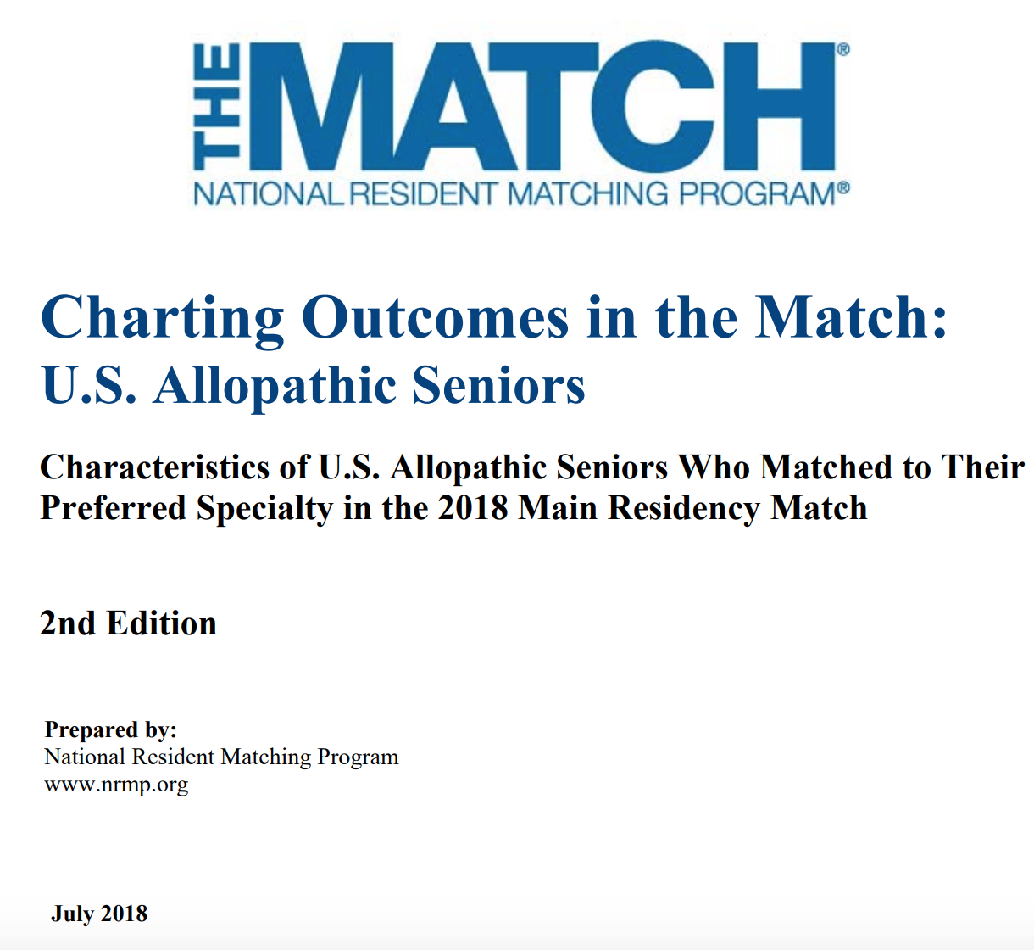

Slide 18
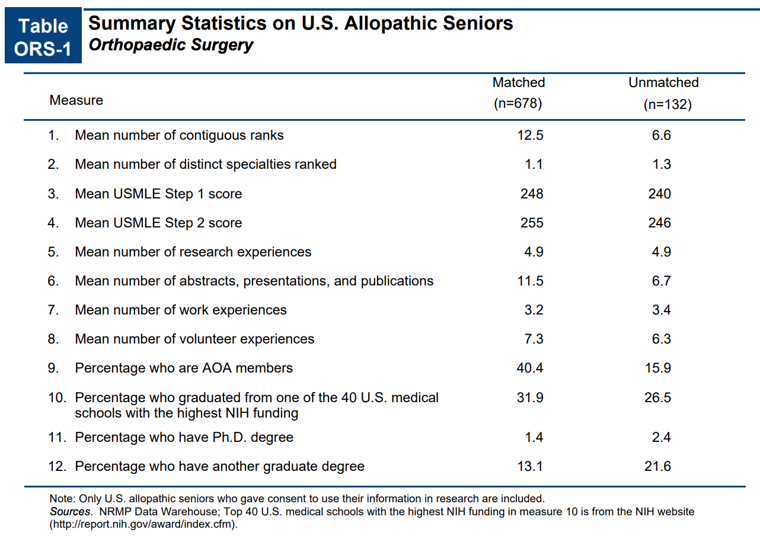
2018 Match Stats

Slide 19
Explaining the Numbers
Publications, abstracts, and presentations
Research Experiences
This number is higher because one project can lead to a couple of these.
This is the project in and of itself.

Slide 20
“Nevertheless, research experience and board examination performance (particularly USMLE Step 1) remain among the most important predictors of match success.”
Work Cited: DePasse JM1, Palumbo MA1, Eberson CP1, Daniels AH1. Academic Characteristics of Orthopaedic Surgery Residency Applicants from 2007 to 2014. J Bone Joint Surg Am. 2016 May 4;98(9):788-95. doi: 10.2106/JBJS.15.00222.

