Slide 1
Orthopaedic Research Committee
Month day, year
Your Name
Class Name
Mission Statement
*To connect students with the information and faculty needed to guide and maximize medical student’s time to choose, start and complete research of the highest quality.

Slide 2
Committee Includes
  Faculty Leader = Dr. Vinod Dasa (vdasa@lsuhsc.edu)
  Faculty Leader = Dr. Robert Zura (rzura@lsuhsc.edu)
  Committee Director = Ms. Cara Rowe (cjoh26@lsuhsc.edu)
  Statistician = Ms. Claudia Leonardi (cleon1@lsuhsc.edu)
  Committee Chair = Stuart Schexnayder (ssche2@lsuhsc.edu)
  Senior Advisor to the Chair = Matthew Fury (mfury@lsuhsc.edu)
  Chair Elect = Hunter Starring L2 (hstarr@lsuhsc.edu)

Slide 3
Committee Meetings will be held quarterly
Q1 - Aug. – Oct.
Q2 - Nov. – Jan.
Q3 - Feb. – Apr.
Q4 - May – July

Slide 4
Goals for Today
Brief Intro
Topic Talk= How to Complete a Literature Review (by Dr. Mora)
Active Projects/Progress/Questions
List of Projects to Start Now
Questions

Slide 5
Goals for Today
Brief Intro
Topic Talk= How to Complete a Literature Review (by Dr. Mora)
Active Projects/Progress/Questions
List of Projects to Start Now
Questions

Slide 6
Active Projects/Progress/Questions

Slide 7
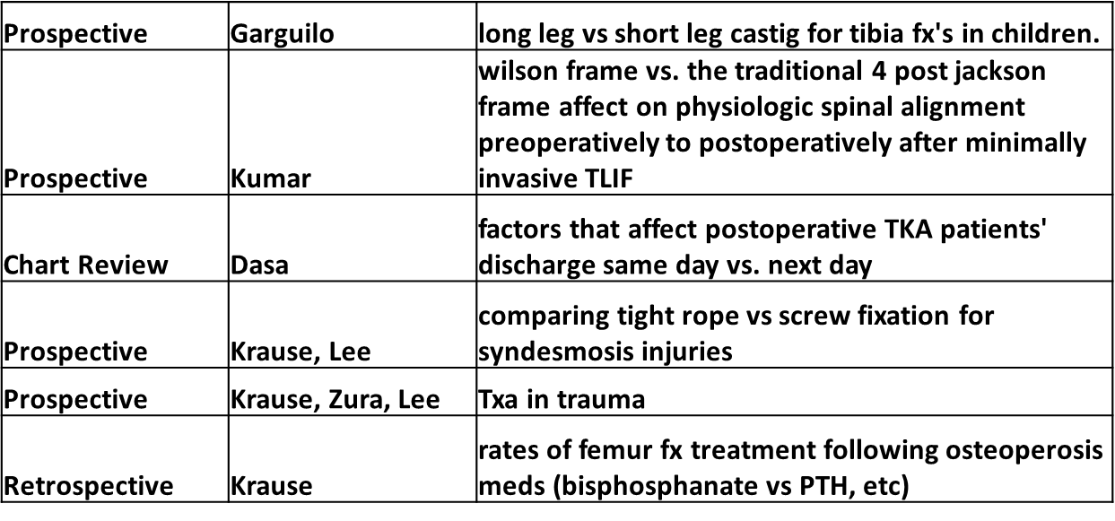
Short List of Projects to Start Now

Slide 8
Short List of Projects to Start Now
How to go about claiming a project

Slide 9
Questions & Discussion

