Slide 1
Musculoskeletal Research Committee *PLEASE SIGN IN*
Month day, year
Your Name
Class Name
Jacob Neary
L3 Chairman
4.24.19

Slide 2
Committee Members
Faculty Leader: Dr. Vinod Dasa (vdasa@lsuhsc.edu)
Faculty Leader: Dr. Robert Zura (rzura@lsuhsc.edu)
Coordinator: Ms. Colette Hilliard (coco71103@yahoo.com)
Statistician: Dr. Claudia Leonardi (cleon1@lsuhsc.edu)
Writing Director: Dr. Amy Bronstone (amy@abmedcom.com)
Committee Chair: Jacob Neary (jnear1@lsuhsc.edu)
Senior Advisor: Hunter Starring (hstarr@lsushc.edu)
Chair Elect: Harry Schwartzberg (hschw@lsuhsc.edu)

Slide 3
Goals for Today
Chair Elect Applications
Brief Overview of IRB changes
REDCap and routing form
Finding New Studies
Presentation by Dr. Claudia Leonardi

Slide 4
Chair Elect
Chair Elect (L2)
Serves as an advisor to the Chair and acts as a voice of the L1 and L2 classes
Becomes the Committee Chair (L3 year) then Senior Advisor to the Chair (L4 year)

Slide 5
Chair Elect
Requirements
Must be Interested in Orthopaedics
Past or Present Involvement with at least one research project
If interested and meet above requirements, email Present Chair Elect (Harry Schwartzberg) containing an attached paragraph

Slide 6
Chair Elect
This paragraph should indicate that they meet the requirements, and why they would be a good fit for this position
Maximum 250 words
Present Chair Elect will narrow it down to 3 finalists
Dr. Dasa will then choose the new Chair Elect
Decision announced at next meeting
DUE: Friday, May 3rd

Slide 7
IRB Changes
Chart Reviews and Exempt projects
Now human subject research
Does my study require IRB review?
IRB Manager
Contact: IRBOffice@lsuhsc.edu

Slide 8
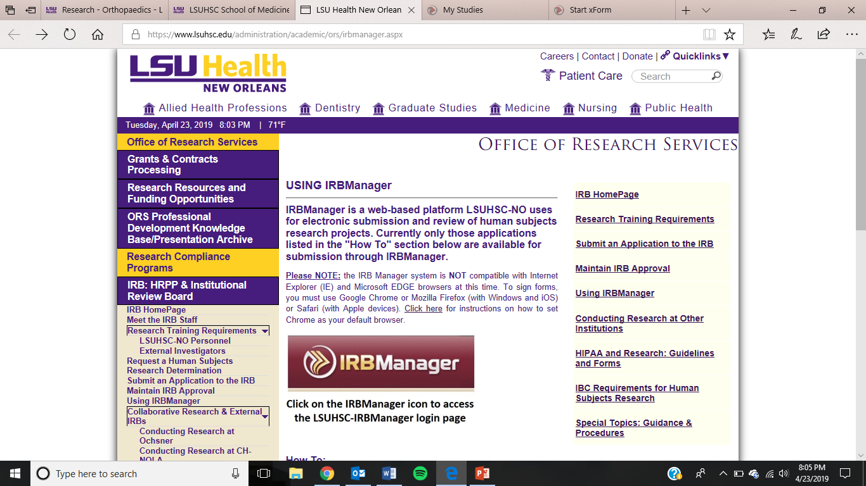

Slide 9
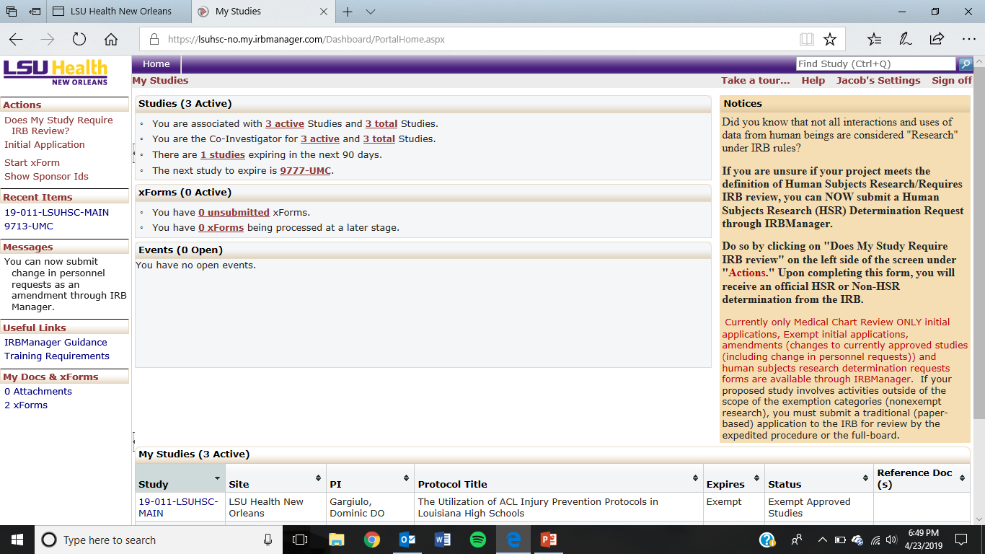

Slide 10
Routing Form
Found under the LSU Orthopaedic Research Medical Student tab
An IRB based form to help guide students and faculty
Contains link to upload project into REDcap

Slide 11
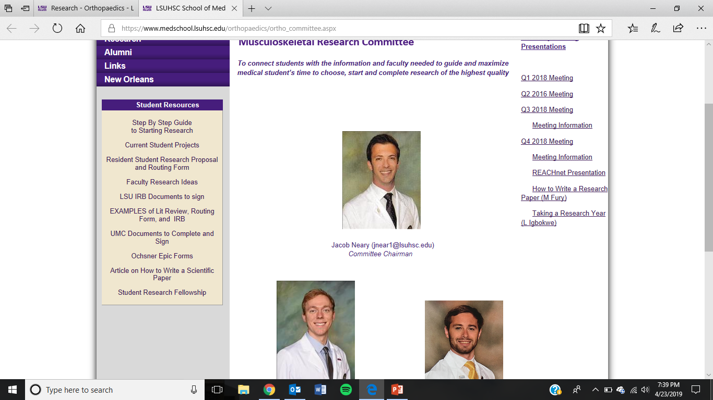
Routing Form

Slide 13
Tips on Literature Review
Utilize your library access off campus
Will give you access to almost all articles
Look at paper similar → on right will show papers that cited it → this will lead you to newer papers → those new papers citations will help as well
Refworks, Zotero

Slide 14
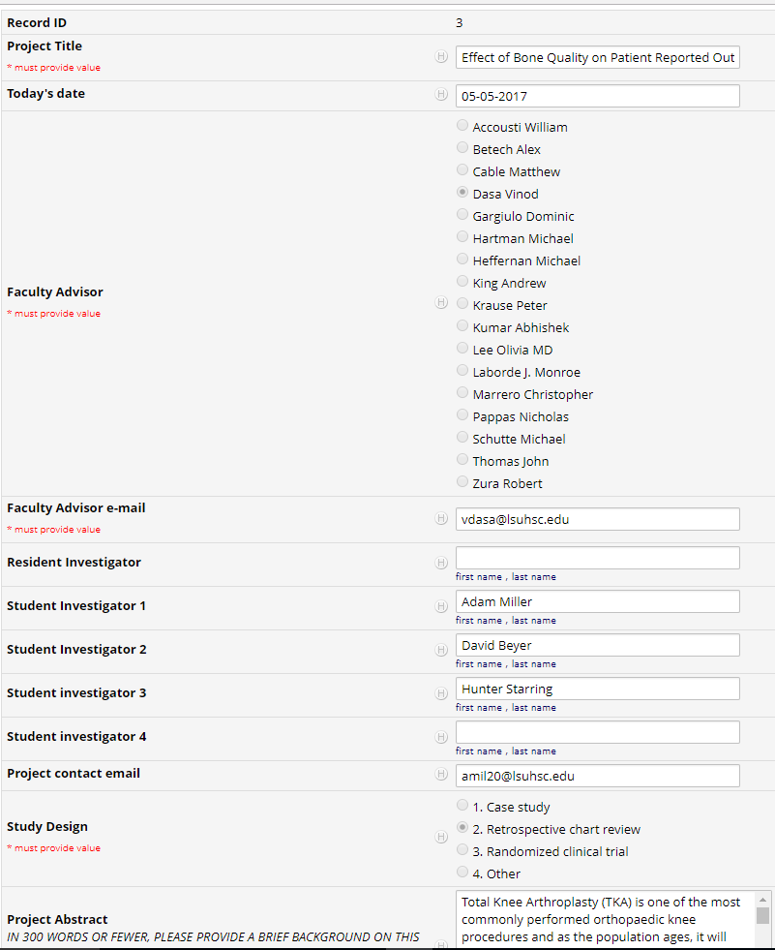
REDCap Database for Routing Form Approval
Approval/Edits in this order:
Faculty
Dr. Dasa
Dr. Bronstone (design)
Dr. Leonardi (stats)
Ms. Hilliard (IRB)

Slide 15
Starting a new project
Find a topic that interests you
Find fellow students to work with
Do a literature review
Reach out to faculty
Complete a routing form

Slide 16
Starting a new project
Tissue bank
Summer projects
New ideas always emerging:
“Limited guidance available on use of corticosteroid injections for knee arthritis”

Slide 17
Topic Talk by Dr. Leonardi

Slide 18
Questions & Discussion
Next Meeting …

