Slide 1
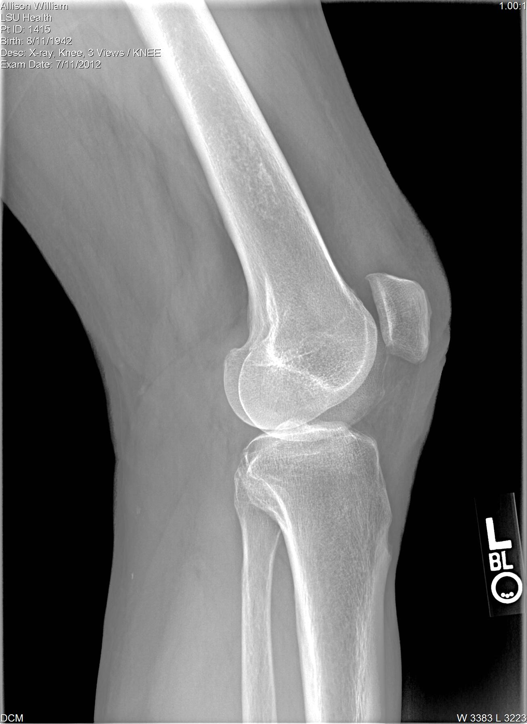
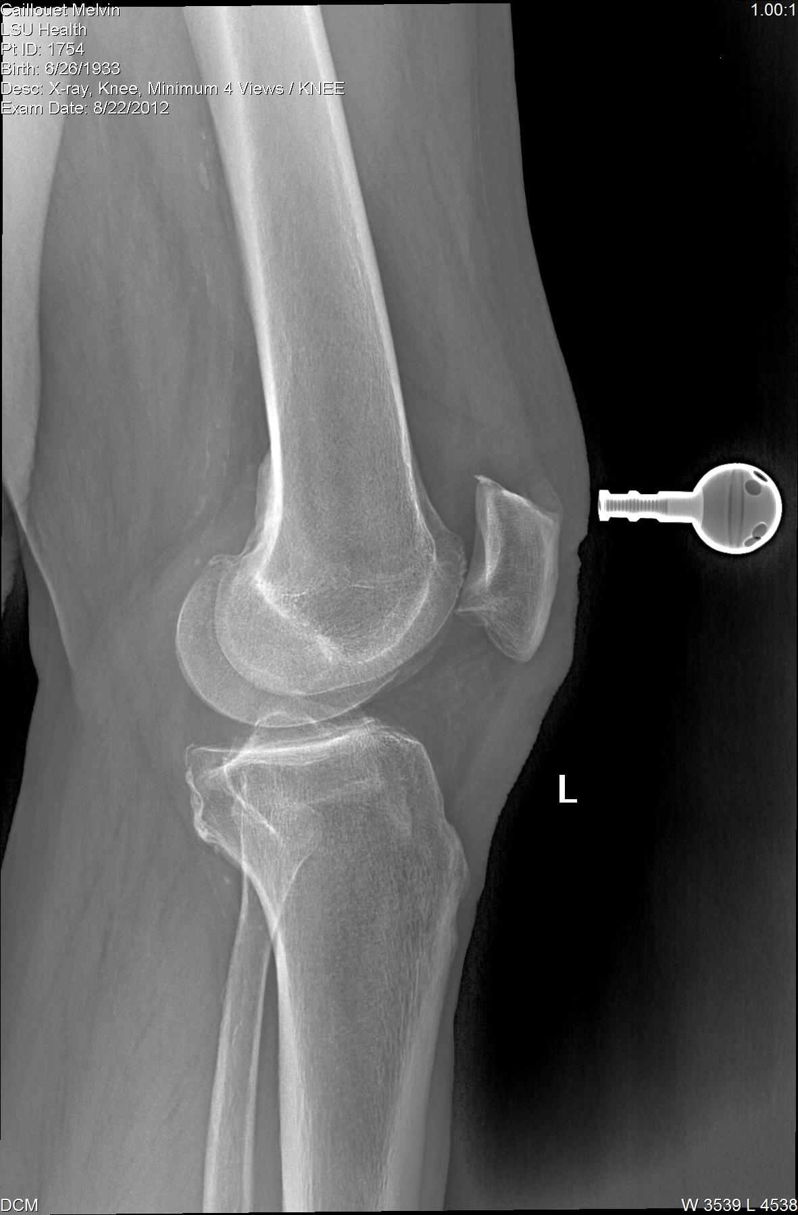
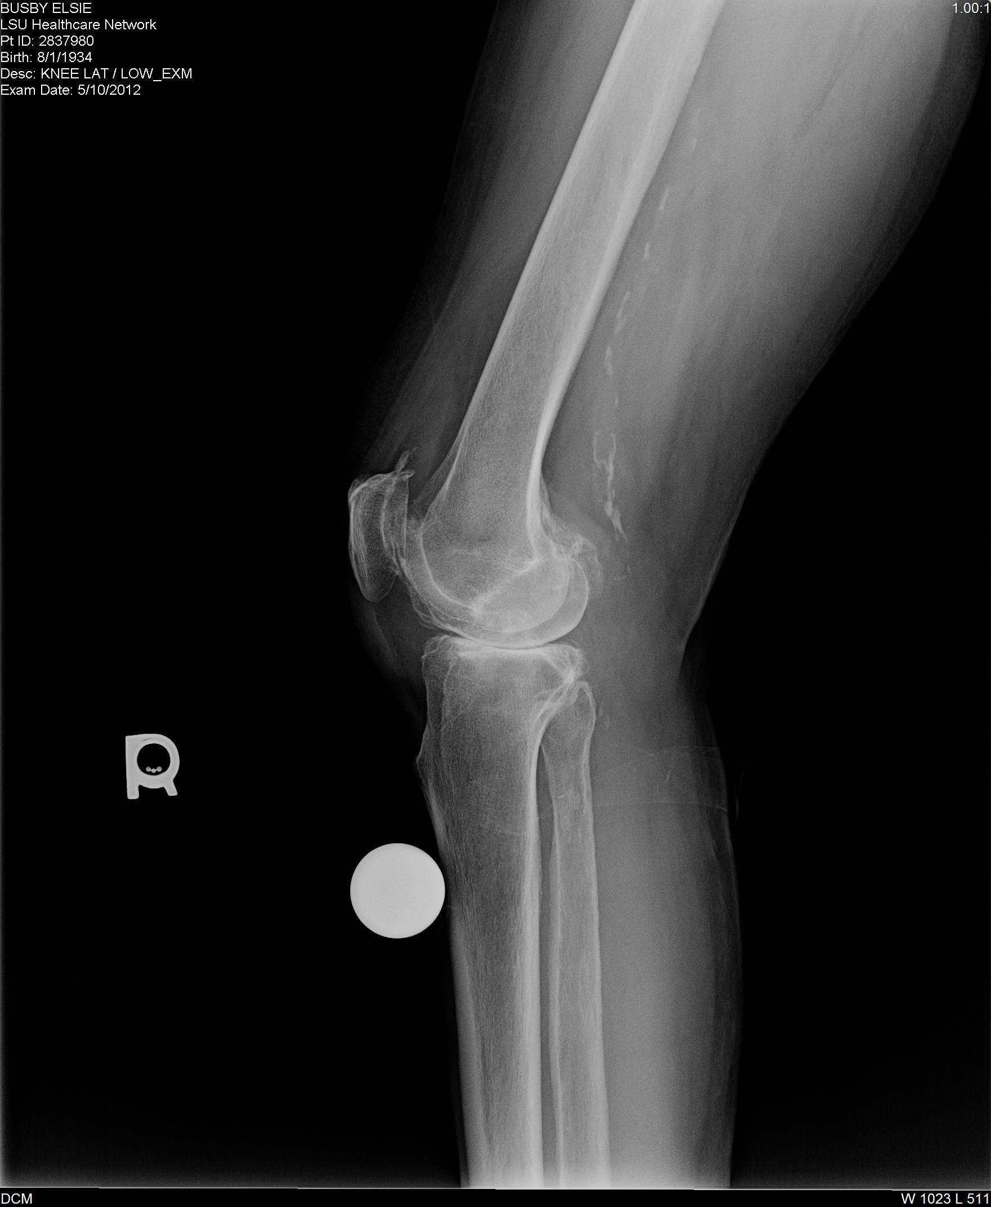
Peripheral Artery Disease in Orthopaedic Patients with Asymptomatic Popliteal Artery Calcification on Plain X-ray
Adam Podet, MS; Julia Volaufova, phD,; Vinod Dasa, MD
abstract
methods
results
Peripheral artery disease (PAD) is known to exist in various arterial beds throughout the circulatory system. Its presence is strongly associated with myocardial infarction, stroke, and cardiovascular death, with approximately 10% of all major adverse cardiovascular and cerebrovascular events (MACCE) being attributed to the direct progression of PAD. In the orthopaedic setting, it is common to encounter asymptomatic calcification of the popliteal artery by plain x-ray imaging for unassociated lower extremity complaints such as arthritis. However, it is unknown whether these findings are a reliable predictor of future sequelae of PAD. The aim of this study was to determine the incidence of asymptomatic PAD in a total joint patient population, and to investigate whether there was an association between asymptomatic PAD and MACCE.
Medical records were reviewed from a single clinical practice site for patients ≥ 50 years of age with no history of symptomatic lower extremity PAD who received a lower extremity lateral view x ray for general orthopaedic complaints. X rays were reviewed blinded to all patient identifiers, and PAD scores were designated as absent, mild, or severe. MACCE were recorded and categorized with respect to known atherosclerotic risk factors such as age, BMI, and smoking history.
A total of 138 consecutive patients were included in the study. Popliteal artery calcification was visualized in 37 patients (26.81%), with 29 receiving a score of mild PAD (21.0%) and 8 receiving a score of severe PAD (5.8%). MACCE occurred in 34 (24.64%) patients, with 16 (11.59%) in the absent PAD group, 12 (8.7%) in the mild PAD group, and 6 (4.35%) in the severe PAD group. Severity of calcification was associated with a greater probability of MACCE (p<0.01), with an odds ratio of 2.9 (95% CI, 1.1 to 7.5) for mild vs. absent PAD, and an odds ratio of 10.9 (95% CI, 1.8 to 65.4) for severe vs. absent PAD, adjusted for additive effect of age, BMI, gender, and smoking history. Age was an independent risk factor for PAD severity (p=.06).
138 medical records were reviewed from a single clinical practice site for patients ≥ 50 years of age with no history of symptomatic lower extremity PAD who received a lower extremity lateral view x ray for general orthopaedic complaints.
X rays were reviewed blinded to all patient identifiers, and PAD scores were designated as absent, mild, or severe
MACCE were defined as myocardial infarct, stroke, transient ischemic attack, aortic dissection, abdominal aortic aneurysm, CABG surgery, valve replacement, percutaneous coronary angioplasty, or a diagnosis of congestive heart failure
MACCE were recorded and categorized with respect to known atherosclerotic risk factors such as age, BMI, and smoking history.
PAD was visualized in 37 of 138 patients .
29 of these were scored as mild PAD and 8 were scored as severe PAD.
Overall incidence of PAD in our patient cohort was 26.8%. The incidence of mild PAD was 21.0%, while the incidence of severe PAD was 5.8%
MACCE occurred in 34 of 138 patients. The overall incidence of MACCE in our cohort was 24.6%.
16 MACCE events occurred in patients without PAD (11.59%)
background
Co-variates | Odds Ratio of MACCE | Confidence Interval
Age | 1.051 | 0.997-1.107
BMI | 1.103 | 0.960-1.070
Mild PAD | 2.852 | 1.084-7.504
Moderate PAD | 10.856 | 1.803-65.356
Female Gender | 0.618 | 0.213-1.791
Smoking | 1.778 | 0.741-4.268
Peripheral artery disease (PAD) is known to exist in various arterial beds throughout the circulatory system. Its presence is strongly associated with myocardial infarction, stroke, and cardiovascular death, with approximately 10% of all cardiovascular and cerebrovascular ischemic events being attributed to the direct progression of PAD (Criqui et. al 1992). Recent epidemiological studies have recorded the prevalence of PAD to be 14.5% among individuals aged ≥ 70 years (Criqui et. al 1985; Selvin and Erlinger 2004). Atherosclerosis, which accounts for 90% of PAD, is the greatest cause of morbidity and mortality of adults in the United States (American Heart Association 2004).
In the orthopedic setting, it is common to encounter asymptomatic calcification of the popliteal artery by plain x-ray imaging for unassociated lower extremity complaints such as arthritis. However, it is unknown whether these findings are a reliable predictor of future sequlae of PAD. Epidemiological studies using the ankle-brachial index to diagnose PAD report the prevalence of asymptomatic PAD to be 8.0% of the population aged 54 to 74 years (Fowkes et al. 1991). This is underscored by subsequent studies which have shown that asymptomatic PAD, identified by the ankle-brachial index, increases risk of death due to coronary artery disease three to six fold compared to the normal population (Criqui et al. 1992; Fowkes et al. 1991). PAD identified as severe by ankle-brachial index was reported to be a consistent indicator of malignant prognosis, with a 64% death rate by six years follow up (Howell et al. 1989). These findings suggest the significance of determining whether popliteal artery calcification on x-ray may be used as a predictor of major adverse cardiovascular and cerebrovascular events (MACCE) related to atherosclerosis.
There are currently no studies examining the risk of MACCE in asymptomatic orthopedic patients identified by arterial calcification on x-ray, and treatment recommendations for this population have not been established. Our study aims to determine the incidence of asymptomatic PAD in a total joint patient population and whether there was an association between asymptomatic PAD and MACCE.
(a) (b)
(a) Lateral knee radiograph with no PAD
(b) Lateral knee radiograph with specks of calcification of the popliteal artery, scored as mild PAD
(c) Lateral knee radiograph with extensive calcification throughout the popliteal artery, extending into the superficial femoral artery. This was scored as severe PAD
objectives
Determine the incidence of asymptomatic PAD in a total joint patient population
Objectively classify PAD severity using plain X-ray
Identify an association between asymptomatic PAD and major adverse cardiovascular and cerebrovascular events
conclusions
Radiographic evidence of asymptomatic popliteal artery calcification in orthopaedic patients was associated with a greater risk of MACCE.
This may warrant vascular surgery evaluation when recognized
Further study is needed to prospectively determine whether asymptomatic popliteal artery calcifications may represent a greater systemic disease burden than is currently appreciated
(c)

