Slide 1
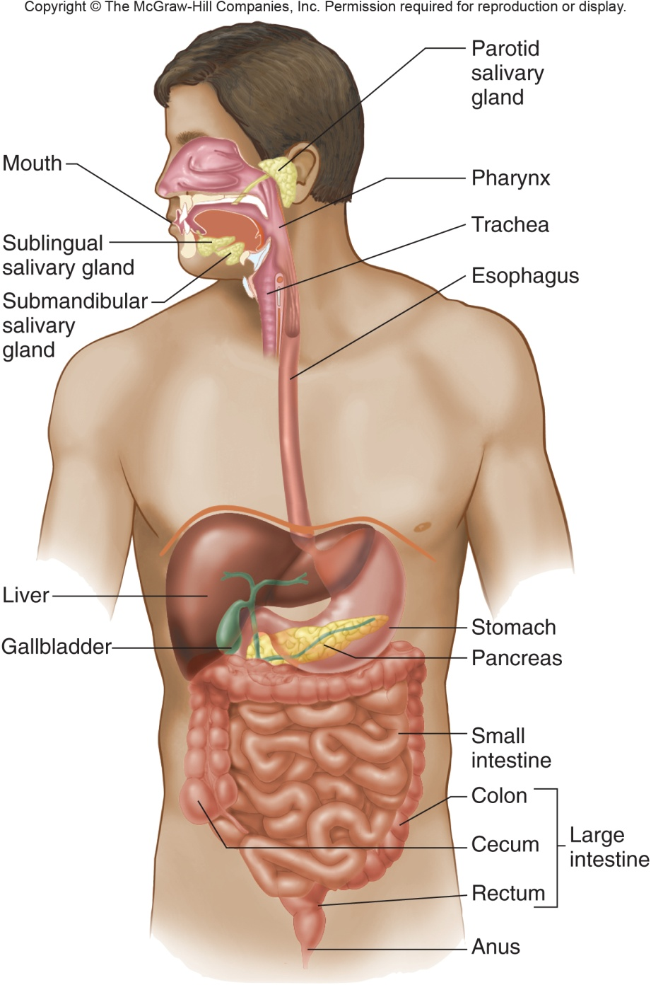
Digestion and Absorption
Proteins and Lipids
GI PHYSIOLOGY
Gregory J. Bagby, PhD
Rozas Professor of Physiology
CSRB Rm 3B9/310
gbagby@lsuhsc.edu
504-568-6188

Slide 2
Lipid Digestion and Absorption
Lecture 7: Objectives
Describe protein digestion and absorption, and the importance of dietary essential amino acids
Describe pathways leading to absorption of vitamin C and vitamin B₁₂
Understand special barriers to absorption of dietary lipids
Describe the phases of lipid digestion that include the role of micelles
Describe events involved in the uptake of different lipid classes by the enterocyte
Delineate pathways for lipid processing and the formation of chylomicrons in the enterocyte

Slide 3
CHO and Protein Digestion and Absorption
Essential and Nonessential Amino Acids
20 naturally occurring amino acids
  11 of a.a. can be synthesized (liver)
  9 a.a. are “essential” and can’t be synthesized
Vegetable sources lack one or more essential amino acid
Notes:
White boxed a.a. – essential and must be part of diet

Slide 4
Protein Digestion and Absorption
Luminal - Gastric Proteolysis
Pepsinogens – pepsins
  Low pH – autocatalytic cleavage to active form
Substrate – neutral amino acids (aliphatic and aromatic)
Product – incomplete digestion
  Few a.a.; mostly non-absorbable peptides
Inactive above pH 4.5
  Protects epithelial cells of duodenum

Slide 5
Protein Digestion and Absorption
Luminal Intestinal Protease Activation
Two families (pancreases)
  Endopeptidases
  Ectopeptidases
Secreted as inactive
precursors
Gut apical membrane
enterokinase activates
trypsinogen
Trypsin activates all others
enterokinase
trypsinogen
trypsin
Notes:
Enterokinase also called enteropeptidase

Slide 6
Protein Digestion and Absorption
Luminal Intestinal Proteolysis
Endopeptidases – chymotrypsin, elastase, trypsin
Ectopeptidases – carboxypeptidases A, - B
Chymotrypsin
Elastase
Carboxypeptidase A
60-70% (peptides)
30-40% (amino acids)
Trypsin
Carboxypeptidase B

Slide 7
Protein Digestion and Absorption
Brush Border Hydrolysis
Large number of endo- and ectopeptidases on the brush board
Villus only
Products
  Free amino acids
  Oligomers

Slide 8
Protein Digestion and Absorption
Transporters and Cytosolic Proteolysis
Free amino acids
  Na⁺ or H⁺ coupled transporters
  Facilitated diffusion
Oligomers (di-, tri-, tetra-)
  Peptide transporter 1 (PEPT1)
  Broad substrate specificity
Cytosolic n-terminal
peptidases
  Dipeptidases
  Tripeptidases

Slide 9
Water-Soluble Vitamin Absorption
Vitamin C (Ascorbic Acid)
Antioxidant, a participant in hydroxylation reactions
Absorption in the ileum
  Apical membrane – Na-coupled cotransporter – SVT1 and SVT2
  Regulated by intracellular signals and own levels in the body

Slide 10
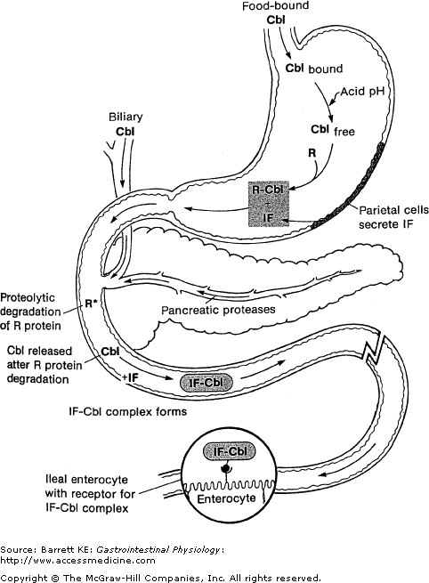
Vitamin B₁₂ (Cobalamin)
Processing and Absorption
B₁₂
Stomach – B₁₂ released from digested proteins & binds to R-binding protein (product in saliva)
Duodenum – Released & bound to intrinsic factor (Gastric parietal cells)
Terminal ileum – IF-B₁₂ complex binds to intrinsic factor-cobalamin receptor (IFCR)
Enterocyte – Internalizes IF-B₁₂. Released & bound to transcolabamin II (TC II)
Enters blood as complex
B₁₂
B₁₂
B₁₂
B₁₂
B₁₂
B₁₂
B₁₂

Slide 11
Lipid Digestion and Absorption
Significance
Hydrophobic
  Special processes needed for digestion and absorption because they are insoluble in water
Energy-rich
  9 calories/gram and stored without water
  Economy of storage for energy needs of the body
Important constituents of the lipid-bilayer
Fat-soluble vitamins
Provide flavor and aroma to food
Insulator

Slide 12
1 - Lipid Digestion and Absorption
Dietary and Endogenous Sources
Exogenous – Lipid-rich foods
    Long-chain triglycerides
    Phospholipids
    Plant sterols, cholesterol, endogenous lipids listed above
    Fat-soluble vitamins in trace amount – Vitamin A (retinoic acid), D (calciferol), E tocopherol) and K
Endogenous –cholesterol, phospholipids from the biliary system and bile acids

Slide 13
2 - Lipid Digestion and Absorption
Luminal Digestion
Order – Emulsification – lipolysis – uptake into micelles – transfer of digested products to epithelial surface – uptake (diffusion) into cells
Lipid digestion starts in the stomach
  Gastric peristalsis and mixing – emulsification
  Gastric (and salivary) lipase
    TG → DG + FA (incomplete)
    pH optimum = 4.0-5.5
    10-30% of lipolysis takes place in
    Lipase resistant to pepsin
    Inhibited by bile acids
    FA protenated so end up
    in oil droplets
Gastric lipase
TG
Fatty acids (FA) and diglycerides

Slide 14
Lipid Digestion and Absorption
Intestinal Digestion
Intestinal digestion
  Emulsification – Aided by phospholipids (diet and bile) and bile acids
  Increased pH ionizes fatty acids
    Move to the surface of the droplets
    FA (a few) dissociate from droplet contact epithelial cells
      Stimulate release of CCK
      via CCK-RP
    Actions of CCK

Slide 15
Lipid Digestion and Absorption
Pancreatic Enzymes, Etc – Lipid Digestion
Pancreatic lipase
Colipase
Secretory PLase A₂
Cholesterol esterase
Breast milk lipase

Slide 16
Lipid Digestion and
Absorption
Pancreatic Lipase and Colipase
Pancreatic lipase
  Acts on C₁ and C₃ of glycerol
  (TG → MG + 2FA)
  Neutral range pH optimum
  Inhibited by bile acids
Colipase
  Secreted as procolipase
  Binds lipase and bile acids
  Positions lipase to hydrolize
  substrare (TG)

Slide 17
Lipid Digestion and Absorption
Other Lipid Enzymes
Phospholipase A₂
  Secreted as inactive proform (protect pancreas)
  Cleaves FA at glycerol C2
  Degrades (reclaims) phosphotidylcholine in biliary secretions
  Requires luminal Ca⁺⁺ ion
Cholesterol esterase
  Degrades esters of cholesterol and vitamins A, D, and E
  Complete hydrolyzes of TG (cleaves FA at C2 of glycerol)
Breast milk lipase (related to cholesterol esterase)
  Milk of lactating females
  Predigest lipid component of milk

Slide 18
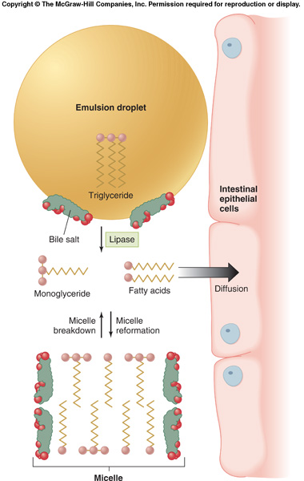
Lipid Digestion and Absorption
Post-Lipolysis Role of Bile Acids/Micelles
Products of lipid digestion (MG and FA) form enter a transitional state called the lamellar phase before forming micelles with bile acids
Absorption - “Free” MG and FA enter enterocytes by diffusion
Some absorption aided by transporters
Micelle

Slide 19
Lipid Digestion and Absorption
Lipid Absorption Processes
Fatty acids and mono-glycerides cross apical membrane by diffusion
Cholesterol absorption via transporter
  Niemann-Pick C1-like 1 (NPC1L1) – cholesterol facilitated diffusion
  Destination of cholesterol
    Secreted ABC-G5, G8
    Used by epithelial cell
    Packaged with TG into chylomicrons

Slide 20
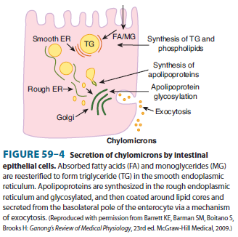
Lipid Digestion and Absorption
Enterocyte Lipid Processing
FA directed to smooth ER by
FA binding proteins for
lipid processing
Other lipids directed
to ER and re-esterified (MG,
DG, PL, cholesterol, vitamins)
Lipids reassembled into
cylomicrons prior to export
  Lipids w/ >80% TG
  Protein coat of
  apolipoproteins
  Exported by exocytosis
  Lymphatic uptake

Slide 21
Lipid Digestion and Absorption
Fat-Soluble Vitamins
Little known about absorption
Esterified and packaged into chylomicrons
Fat-soluble vitamin deficiencies occur if micelles fail to form
Clinical manifestation
  Rickets (D)
  Osteomalacia (D)
  Night blindness (A)
  Impaired clotting (K)

Slide 22
Pathophysiology and Malabsorption
Short bowel syndrome
  Cause – surgical resection for conditions like necrotizing enterocolitis (pediactric) or Crohn’s disease
    Usually involves the late small intestine – lacks bile acids absorption
  Consequences – Bile acid-diarrhea without blood
  Solution - parenteral nutrition (intravenous)

Slide 23
The GI Lecture Outline
Overview of GI Physiology (1)
  GI tract and accessory organs
  Regulation
Secretions (2)
  Salivary and Gastric
  Pancreatic and Biliary
  Intestinal Water and Electrolyte Absorption and Secretion
GI motility (2)
Digestion and Absorption (2)
  Carbohydrates, Proteins and Water Soluble Vitamins
  Lipids
GI-Microbial Interactions (< 0.5)

Slide 24
Mucosal Immunology and Ecology
Mucosal Immunology refers to host defense of mucosal tissue (GI, lung, genital tract)
  Innate – macrophages, neutrophils, etc
  Adaptive - lymphocytes
    GI – Mature T lymphocytes (effector and memory)
    GI – Humoral aspect – IgA
  GI in a chronic state of “inflammation” as it deals with the ever-present microbes
Microbiota or microbiome
  400 bacterial species
  Endogenous toxins control growth – HCl, bile acids, defensins, lysozymes, digestive enzymes, IgA
  Movement of contents
  Mostly in the colon 10¹² per gram of colonic contents

Slide 25
Consequences of Mucosal Immune System and the Microbiome
Immune
  Protects
  Interaction can lead to inflammatory states
Microbiome
  Benefits
    Digestion – bile acids, fiber
    Protect from pathogenic pathogens by numbers
  Disease
    Translocation – e.g. alcohol liver disease is a conseqence
    Barrier disruption – life threatening sepsis
    Microbiome shown to impact diabetes and heart disease

