Slide 1

NTM Patient
Support Group Meeting
October 17, 2018
3:30 PM
University Medical Center
Conference Center C

Slide 2
Presenters/ Partners in Care
Juzar Ali MD, FRCP(C), FCCP
LSU Health Sciences Center – LSU Alumni Klein Professor of Medicine
Section Pulmonary/Critical Care & Allergy/Immunology
Director LSUHSC -Wetmore Mycobacterial Disease/NTM /Bronchiectasis Program
University Medical Center - NTM / Environmental Lung Disease Clinic
Nicole Lapinel MD
LSU Health Sciences Center - Assistant Professor of Medicine
Section Pulmonary/Critical Care & Allergy Immunology
Co-Director LSUHSC-Wetmore Mycobacterial Disease/NTM /Bronchiectasis Program
University Medical Center - NTM / Environmental Lung Disease Clinic

Slide 3
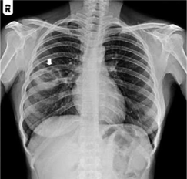
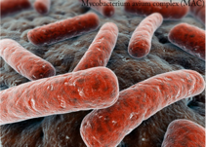
NONTUBERCULOUS MYCOBACTERIA:
Definition: Bacteria that do not cause tuberculosis or leprosy
Group of bacteria naturally found in soil and water (heaviest concentration)
Found in drinking water, household plumbing, hospital/dental water systems
Form biofilms which help with resistance to disinfectants/antibiotics
Many are resistant to high temperatures and low pH

Slide 4

A ‘bug’ by (m)any other name(s)
Anonymous
Atypical
Unclassified
Unknown
Tuberculoid
Environmental
Opportunistic
MOTT

Slide 5
Short History of Mycobacteria
1888: “Tuberculosis In Chickens” Leads To Discovery Of M. Avium
1933: MAC strains Identified In humans
1953: Increasing identification of MAC in humans (but connection with infection overlooked)
1954: Runyoun Classification for NTM Is Implemented
1970s: MAC recognized as most common cause of Pulmonary Disease among all NTM
1970-80s: Early reports of MAC A/W coal miners, sandblasters, welders:
  83 Sandblasters w/ silicosis In New Orleans: 22 w/ complicated Mycobacterial Infections, 3 A/W MAC
1992: (Chest, Reich & Johnson) Reviewed 29 Patients With Pulmonary Mac Among Which 6 Were Identified With Previously Undescribed Pattern Of Involvement
  Lingular / Right Middle Lobe Nodular Bronchiectatic Disease Occurring In Older, Thin, Non-smoking Women

Slide 6
Nontuberculous Mycobacteria (NTM) Fact Sheet
~200 species of NTM identified
Variable pathogenicity
At least 40 species known to cause disease in humans
Ubiquitous, typically found in water and soil habitats
Geographic variation of common strains nationally & internationally

Slide 7
NTM Transmission
Environment = A major source of human NTM infections
Environmental Sources of NTM
Soils, acidic pine forest or coastal swamp soils
Dusts from agriculture, garden & potting soils
Drainage waters from acidic pine forests or coastal swamps
Natural waters
Drinking water
Water / ice from refrigerators
Water from granular activated charcoal filters
Aerosols from natural & drinking waters
Aerosols from indoor humidifiers
Mist from indoor swimming pools
ROUTES OF EXPOSURE:
  Aerosolization and Inhalation
  Swallowing and Aspiration
  Introduction Into Wounds (Injury/Surgical)
  Zoonotic (Pigs, Birds, Cattle)
Rarely Transmitted From Patient To Patient

Slide 8
NTM Prevalence

Slide 9
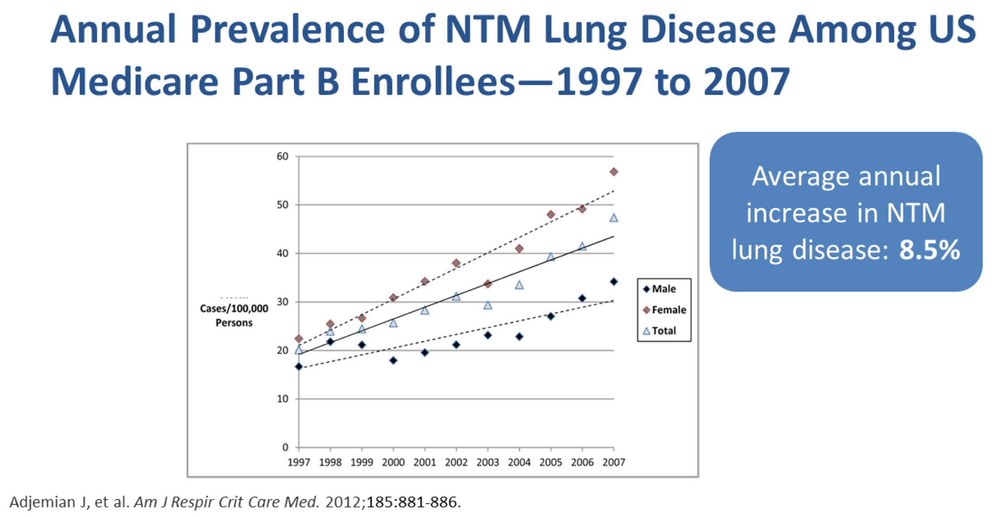
NTM: How common is it?

Slide 10
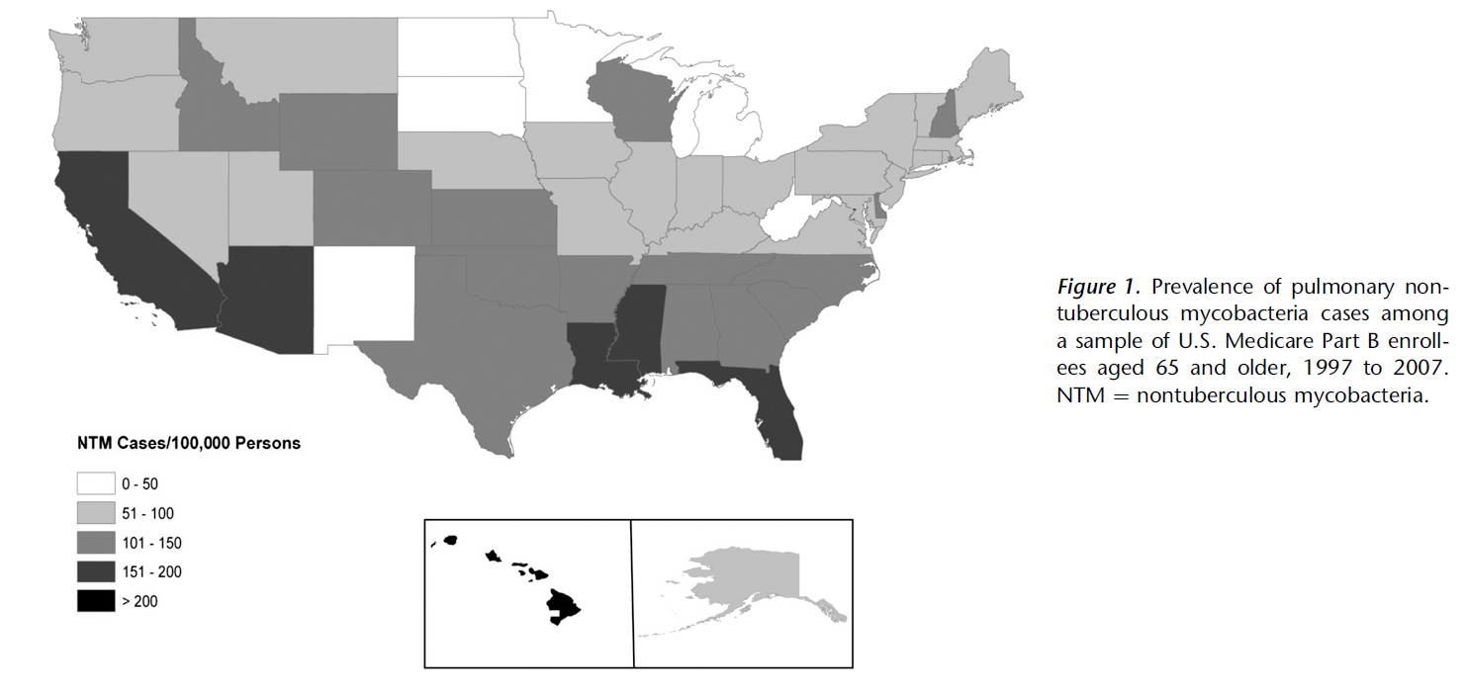
Pulmonary NTM Distribution in the United States

Slide 11
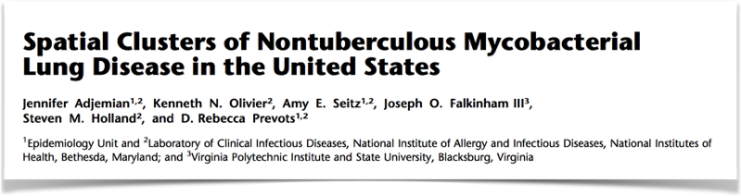
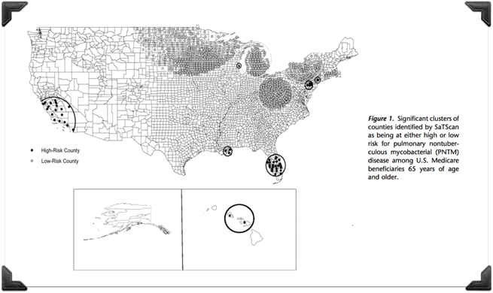
NTM: Where is it?
One study of 25 US states showed NTM bacteria were found in nearly 8 out of 10 water samples
NTM lung disease varies by geographic area: coastal regions, including Gulf States, have higher rates of infection, accounting for 70% of annual NTM cases in the US
3 Southern Coastal Parishes identified within the cluster in Louisiana:
  Plaquemines
  Jefferson
  St. Bernard
Half of diagnosed NTM lung disease patients reside within 7 states: Florida, New York, Texas, California, Pennsylvania, New Jersey, and Ohio

Slide 12
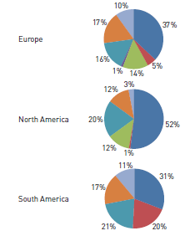
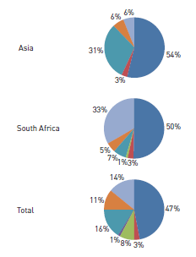
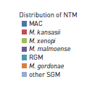
Worldwide Pulmonary NTM Distribution

Slide 13
NTM Prevalence:
Increasing? or Increasing!
Why The Increase?
Improved Techniques For Primary Culture Of NTM
Detection Of Infection By Direct DNA Isolation & Sequencing
Increased Awareness = Increased Testing
Increased Susceptibility/Vulnerability?
  Elderly
  Immunocompromised - Cancer, Autoimmune Disease, Hiv/Aids (Worldwide)
Greater Exposure Increased Disease?

Slide 14
NTM: Why me?!?

Slide 15
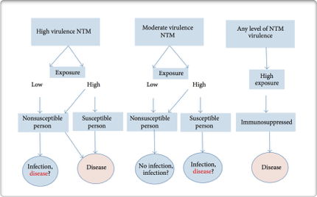
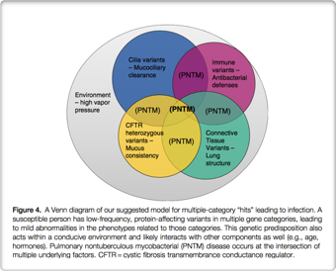
Why me? – Why am I affected by NTM?
Susceptible individual:
  Chest wall abnormality
  Anatomical lung abnormality
  Mendelian abnormality***
  Immunosuppressed
    Autoimmune on anti-TNF-alpha
    HIV/AIDS
    Active malignancy on chemo/radiation
    Steroids
    Primary immunodeficiency
PULMONARY NTM DISEASE = Gene Variants + Environmental Exposure + Susceptibility

Slide 16
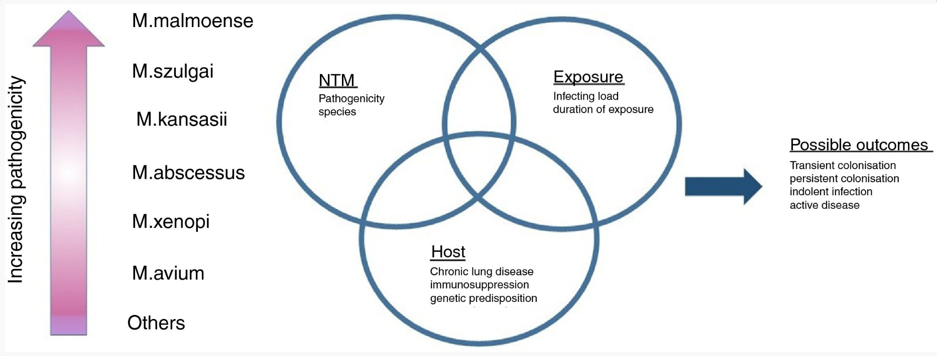

Slide 17
Diagnosis of Pulmonary NTM

Slide 18
Common Symptoms of Pulmonary NTM*
Cough
Night sweats, fever
Loss of weight and loss of appetite
Lack of energy/FATIGUE
Feeling short of breath
Wheezing
Chest pain around the lung area
* Dependent on underlying disease too

Slide 19
Diagnosis of Pulmonary NTM
(MAC, M. abscessus, M. kansasii)
Clinical
Pulmonary symptoms, nodular or cavitary opacities on CXR
RADIOGRAPHIC
Chest CT shows bronchiectasis w/ multiple small nodules/COULD FORM CAVITY
MICROBIOLOGIC
2 (+) EXPECTORATED SPUTUM CULTURES
^{OR}
1 (+) BAL CULTURE

Slide 20
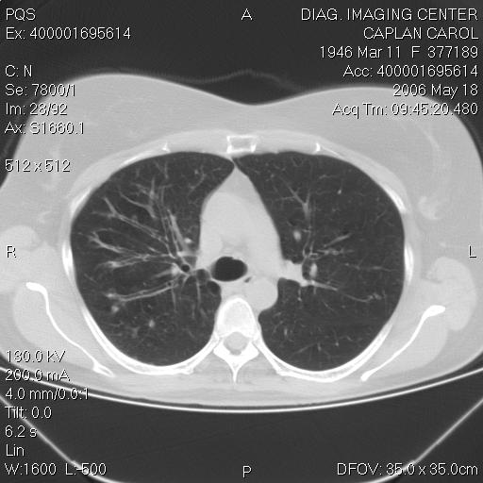
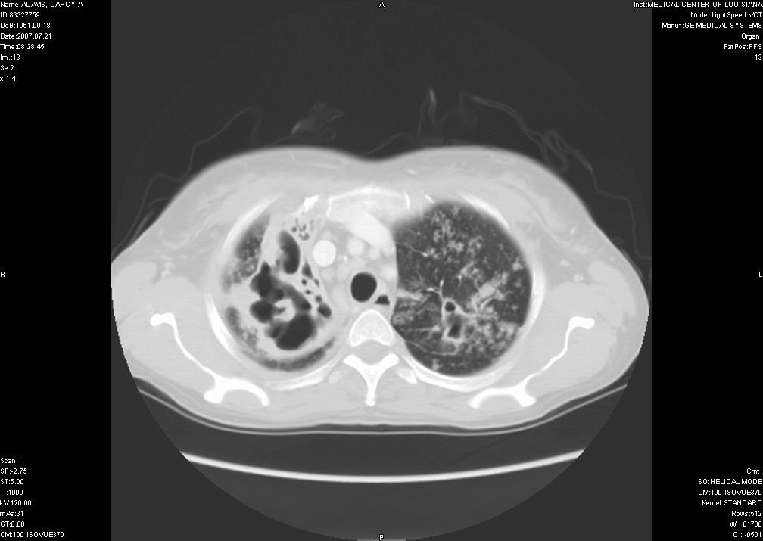
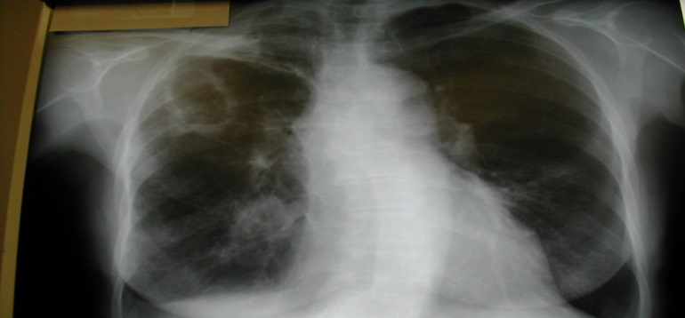
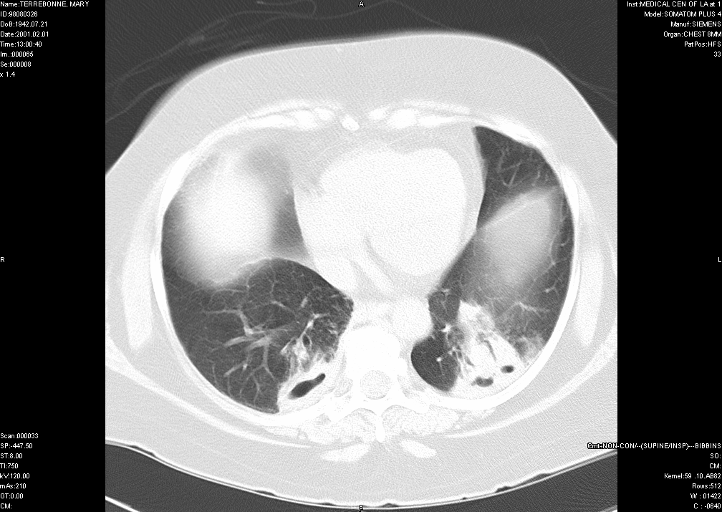
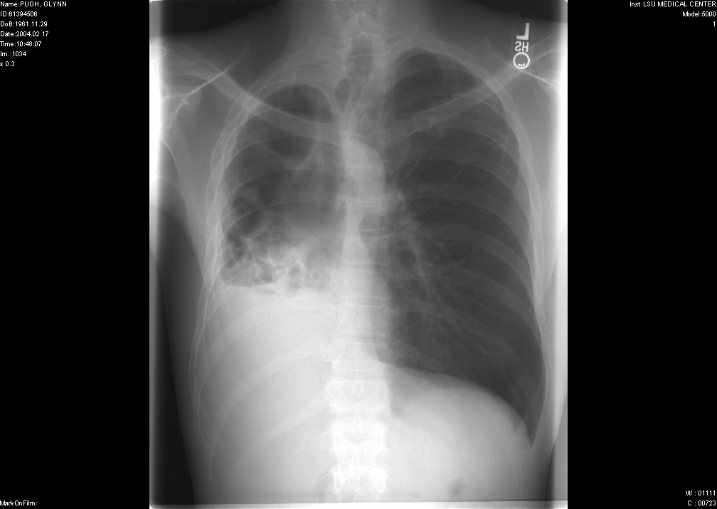
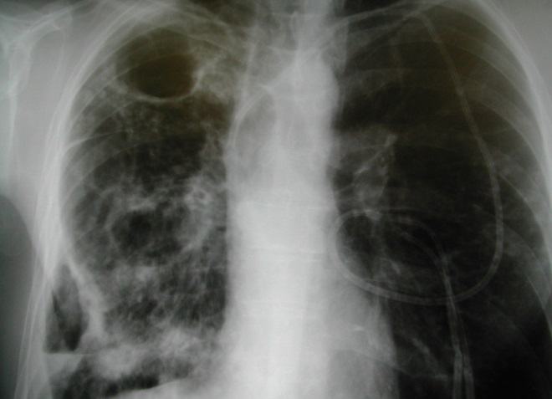

Slide 21
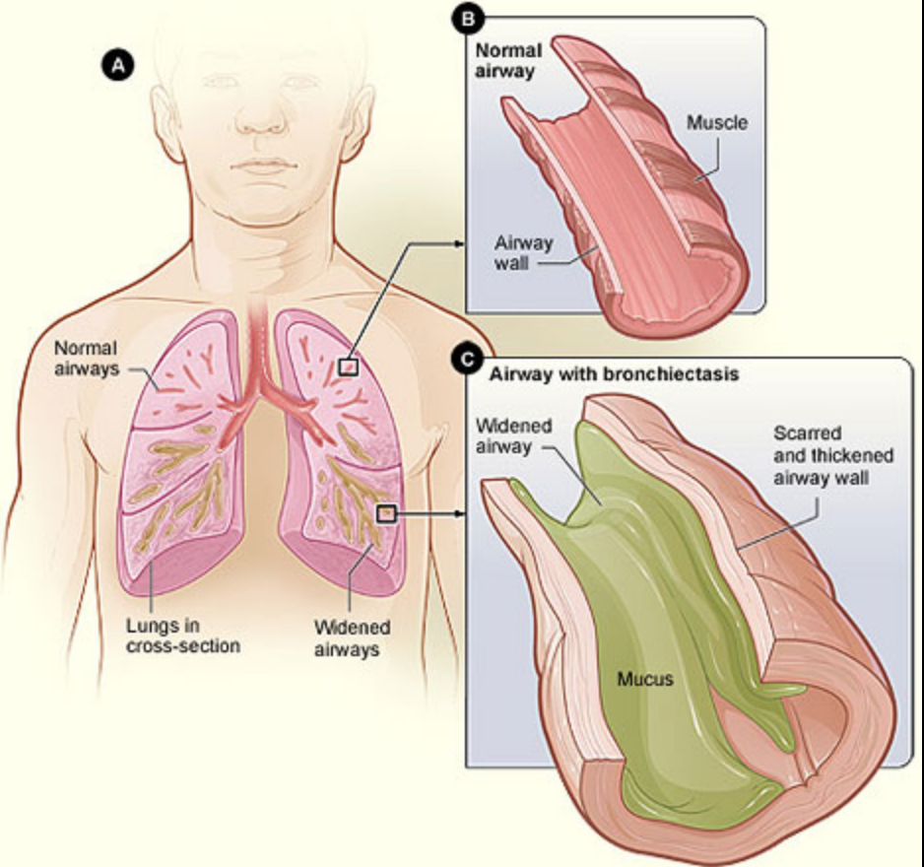
What is Bronchiectasis
Bronchiectasis comes from the Greek words “bronckos” (airway) and “ektasis” (widening)
Abnormal dilatation of the airways due to recurrent infection and inflammation
Seen on Chest CT
Notes:
caused by the destruction of the muscular and elastic components of their walls

Slide 22
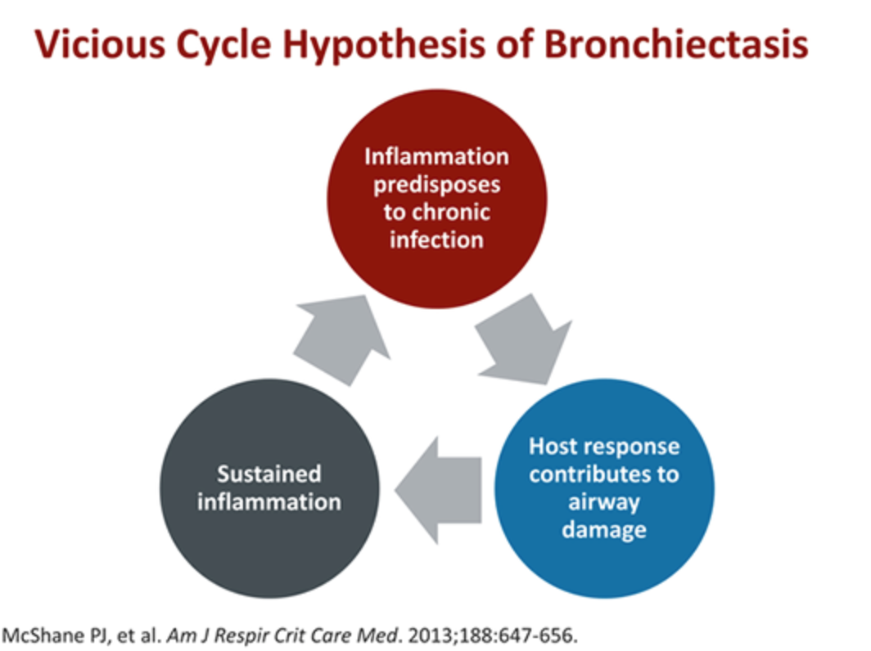
Bronchiectasis: NTM-Related

Slide 23
NTM Management

Slide 24
NTM Bronchiectasis/Pulmonary Disease: Management & Partnership In Care
GOALS
  Reduce symptoms
  Maintain lung function
  Prevent exacerbations
TREATMENT OPTIONS
  Antibiotic therapy
  Airway Clearance / Mucolytics
  Anti-inflammatory agents
  Surgery

Slide 25
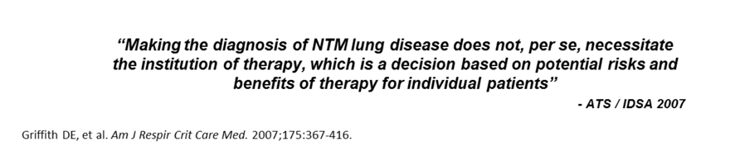
NTM Management

Slide 26
NTM-Related Bronchiectasis/Pulmonary Disease: Exacerbations
Definition: Acute change in cough, sputum (color, viscosity, volume) and may include other symptoms, such as:
  Shortness of breath
  Wheezing
  Malaise
  Fatigue
  Fever
  Chills
  Chest pain/discomfort
  Coughing up blood
  Worsening oxygenation/spirometric measures
Why is it important to reduce exacerbations?
  Minimize airway inflammation
  Minimize systemic inflammation
  Reduce lung damage

Slide 27

It Takes A Team…

Slide 28
NTM: Multidisciplinary Management Approach
Antimicrobial Therapy (Oral, IV, Inhaled)
  Surveillance
  Suppressive Treatment
  Active Treatment (Minimum 3 antibiotics Simultaneously)
Underlying Disease
  Autoimmune: Co-management with Rheumatology Specialist
  Chronic Rhinitis / Sinusitis: Referral To ENT
  GERD/Esophageal Motility D/O: Referral To GI
Laboratory
  Speciation/Susceptibility Testing
Nutritional Support
Respiratory Therapy
  Pulmonary Function Tests
  6 Minute Walk Tests
  Education
  Airway Clearance Techniques (Nebulizer / PEP Devices / Percussive Vests / Postural Drainage)
Psychological Support
  Patient Outreach (Support Groups)

Slide 29
AIRWAY CLEARANCE
Mucous stasis contributes to bacterial colonization
Biofilms complicate effective antimicrobial therapy
THEREFORE…mobilize secretions and interrupt the cycle of inflammation and infection

Slide 30
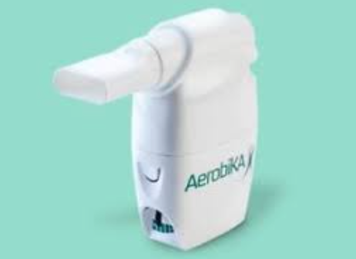
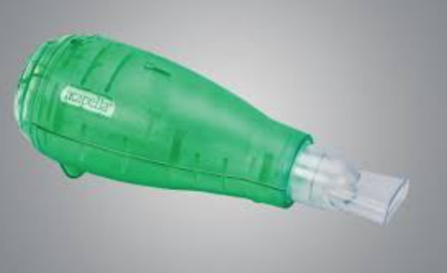
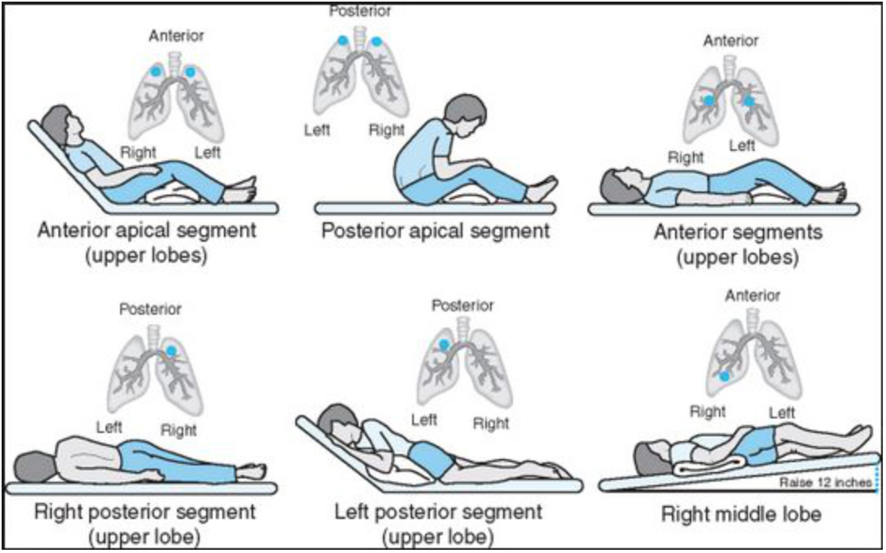
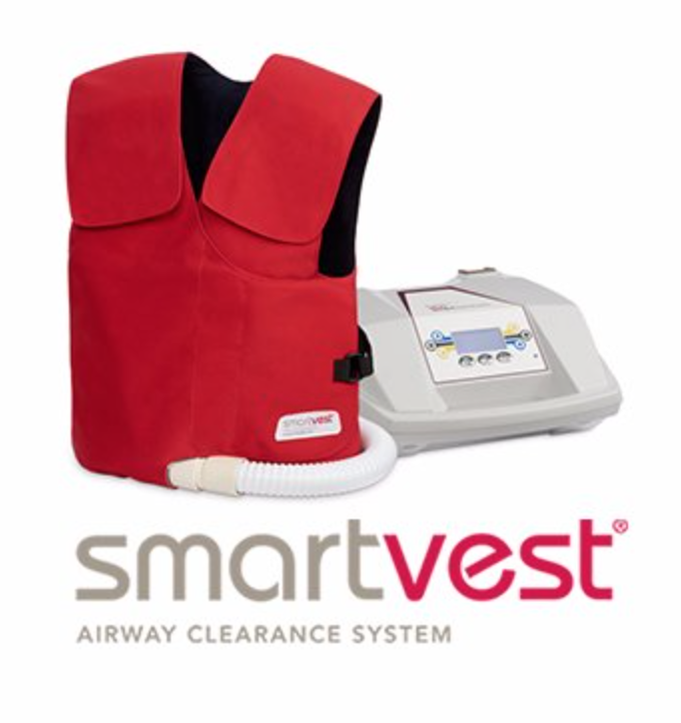
AIRWAY CLEARANCE
Options
  Traditional CPT/postural drainage
  Oscillatory positive expiratory pressure (PEP) (i.e. Aerobika, Acapella)
  High frequency chest wall oscillation (The VEST)
  Autogenic drainage
  Active cycle breathing with huff coughs

Slide 31
Non-antibiotic treatment: Summary
Aggressive airway clearance
Careful treatment of obstructive lung disease
Control of reflux/aspiration
Exercise
Nutritional supplementation
Adjuvant surgical intervention in very specific cases
Exposure avoidance: hot tubs, shower precautions?, avoid aerosol water exposure, gardening/soil precautions, point-of-use filters

Slide 32
Common Clinical Challenges
Who to treat?
How long to treat?
Which regimen is ideal?
  Drug intolerance
  Drug side effects
  Drug-drug interactions
How do patients afford their lengthy/complicated medication regimen?
Are susceptibility data reliable?

Slide 33
Current NTM Research at LSU
NTM Database and Biospecimen bank
  Objective: Create a longitudinal data resource to fuel future research projects that will help inform our understanding of NTM disease
  What is it? – A comprehensive database composed of information from patients with active NTM or a history of NTM
        Clinical Database
        Biospecimen Bank Includes: Sputum cultures & Blood Samples
  Future questions to be answered:
  (1) Patient populations at risk of NTM disease
  (2) Appropriate NTM surveillance techniques
  (3) Distinguish most common NTM affecting our patient population
  (4) Sensitivity and resistance profiles of common NTM strains
  (5) Assist in development of updated management guidelines

Slide 34
In Summary…
Pulmonary disease due to NTM is increasing in prevalence worldwide, particularly among the elderly
NTM is ubiquitous in the environment with important geographic predilections or “hot spots”
For NTM disease to progress it requires a complex interplay between host susceptibility, inoculum size/frequency and mycobacterial evasion techniques
Diagnosis of NTM disease is complex and requires communication and coordination between pulmonologists/ID specialists, radiologists and microbiologists
NTM causes various forms of pulmonary disease (i.e. nodular, bronchiectatic, cavitary) requiring different management approaches
Treatment options remains limited and are encumbered by long, ill-tolerated multi-drug regimens. Engagement of patients/caregivers/ Goals of Rx / Limitations/ Outcomes well understood
THUS : NEED FOR COORDINATED EFFORTS/ REGISTRIES / STUDIES/PARTNERSHIPS

Slide 35


