Slide 1



GS-HPC OVERVIEW
Emily Blejwas Danny Patterson

Slide 2
GULF STATES HEALTH POLICY CENTER
The Gulf States Health Policy Center is a comprehensive community, education, and research center focused on improving health outcomes in the Gulf States region (Alabama, Mississippi, Louisiana, Florida, and Texas). The Center’s work involves coalition building, health education, and interdisciplinary, community-based research. It is committed to identifying health policies that will ultimately improve the health rankings of the region.

Slide 3
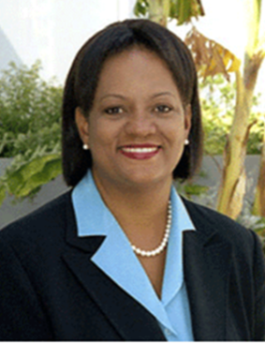
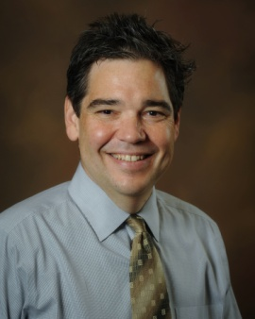

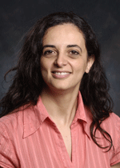

GULF STATES HEALTH POLICY CENTER
PRINCIPAL INVESTIGATORS
Regina Benjamin, MD, MBA
David Butler, PhD
Maria Pisu, PhD

Slide 4
GULF STATES HEALTH POLICY CENTER
NATIONAL STEERING COMMITTEE
David Satcher, MD, PhD Satcher Health Leadership Institute
Gail Christopher, PhD W.K. Kellogg Foundation
Irene Dankwa-Mullan, MD, MPH National Institute on Minority Health and Health Disparities
Bisakha Sen, PhD University of Alabama at Birmingham
Regina Benjamin, MD, MBA Gulf States Health Policy Center
David Butler, PhD Gulf States Health Policy Center
Maria Pisu, PhD Gulf States Health Policy Center
Notes:
Principal Investigator
National Institute of Health

Slide 5
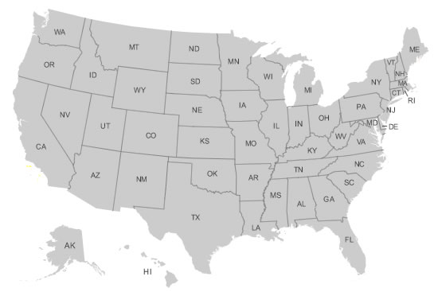
GULF STATES HEALTH POLICY CENTER
A TRANSDISCIPLINARY COLLABORATIVE CENTER
One of seven Transdisciplinary Collaborative Centers for Health Disparities Research (TCCs), funded by NIMHD
The only TCC based in a community organization
  Mid-South Transdisciplinary Collaborative Center for Health Disparities Research
  TCC for Health Disparities: Informing & Influencing Health Policy and Practice
  The Health Policy Research Consortium (HPRC) Program
  National Transdisciplinary Collaborative Center for African American Men's Health
  Gulf States Health Policy Center
  Collaborative Research Center for American Indian Health
  The Hampton University Regional Transdisciplinary Collaborative Center

Slide 6
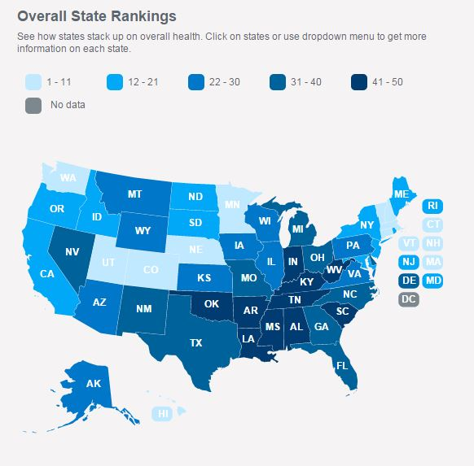
2015 RANKINGS
1 | Hawaii
2 | Vermont
3 | Massachusetts
4 | Minnesota
5 | New Hampshire
6 | Connecticut
7 | Utah
8 | Colorado
9 | Washington
10 | Nebraska
11 | New Jersey
12 | North Dakota
13 | New York
14 | Rhode Island
15 | Maine
16 | California
17 | Idaho
18 | Maryland
19 | South Dakota
20 | Oregon
21 | Virginia
22 | Iowa
23 | Montana
24 | Wisconsin
25 | Wyoming
26 | Kansas
27 | Alaska
28 | Illinois
29 | Pennsylvania
30 | Arizona
31 | North Carolina
32 | Delaware
33 | Florida
34 | Texas
35 | Michigan
36 | Missouri
37 | New Mexico
38 | Nevada
39 | Ohio
40 | Georgia
41 | Indiana
42 | South Carolina
43 | Tennessee
44 | Kentucky
45 | Oklahoma
46 | Alabama
47 | West Virginia
48 | Arkansas
49 | Mississippi
50 | Louisiana
www.americashealthrankings.org

Slide 7
Health Rankings By State, 2015
 | Overall | Smoking | Diabetes | Obesity
Alabama | 46 | 40 | 47 | 46
Mississippi | 49 | 45 | 48 | 48
Louisiana | 50 | 46 | 39 | 47
Texas | 34 | 5 | 34 | 40
Florida | 33 | 24 | 37 | 7
www.americashealthrankings.org

Slide 8
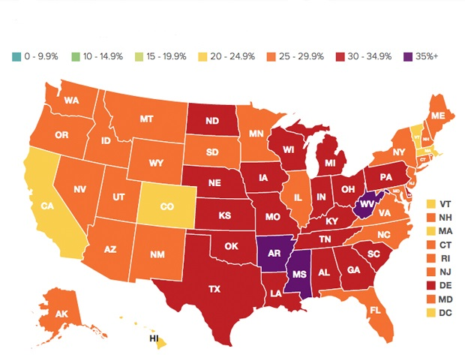
Adult Obesity Rates by State, 2015
Percent of Obese Adults (Body Mass Index of 30+)
www.americashealthrankings.org

Slide 9
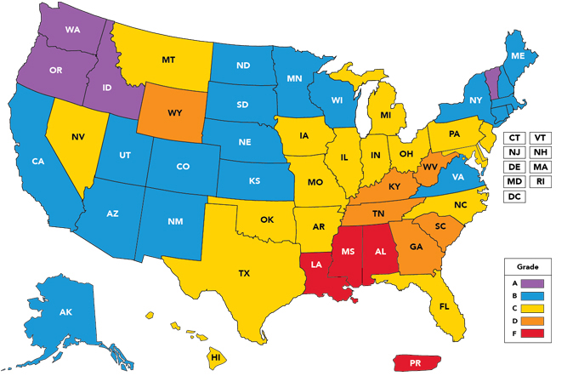

Premature Birth Report Card, 2015

Slide 10
Impact of Socio-Economic Determinants of Health
Many factors affect an individual’s or a community’s health and wellbeing
Side walks, green space, bike lanes, walking trails…
Housing, food, education, jobs, economics, transportation, public safety, technology infrastructure

Slide 11
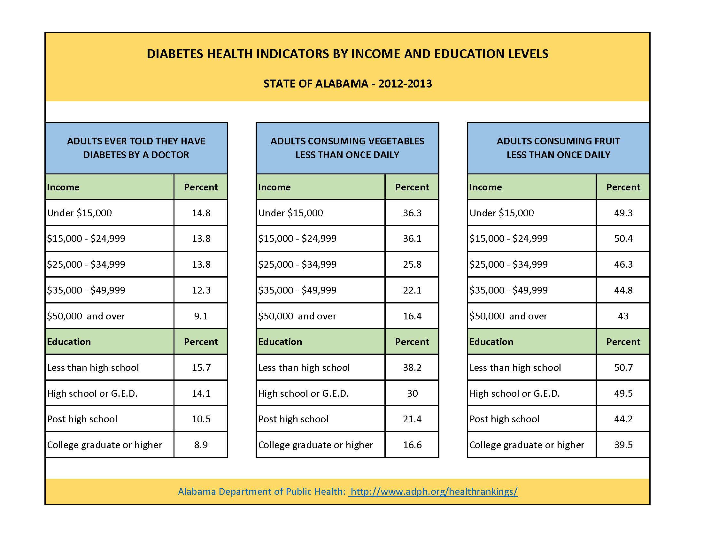
Notes:
Change this with either updated data or no data!

Slide 12
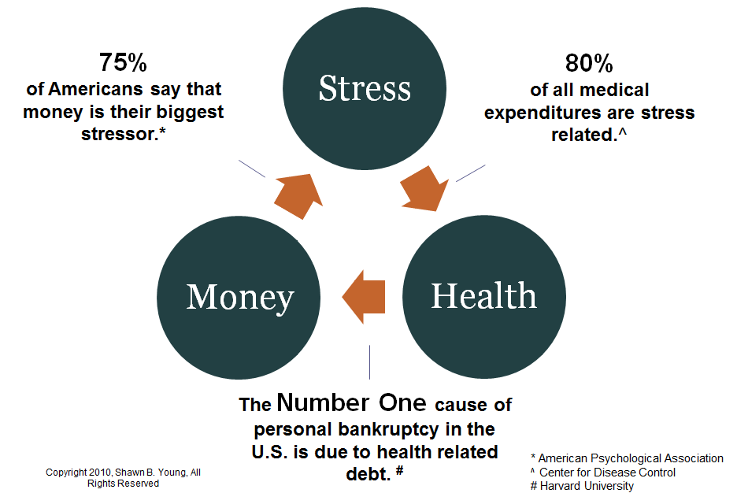

Economic influence on health
Stresses can lead to negative side effects such as depression, anxiety, migraines, high blood pressure, stomach ulcers and heart disease. It stimulates unhealthy behaviors like drinking, smoking and overeating.
Notes:
Change this with either updated data or no data!

Slide 13
GULF STATES HEALTH POLICY CENTER
WHAT WE DO
  Serve as an infrastructure to support health policy and health systems research
  Foster diverse partnerships by building trust, sharing power and resources, and working toward health equity
  Support local and regional initiatives to improve health outcomes in the Gulf States

Slide 14
GULF STATES HEALTH POLICY CENTER
HOW WE WORK
Research Grants (Subprojects)
Collaborations and Partnerships
Community/Academic Grants (Pilot Projects)
Notes:
Two Research Grants are underway: UAB – Obesity and USM – Disaster Resilience
Collaborations and partnerships for the region: Broken up geographicly for logistical reasons: Birmingham / Jefferson County area and over in Mississippi in the Hattiesburg Area, here BLB main site (montgomery, FL, LA, TX)
Community / Academic grants

Slide 15
GULF STATES HEALTH POLICY CENTER
Research Grants (Subprojects)
  Obesity Prevention: Policy, System, and Environmental Changes: A Comprehensive Approach to Reducing Obesity (Dr. David Butler, USM)
  Disaster Impact: Research Core Progress Report: Health Disparities in the Deep South: A Public Health Policy Study of the Effects of Disaster (Dr. Mona Fouad, UAB)
Notes:
Two Research Grants are underway: UAB – Obesity and USM – Disaster Resilience
Collaborations and partnerships for the region: Broken up geographicly for logistical reasons: Birmingham / Jefferson County area and over in Mississippi in the Hattiesburg Area, here BLB main site (montgomery, FL, LA, TX)
Community / Academic grants

Slide 16
GULF STATES HEALTH POLICY CENTER
Community/Academic Grants (Pilot Projects)
CBPR of Policies and Practices Affecting Adolescent Sexual Health in Mississippi, Southeast Mississippi Rural Health Initiative and University of Southern Mississippi
Opt-Out HIV Testing Guidelines and Barriers of Implementation in Alabama, Whatley Health Services and University of Alabama at Birmingham
Compliance Barriers and Initial Outcomes of the Medicaid First Dental Home Policy in Dallas County, Community Council of Greater Dallas and Texas A & M University
Physical Activity and Screen-Time Regulations in Child Care Centers: Influence on Young Children's Health Behaviors, Mayor of Baton Rouge – Health City Initiative and Louisiana State University
Policies on Intergenerational Relationships in Livable Communities and Their Impact on Health Outcomes, Via Health, Fitness, and Enrichment Center and University of South Alabama
Making Environmental Policy Work for Communities: A Culturally Competent CBPR Approach to Advancing the Health of Gulf Coast Vietnamese-Americans, Mississippi Coalition for Vietnamese-American Fisher Folks and Families and Tulane University
Notes:
Two Research Grants are underway: UAB – Obesity and USM – Disaster Resilience
Collaborations and partnerships for the region: Broken up geographicly for logistical reasons: Birmingham / Jefferson County area and over in Mississippi in the Hattiesburg Area, here BLB main site (montgomery, FL, LA, TX)
Community / Academic grants

Slide 17
GULF STATES HEALTH POLICY CENTER
Collaborations and Partnerships
  Health Policy Coalition meets monthly in three locations to identify significant local health issues and policy opportunities
  Each coalition branch identified policy focus areas and is in the process of crafting a community action plan
  Support local and regional initiatives to improve health outcomes in the Gulf States
Notes:
Two Research Grants are underway: UAB – Obesity and USM – Disaster Resilience
Collaborations and partnerships for the region: Broken up geographicly for logistical reasons: Birmingham / Jefferson County area and over in Mississippi in the Hattiesburg Area, here BLB main site (montgomery, FL, LA, TX)
Community / Academic grants

Slide 18
GULF STATES HEALTH POLICY CENTER
Bayou La Batre Coalition
  The Bayou La Batre Coalition determined three Policy Focus Areas:
    Health Literacy
    Financial Literacy
    Education
    Before crafting a Community Action Plan, coalition members tested these areas with community members through community forums.
Notes:
Two Research Grants are underway: UAB – Obesity and USM – Disaster Resilience
Collaborations and partnerships for the region: Broken up geographicly for logistical reasons: Birmingham / Jefferson County area and over in Mississippi in the Hattiesburg Area, here BLB main site (montgomery, FL, LA, TX)
Community / Academic grants

Slide 19
GULF STATES HEALTH POLICY CENTER
Community Forums
Held in November – December 2015
Facilitated by the David Mathews Center for Civic Life
Explored three policy focus areas in three Mobile County locations:
  Health literacy (Bayou La Batre)
  Financial literacy (Prichard)
  Education (Mobile)
Notes:
Two Research Grants are underway: UAB – Obesity and USM – Disaster Resilience
Collaborations and partnerships for the region: Broken up geographicly for logistical reasons: Birmingham / Jefferson County area and over in Mississippi in the Hattiesburg Area, here BLB main site (montgomery, FL, LA, TX)
Community / Academic grants

Slide 20
Questions?

Slide 21
Thank you!

