Slide 1
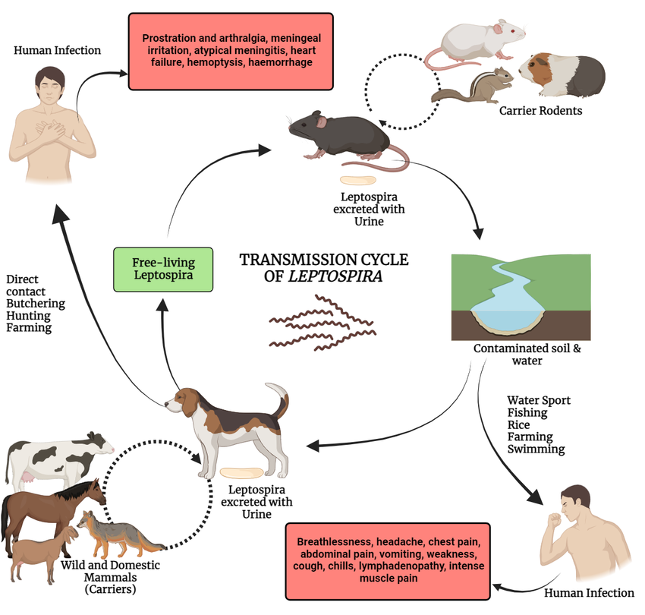
Leptospirosis: An Uncommon Cause of Fever and Transaminitis in the Continental United States
Allen Byl DO, MPH¹, Hope Oddo MD¹, Danielle Gilbert DO, MPH¹, Michael Olejniczak MD¹, Ashley Misky DO¹, Tom Fox MD¹, Alexa Lapointe MD¹,
Michael Modica MD¹, Michelle Blyth MD¹ ¹Louisiana State University Health Sciences Center Department of Medicine, New Orleans, LA
Background
Case Presentation
Discussion
Leptospirosis is a zoonotic and waterborne infection with global distribution caused by the spirochete bacterial genus Leptospira.
Leptospira has numerous reservoir host mammals, the most significant of which are small rodents, which can transmit infection, through urine or direct contact, to cattle, swine, dogs, and humans.
Infected animals shed Leptospira from their renal tubules into their urine, which can then spread to other animals and humans through affected soil or water via breaks in the skin or direct exposure to mucous membranes of the mouth, eyes, or nose.
Leptospirosis is more common in resource poor countries in tropical regions, and is associated with poor sanitation and housing, occupational exposure to environmental water (sewage workers, fishermen, farmers, etc.), as well as recreational water exposure (swimming, rafting, kayaking).
While Leptospirosis is more common in endemic tropical regions, cases are increasing in temperate regions such as the United States.
Infection with Leptospira does not always result in clinically significant disease, manifestations are often subclinical but can be fatal.
While most infections are subclinical, up to 10% of human infections result in anicteric disease commonly characterized by rapid onset of fever, headache, and muscle aches.
Conjunctival suffusion is common but not always present.
Leptospira infection can directly affect almost every organ system, especially microvascular structures, the kidneys, liver, and skeletal muscle (most commonly the muscles of the legs).
Severe infection can result in multisystem organ failure. One of the most well-known manifestations of severe (icteric) Leptospirosis, referred to as Weil’s Disease, involves widespread hemorrhage accompanied by acute liver and kidney failure.
Patient History
The patient is a 24- year-old male with no significant past medical history. He had recently returned from a 2-week trip to Columbia, during which time he went white water rafting, drank filtered stream water, and ate locally prepared food, including meat. No one else from the trip experienced a similar illness.
Patient Presentation
He presented to the hospital with fevers, rigors, muscle aches in his back and legs, and headache for 6 days. He had previously presented to the ED, was treated for headache, and discharged.
At time of hospital admission, he was febrile to 101.2 F. He had no rash, lymphadenopathy, or conjunctival injection.
Initial labs revealed thrombocytopenia of 110x10^3 uL, elevated haptoglobin to 239 mg/dL, transaminitis (ALT 196 U/L, AST 131 U/L), total bilirubin 1.8 mg/dL, and EGFR 82.
Testing for acute hepatitis was negative. Chest radiograph, CT head with contrast, and abdominal ultrasound were unrevealing.
Hospital Workup
The patient’s presentation raised concern for leptospirosis, hantavirus, arthropod-transmitted diseases including malaria, dengue fever, chikungunya virus, zika virus
Infectious workup included:
Blood cultures
Malaria antigen with smear
Zika PCR, Zika IgM
Dengue virus IgG and IgM
Hantavirus IgG and IgM
Leptospira IgM
HIV screening
Mononucleosis screening
Conclusion
Diagnosis of Leptospirosis can be delayed due to low clinical suspicion in non-endemic regions and the non-specific nature of symptoms at onset, which can be confused for other diseases.
Early recognition and high clinical suspicion are necessary to establish the diagnosis and initiate prompt treatment to prevent serious sequelae, morbidity, and mortality.
Treatment of Anicteric Leptospirosis consists of oral doxycycline or azithromycin. More severe, Icteric Leptospirosis (Weil’s Disease) is treated with IV antibiotics: penicillin G (preferred), doxycycline, or ceftriaxone.
This case highlights the importance of a broad differential diagnosis in travelers with non-specific symptoms, as Leptospirosis can easily be mistaken for other entities.
The patient was started on empiric therapy for Leptospirosis with doxycycline PO for seven days. He clinically improved and was discharged.
Leptospirosis IgM subsequently returned as positive.
Figure 1: Transmission cycle of Leptospira
References
Guerra MA. Leptospirosis. J Am Vet Med Assoc. 2009 Feb 15;234(4):472-8, 430. doi: 10.2460/javma.234.4.472. PMID: 19222355.
Karpagam, K. B., & Ganesh, B. (2020). Leptospirosis: a neglected tropical zoonotic infection of public health importance—an updated review. European Journal of Clinical Microbiology & Infectious Diseases, 39(5), 835-846.
Adler, B., & de la Peña Moctezuma, A. (2010). Leptospira and leptospirosis. Veterinary microbiology, 140(3-4), 287-296.
Levett PN. Leptospirosis. Clin Microbiol Rev. 2001 Apr;14(2):296-326. doi: 10.1128/CMR.14.2.296-326.2001. PMID: 11292640; PMCID: PMC88975.
Figure 2: Leptospira electron micrograph showing “question mark” hook.

