Slide 1




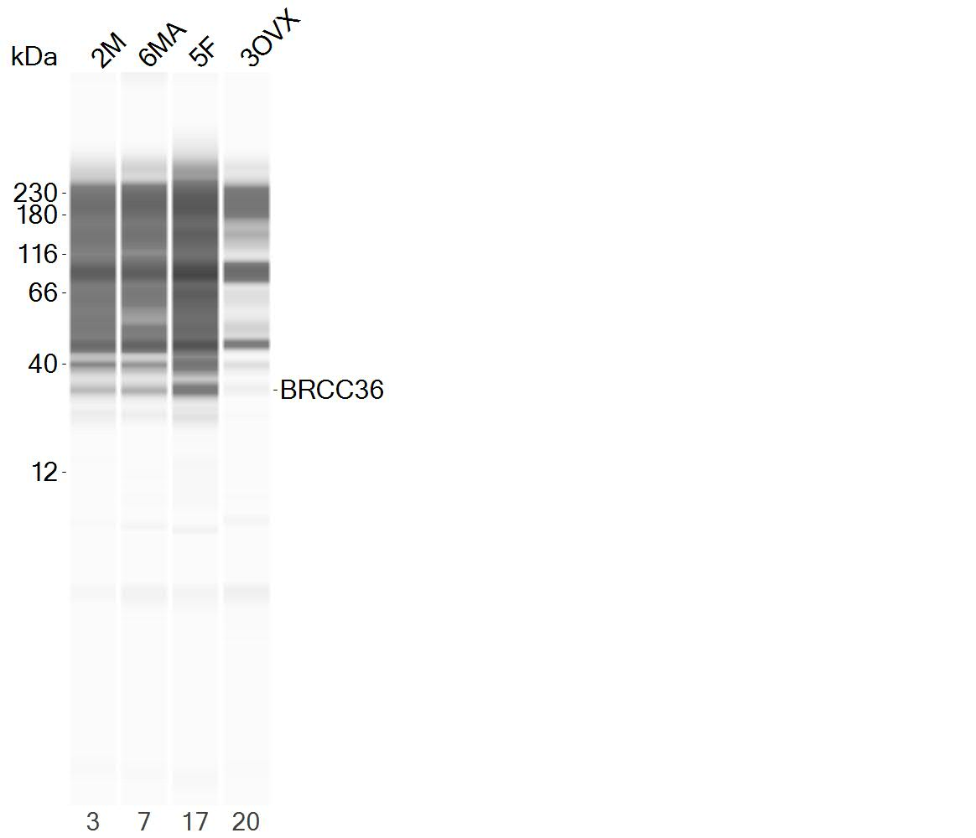
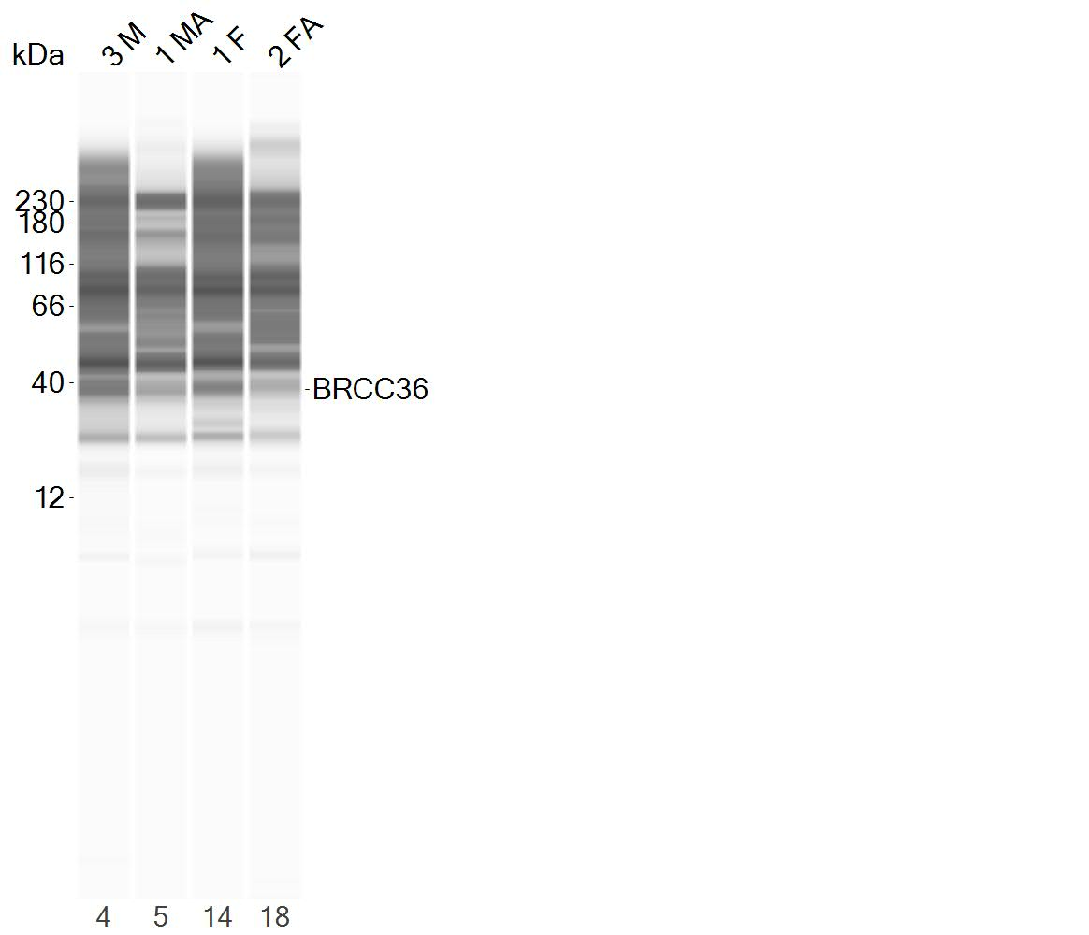



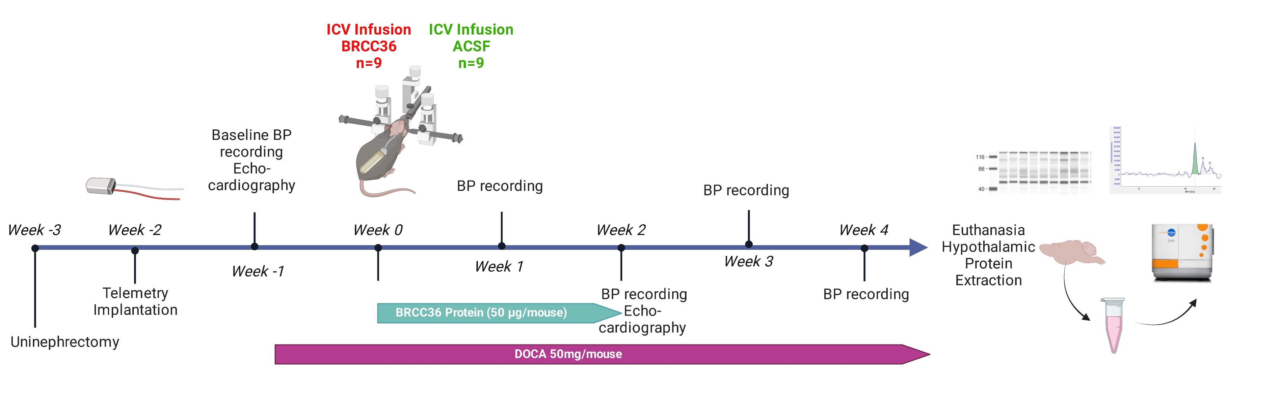
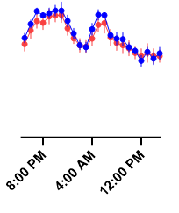
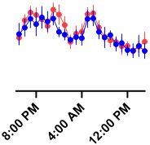
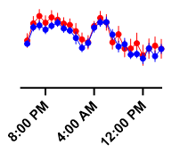
BRCC36 Contributes to ACE2 Deubiquitination in Salt-Sensitive Hypertensive Female Mice
Hasan Mir¹, Mona Elgazzaz^{1,2,3,4}, Kevin Miao¹, Alexa Martinez¹ and Eric Lazartigues^{1,2,3}
¹Cardiovascular Center of Excellence, ²Department of Pharmacology & Experimental therapeutics, Louisiana State University Health Sciences Center, New Orleans, LA 70112; ³Southeast Louisiana Veterans Health Care System, New Orleans, LA 70119, USA; ⁴Genetics Unit, Department of Histology and Cell Biology, Faculty of Medicine, Suez Canal University, Ismailia, Egypt.
Email: hmir1@lsuhsc.edu
Introduction
Overexpression of BRCC36 preserves ACE2 expression and activity under Ang-II stress
.
The brain renin-angiotensin system (RAS) plays a pivotal role in the pathogenesis of hypertension. Angiotensin-II (Ang-II) binds to the Ang-II type 1 receptor (AT1R) and mediates the vasoconstrictive and pro-hypertensive effects. On the other hand, angiotensin-converting enzyme 2 (ACE2) mitigates the pro-hypertensive effects of Ang-II by cleaving it into Ang-(1-7), a vasodilator. We have previously reported that Ang-II mediates the internalization and degradation of ACE2. In hypertensive males, we identified NEDD4-2 and UBR1 as E3 ubiquitin ligases targeting ACE2. Based on discovery proteomics mass spectrometry for hypothalamic tissue extracted from normal and hypertensive mice, BRCC36, a Lys-63-specific deubiquitinase, was observed to be downregulated in hypertensive female mice. In this study, we aim to investigate the role of BRCC36 in hypertensive female mice and its correlation with ACE2 levels.
Hypothesis
BRCC36 plays a role in deubiquitination of ACE2
BRCC36 downregulation is associated with ACE2 downregulation exclusively in hypertensive females
BRCC36 ~ 35 kDa
Figure 2: BRCC36 preserves ACE2 expression and activity. HEK293T cells were transfected with hACE2-GFP, AT₁R-HA and BRCC36-HA plasmids for 6 hours before exposure to Ang-II (100 ng) for 4 hours. (A) Representative immunoassays for ACE2 and β-Tubulin. (B) Ang-II treatment induced a significant reduction (~60%) of ACE2 levels that was prevented by prior transfection with BRCC36. (C) ACE2 activity was significantly decreased by Ang-II treatment and this effect was prevented by transfection with BRCC36 (D) ACE2 (green) localizes at the plasma membrane while BRCC36 (red) is present in the cytoplasm. They colocalize following Ang-II-mediated internalization of ACE2 in the cytoplasm. Nuclei are identified by DAPI staining (blue). Data are shown as mean±SEM (n=3, in triplicate). Statistical significance: One-way analysis of variance (ANOVA) followed by Bonferroni test for multiple comparisons, *P<0.05, ***P<0.001 vs. solid red; #P<0.05 ##P<0.01 vs. hatched green.
ACE2 ~ 130 kDa
GAPDH ~ 50 kDa
A
B
ICV Infusion of BRCC36 did not reduce BP in hypertensive female mice
A
B
Baseline
Week 1
Week 3
C
D
Figure 3: ICV Experiment timeline: (A) C57BL/6J female mice (10 weeks old, n=20) were subjected to uni-nephrectomy surgery to increase their salt sensitivity. Using radiotelemetry probes, the baseline BP was recorded followed by subcutaneous implantation with Deoxycorticosterone Acetate (DOCA) pellets (50 mg/mouse) together with 0.9% saline water for drinking ad libitum. Mice were then divided into two groups for intracerebroventricular infusion of either BRCC36 or artificial cerebrospinal fluid (ACSF) (50 µg/mouse, n=9/group) using a subcutaneous mini-osmotic pump connected through a catheter to an ICV cannula. After 4 weeks of BP recordings, the mice were euthanized, and protein was extracted from the hypothalamus for capillary western analysis to measure ACE2 and BRCC36 protein expression among the two groups. (B) Throughout 4 weeks of DOCA pellet implantation and ICV infusions, BP was recorded in both the ACSF and BRCC36 groups.
Conclusions
Figure 1: BRCC36 and ACE2 expression are differentially regulated by sex hormones in Ang-II-mediated hypertension. After 4 weeks of Ang-II infusion, BRCC36 and ACE2 expression was assessed in hypothalamus (n= 3-5/group) (A, C) and heart (n=3/group) (B, D). Data are shown as mean±SEM. Statistical significance: Two-way analysis of variance (ANOVA): ***P<0.001, *P<0.05, **P<0.01
ACE2 downregulation in females is associated with BRCC36 downregulation
BRCC36 ICV infusion did not affect BP in hypertensive female mice
Future directions: perform titration studies to detect the best dose for BRCC36 injections in cells and mice
Support
NIH/NHLBI (HL150592), VA Merit Award (BX004294)

